Slide 1
Collaborating Through IOER
Intro to IOER: Module 3
Ioer.ilsharedlearning.org
#IOER

Slide 2
Objectives
At the end of this module, learners will be able to:
Assign tags to a resource
Add new content to IOER (Tag Resources)
Create Indexed lists and sets of OER materials, around classroom topics and/or a specific purpose

Slide 3
What are Tags?

Slide 4
Tags
Keywords, labels and other information associated with a resource, learning list or learning set.

Slide 5
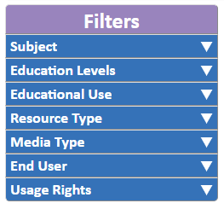
Tags = Filters
Search filters are based on resource tags
Filter Categories

Slide 6
Tag Categories
Title (open)
Description (open)
Keywords (open)
Usage Rights
Education Levels
Resource Type
Media Type
Subject
Learning Standards
Creator
Publisher
Technical/Equipment Requirements
Access Rights
Language
Educational Use
End User
Group Type
Assessment Type
Accessibility Control
Accessibility Feature
Accessibility Hazard

Slide 7
Small Group Activity – Determine the Tags
Each group will review the given resource.
You have 5 minutes to discuss the resource and determine the appropriate tags and standard alignment for that resource.
You will share out and compare your list of tags with the other groups.
Discussion: Why are tags different?

Slide 8
Adding Content to IOER
Tagging Resources

Slide 9
Contribute Resources

Slide 10
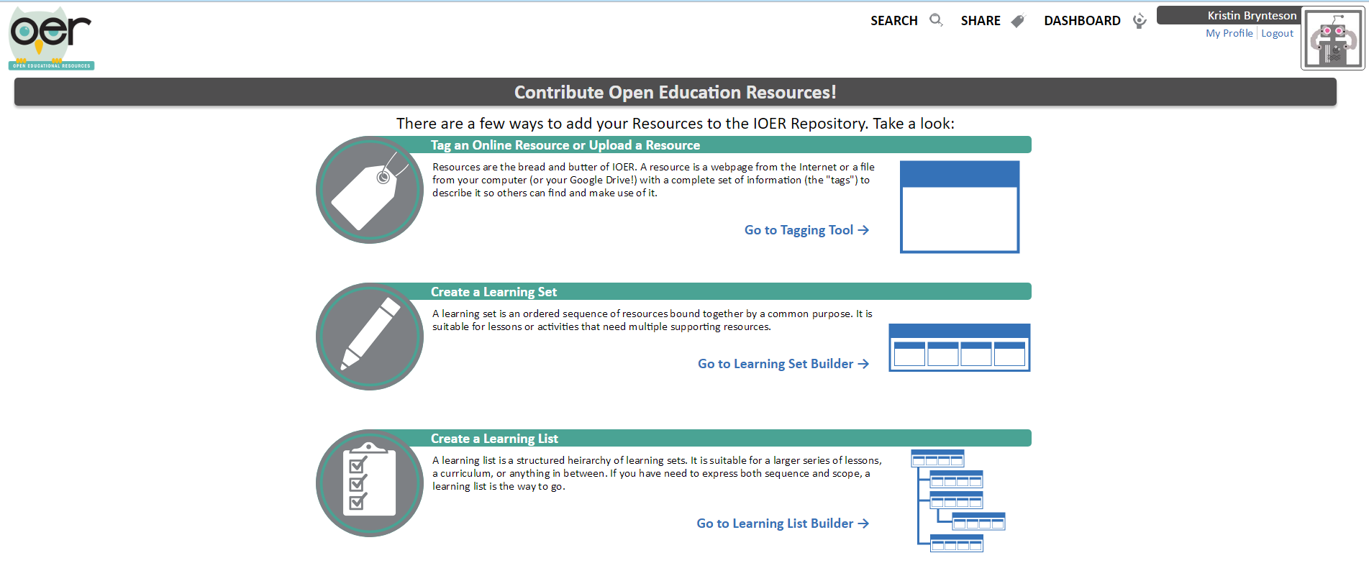

Slide 11
Three Sources
Web-based - url
Local file – upload
Google Drive – file copy/upload

Slide 12
Tag Categories
Title (open)
Description (open)
Keywords (open)
Usage Rights
Education Levels
Resource Type
Media Type
Subject
Learning Standards
Creator
Publisher
Technical/Equipment Requirements
Access Rights
Language
Educational Use
End User
Group Type
Assessment Type
Accessibility Control
Accessibility Feature
Accessibility Hazard

Slide 13
Publishing Options
Organization – Tagging on your behalf or as an organization
IOER Access Limitations
Anyone (including students)
Anyone in my Organization
Anyone in my Organization Region (School District)
Only Illinois Teachers
Add to the Library
IOER Tagging Community Working Library

Slide 14
Small Group Activity – Tagging Resources
Locate and discuss web-based resources.
As a group, tag two new resources into IOER and align them to standards.

Slide 15
Learning Lists and Sets
Grouping Resources in Meaningful Ways

Slide 16
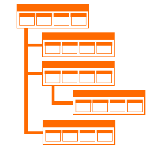
Learning Set
An ordered sequence of resources bound together by a common learning purpose or theme.
Learning List
A structured hierarchy of Learning Sets.

Slide 17
Contribute Resources

Slide 19
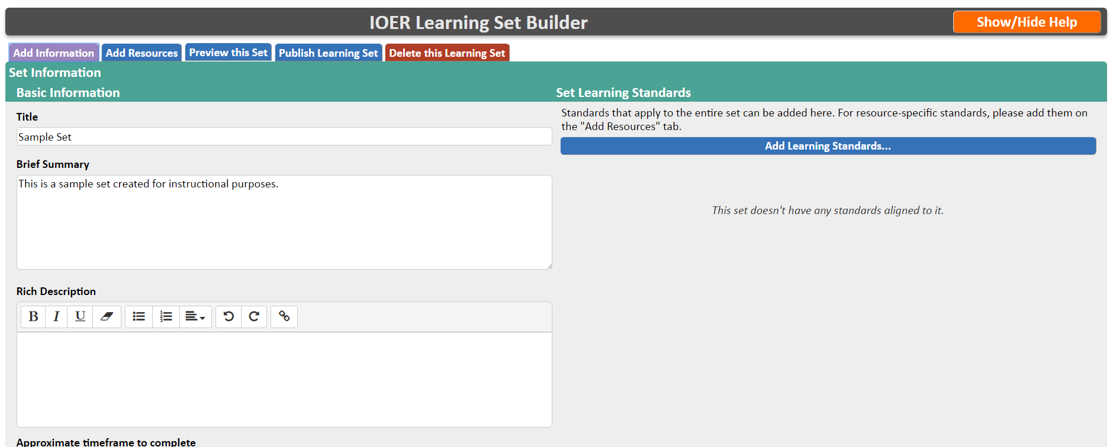
Set Builder

Slide 20
List Builder

Slide 21
Resources I Created

Slide 22
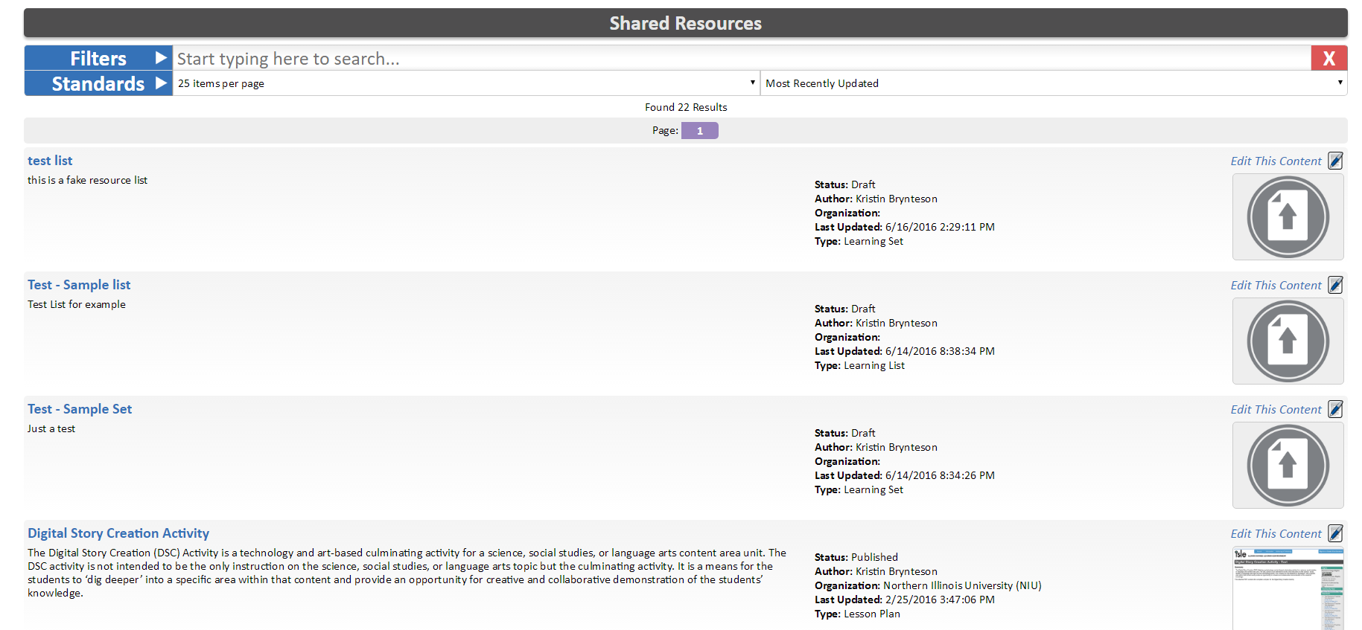

Slide 23
Small Group Activity – Create a Learning Set
Locate three related online resources.
As a group, tag the three resources as a set.
NOTE: Do not publish the set.

Slide 24
Small Group Activity – Create a Learning List
As a group, tag the same three resources as a list.
NOTE: Do Not publish the list.

Slide 25
IOER Website and Technical Questions
Email: info@ilsharedlearning.org
Professional Development and Training Questions
Kristin Brynteson kbrynteson@niu.edu
ioer.ilsharedlearning.org
#IOER
Sponsored by: Illinois Department of Commerce and Economic Opportunity and Illinois State Board of Education

