Slide 1
Finding, Saving and Evaluating OER using IOER
Intro to IOER: Module 2
ioer.ilsharedlearning.org
#IOER

Slide 2
Objectives
At the end of this module, learners will be able to:
Search within the system to locate specific OER
Organize resources using libraries
Evaluate resources using the IOER tools

Slide 3
Searching
Searching for Resources, Libraries and Learning Lists/Sets

Slide 4
Search IOER
Resources
Personal and Organizational Libraries
Learning Lists/Sets
Notes:
Using the search features in IOER one can search for teaching and learning resources, user and organizational libraries, and Learning lists/sets.

Slide 5
Resource Search
Search by
Keyword
Filters
Standards
Note: You do not need to be a registered user to search.

Slide 6
Learning List or Set Search
Search by
Keyword
Filters
Standards
Note: Do not need to be registered user to search.

Slide 7
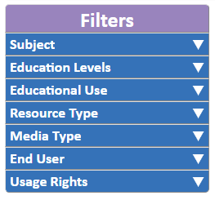
Filters
Search filters are based on resource tags
Filter Categories

Slide 8
Search Results

Slide 9
Resource Information
Comments
Like/Dislike
Evaluation Score
Number of Libraries
Number of Clicks

Slide 10
Open a Resource Detail Page
Notes:
Select the title of a resource to open the detail page.

Slide 11
Resource Detail Page
Notes:
The detail page provides more information about the resource.

Slide 12
Resource Detail Page
Resource Information
Suggested resources similar to selected resource
Notes:
The left hand side of the detail page provides more information about the resource. Including all of the tags associated with the resources. At the bottom of the page you will see “10 More Like This”. Here you will find suggested resources that are similar to the one you are looking at.

Slide 13
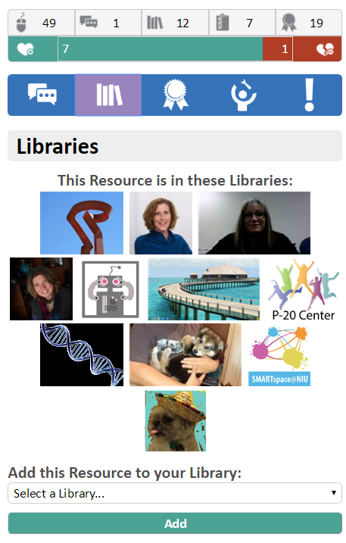
Resource Detail Page
User feedback
Library information
Notes:
The right hand of the details page provides user feedback on the resource. Navigate through the information by using the tabs. Only registered users can provide feedback.
Comment – Add a comment about this resource
Library – Add this resource to your personal or organizational library
Evaluation – Use the embedded rubrics to evaluate the resource
Tools – Add tags to this resources
Report – Report a problem with this resource

Slide 14
Library Search
Search for
Most recently updated
Individual or Organizational libraries
All public or just libraries where you are a member
Note: You do not need to be a registered user to search.

Slide 15
Small Group Activity – Searching
Each group will search for a different topic.
Search and find three resources about your topic.
Use at least 2 filters to facilitate the search.
Highlight three interesting facts about each resource. (i.e. How many libraries is it saved in? Is it aligned to standards? What are the usage rights? Does it have an evaluation score? )
Locate one resource through the “More like this feature.”

Slide 16
Organizing
Creating and Using Libraries and Collections

Slide 17
Library
Collection of resources managed by an organization or individual registered IOER user
User created collections to organize content
Searchable
User controlled privacy and collaboration settings

Slide 18
Accessing your Library
Dashboard Tab at the top of any screen
My Dashboard or My Library and Collections

Slide 19
My Dashboard
Update your profile
Manage your Stuff
See recent additions to your library
View all libraries where you are a member
Access recently tagged resources
View libraries you are following
Manage your library memberships
Notes:
The dashboard provides you with access to all of your IOER. Using the menu on the left you can open your library, view the resources you created, search the libraries you follow and manage your library membership.
On the right hand of the screen you see thumbnails of recent resources and direct links to different libraries.

Slide 20
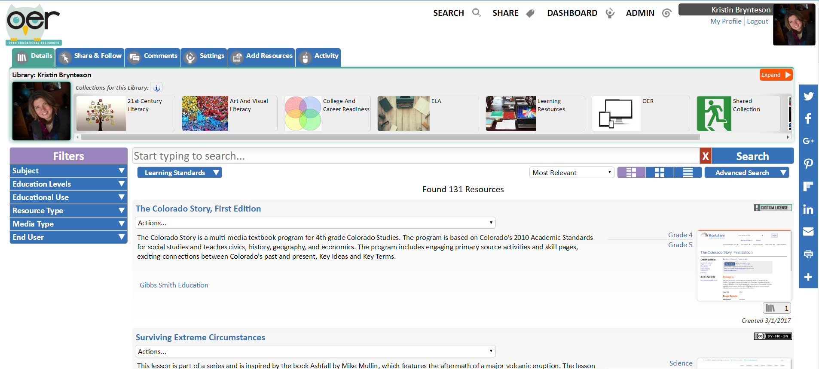
Library
Notes:
Your library is where you organize resources within IOER. Your library allows you to save links to resources so you do not have to search for them every time you come to IOER. You can create collections in your library to help you organize your links further. Both the overall library and each collections is searchable using the filter menu.

Slide 21
Manage your Library Tabs
Details – Like or Dislike a Library
Share & Follow – Access library URL or embed code
Comments – Add comments to your library
Settings – Control access to your library
Add Resources – add resources to your library from a search or by tagging
Activity – Usage stats on your library and collections
Notes:
Use the tabs at the top of your library to manage

Slide 22
Activity
Open your Library
Write a description, upload a new image, and set access for your library.
Edit the title, description, image and access of your default collection.
Create a new collection.

Slide 23
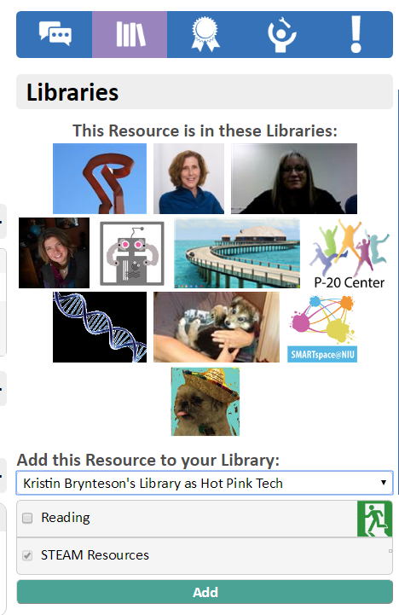
Add Resources to Your Library
Select your Library
Select your Collection

Slide 24
Activity
Search for resources that you need in your classroom.
Locate and save at least 3 resources.
Move or copy a resource from one collection to another.
Create a new collection and adjust settings to allow for contributions from others.

Slide 25
Share and Follow Libraries
Select your Library
Select you Collection

Slide 26
Activity
Use the library search to locate personal and organizational libraries.
Sign up to follow at least one library or collection.

Slide 27
Evaluating
Providing Feedback through IOER Tools

Slide 28
Feedback on Resources
Multiple feedback channels
Standards Alignment
Like or Dislike
Comments
Evaluate using OER Rubrics
Feedback accepted from multiple users
Only registered users can provide feedback

Slide 29
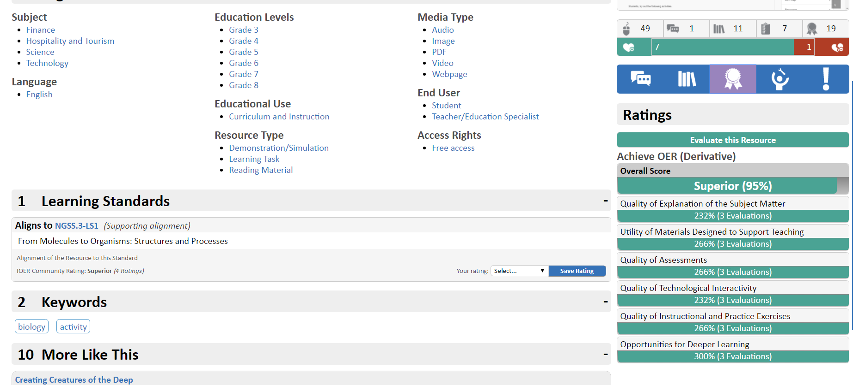
Feedback Channels

Slide 30
Alignment to Standards

Slide 31
Like/Dislike and Comments

Slide 32
Rubrics
Derivative of rubrics created by Achieve
General OER quality
CCSS specific
ELA
Mathematics
NGSS – in process, not yet implemented

Slide 33
OER Quality
OER Rubric from Achieve http://www.achieve.org/oer-rubrics
Evaluate objects found in OER (e.g. images, applets, lessons, units, assessments)
Rubric I. Degree of Alignment to Standards
Rubric II. Quality of Explanation of the Subject Matter
Rubric III. Utility of Materials Designed to Support Teaching
Rubric IV. Quality of Assessment
Rubric V. Quality of Technological Interactivity
Rubric VI. Quality of Instructional and Practice Exercises
Rubric VII. Opportunities for Deeper Learning
Rubric VIII. Assurance of Accessibility

Slide 34
EQuIP Rubric from Achieve
Information from Achieve…When to use EQuIP
“Lessons that include instructional activities and assessments aligned to the CCSS that may extend over a few class periods or days
Units that include integrated and focused lessons aligned to the CCSS that extend over a longer period of time
The rubric is NOT designed to evaluate a single task or activity
The rubrics do not require a specific template for lesson or unit design”
Three Rubrics
Mathematics
ELA/Literacy
ELA/Literacy (K-2)
http://www.achieve.org/our-initiatives/equip/rubrics-and-feedback-forms

Slide 35
Learn More!
Visit Classrooms in Action for more resources and information on evaluating resources.
http://www.ilclassroomsinaction.org/curriculum-alignment.html

Slide 36
Activity
In groups - open the activity Creatures of the Deep http://ioer.ilsharedlearning.org/Resource/585503/creating_creatures_of_deep.
In small groups review and discuss the activity.
Rate the alignment to the tagged standards.
Discuss and evaluate the resource using the Achieve OER (derivative) rubric. Use the scoring guide to discuss each criteria and determine the strength of each element.

Slide 37
Activity
In groups, search for one instructional resource (i.e. lesson plan or unit plan)
Discuss and rate the alignment to the tagged standards.
Discuss and evaluate the resource using the Achieve OER (derivative) rubric. Use the scoring guide to discuss each criteria and determine the strength of each element.

Slide 38
IOER Website and Technical Questions
Email: info@ilsharedlearning.org
Professional Development and Training Questions
Kristin Brynteson kbrynteson@niu.edu
ioer.ilsharedlearning.org
#IOER
Sponsored by: Illinois Department of Commerce and Economic Opportunity and Illinois State Board of Education

