Slide 1
Build fractions from unit fractions by applying and extending previous understandings of operations on whole numbers.
B. Decompose a fraction into a sum of fractions with the same denominator in more than one way, recording each decomposition by an equation. Justify decompositions, e.g., by using a visual fraction model. Examples: 3/8=1/8 + 1/8 + 1/8; 3/8= 1/8 + 2/8; 2 1/8= 1 +1 + 1/8 = 8/8 + 8/8 + 1/8.
D. Solve word problems involving addition and subtraction of fractions referring to the same whole and having like denominators, e.g., by using visual fraction models and equations to represent the problem.

Slide 2
Decompose $\frac{7}{3}$ into a sum of fractions with the same denominator.
How many ways can you find to create $\frac{7}{3}$ as a sum of fractions with the same denominator?
Notes:
Have students use an area model to justify their response. Let several students show their reasoning and area models.

Slide 3
MP. 3 Critique the Reasoning
George said, “½ + ½ = 2/4”.
Martha said, “½ + ½ = 2/2”.
Washington said, “½ + ½ = 1”.
Who is correct and why? Use a fraction model to justify your answer.
Notes:
Give plenty of students an opportunity to share their reasoning.

Slide 4
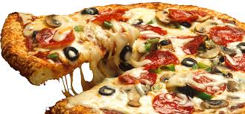
Solve using a fraction model
Khloe’s class had a pizza party. There is 3/8 of a sausage pizza remaining, 1/8 of a cheese pizza remaining, and 5/8 of an anchovies pizza remaining. How much total pizza is remaining?

Slide 5
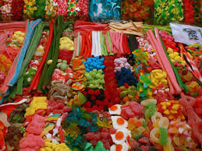
Solve using a fraction model
Sally Jo has $7\frac{4}{5}$ pounds of candy. If she gives 2$\frac{3}{5}$ pounds to her friend Jennie and she gives 1$\frac{1}{5}$ pounds to her sister Betty Anne, how much candy does Sally Jo now have?

Slide 6
Write an equation and solve
Notes:
4/12 + 6/12 +8/12 = 18/12 = 1 6/12 = 1 ½

Slide 7
Write an equation and solve
Notes:
2 ¾ - 1 2/4 – 2/4 = ¾ or 2 ¾ + 1 2/4 + 2/4 = 4 3/4

