Slide 1
Lesson 9.8: Relative Risk
Obj. 9.8: Quantify the relationship between two variables using relative risk.
Module 9: Epidemiology
Notes:
Overview: This lesson will instruct students to calculate relative risk, an advanced level, yet simple and intuitive concept that allows students to understand the relationship between variables on a quantitative level. Students will begin with a familiar example of the flu to familiarize themselves with a 2x2 table. They will then review notes explaining relative risk and walking through the calculation. Finally, they will have a chance to practice it and discuss limitations and possible stumbling blocks to using it in studies.
Image source: http://commons.wikimedia.org/wiki/File:Skydive_Miami.jpg

Slide 2
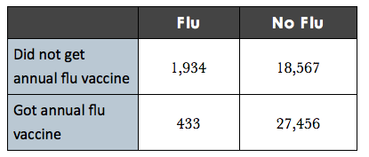
Do Now: Influenza & the Flu Shot
Today you will learn about the 2x2 contingency table, a tool used by epidemiologists to organize data in order to quantify relationships between variables. Use the table below to answer the questions that follow.
Notes:
Ask students, “How else could you organize this data? What is true of 27,456 people in this sample population? What percentage of people did get the flu vaccine vs. did not? (need a calculator for this, or they can estimate)”

Slide 3
Do Now: Influenza & the Flu Shot
1. Describe the data shown in the table.
2. What can you learn from this information?
3. How might you determine the relationship between the two variables in this data?

Slide 4
What is a 2x2 contingency table?
A 2x2 contingency table is used in statistics to organize and display the frequency of variables. A 2x2 table setup is shown below:
2x2 Contingency Table
So how can we use a 2x2 table to quantify the relationship between variables?
Notes:
For more information on this, see: http://practice.sph.umich.edu/micphp/epicentral/relative_risk.php

Slide 5
What is Relative Risk?
Relative Risk (RR): A ratio of the probability of the event (outcome variable) occurring in the exposed
(risk factor) group to the probability of the outcome occurring in a non-exposed (no risk factor) group.

Slide 6
How to Calculate Relative Risk:
Steps to calculating RR:
Step 1: Focus on the risk factor row (1st row) [i.e., not vaccinated]
Step 2: Calculate the incidence rate of the outcome [i.e., flu] for those who have the risk factor
Incidence for RISK FACTOR group: a/(a+b) = X
Step 3: Focus on the NO risk factor row (2nd row) [i.e., vaccinated]
Step 4: Calculate the incidence rate of the outcome for those who are do not have the risk factor
Incidence Calculation for NO RISK FACTOR group: c/(c+d) = Y
Step 5: Use the two calculations to find Relative Risk (RR)
Relative Risk Calculation: X/Y = [a/(a+b)] / [c/(c+d)]

Slide 7
What does the RR value mean?
RR = 1?
There is no association.
The incidence in the risk factor group and no risk factor group were the same.
RR > 1
There is an association. (i.e., RR = 1.5 might indicate a strong association)
The risk factor group is 1.5 times more likely to experience the outcome than the non-risk factor group. (50% more likely)
RR < 1
There is an inverse association (i.e., RR = .8 indicates an inverse relationship--the non-risk factor group was actually more likely to have the outcome. In other words, a relationship opposite of the hypothesized one is occurring.)
The risk factor group is only 0.8 times as likely to experience the outcome than the non-risk factor group. (20% less likely)
Notes:
Explaining the meaning of the resulting relative risk number can be quite confusing for students if they do not recall that relative risk is really just a ratio, comparing incidence in an exposed group vs. incidence in a non-exposed group. This will help them understand that an RR =1 shows that the top and bottom of the fraction are equal, or there is a 1:1 ratio. In other words, the outcome occurs equally often in both groups despite the presence of the factor/exposure.

Slide 8
Think: PRACTICE!
A university is piloting a mandatory health education course for incoming freshmen. In the first year, half of the students take the course and the university decides to compare their health outcomes with those of the students who did not take the course. A small sample agrees to take a follow up survey four years later. One outcome studied is the rate of obesity in the two groups. Use the data below to calculate relative risk for obesity based on taking a health education course.
Notes:
Calculation: [a/(a+b)]/[c/(c+d)] = [35/(35+122)]/[21/(21+137)] =.222/.133 = 1.67 (RR = 1.67 means that those who did NOT take a health education course are 67% more likely to be obese than those who DID take a health education course)

Slide 9
Think: PRACTICE!
1. Calculate the incidence of obesity for the risk factor group (those who did not take a health education course):
2. Calculate the incidence of obesity for the non-risk factor group (those who took the health education course):
3. Calculate the relative risk:
4. Write the relative risk in the form of a statement:

Slide 10
Discuss: Limitations
With a partner, discuss and list below the possible limitations or common errors that may come with the relative risk calculation.
Notes:
A relative risk calculation can only be done for a cohort study or a clinical trial. A case control study could be analyzed using a different measure called the odds ratio. Relative risk can only show that two variables are associated, it cannot prove a causal relationship. Relative risk requires large sample sizes to achieve statistical significance.

Slide 11
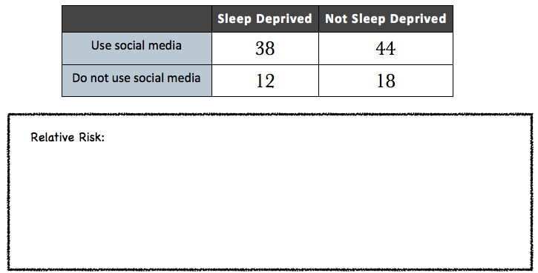
Assess: Calculate RR
Notes:
Calculation: [a/(a+b)]/[c/(c+d)] = [38/(38+44)]/[12/(12+18)] = .46/.4 = 1.15 (RR = 1.15 means that those who use social media are 15% more likely to be sleep deprived than those who do not use social media)

Slide 12
Homework: Be the Teacher!
Explain the meaning of Relative Risk as if you were speaking to a 6th grader. Be sure to write our your explanation and include answers to the questions: How do you calculate it? What does it mean? Why is it useful?
Notes:
The purpose of this assignment is to give students time to process the concepts they learned and simplify them. If students are still having difficulties, this assignment will help them break it down, or serve as a red flag that they need more help and/or practice.

