Slide 1
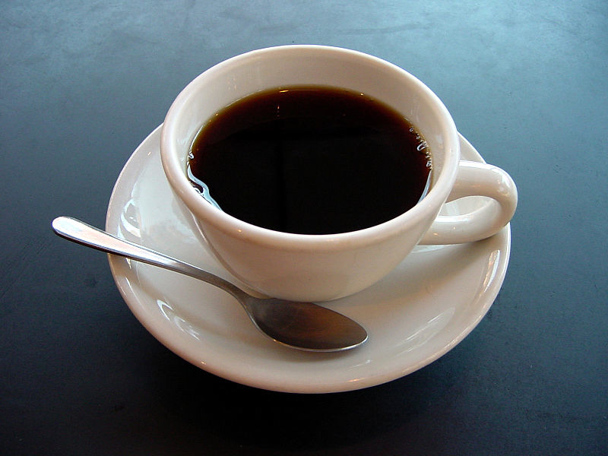
Lesson 9.10: Claim-Evidence-Warrant
Obj. 9.10: Use the Claim-Evidence-Warrant framework to make a conclusion.
Module 9: Epidemiology
Notes:
Overview: This lesson introduces students to the concept of claim-evidence-warrant, the Toulmin Method, for making conclusions. Through examples, practice, and readings, students will practice analyzing arguments as well as creating their own.
Image source: Julius Shorzman, Wikimedia Commons (http://en.wikipedia.org/wiki/File:A_small_cup_of_coffee.JPG)

Slide 2
Do Now: Evaluate the Claim
Read the following statement:
“Teens who get at least 9 hours of sleep per night, on average, tend to be happier than those who get less sleep.”
1. Do you agree or disagree? Why?
2. What would you change or add to this statement to make it more convincing?
Notes:
Whether or not students think the statement is correct or not is unrelated to the fact that there is no evidence or reasoning provided for the statement. Push students to explain what additional information would make this a stronger, or more believable claim.

Slide 3
Claim-Evidence-Warrant
Claim: The statement being argued, the thesis, or the basic conclusion.
A good claim is not obvious. Why bother proving a point nobody could disagree with?
A good claim is engaging. Consider your audience’s attention span and make claims which point out new ideas: teach the reader something new.
A good claim is not overly vague. Attacking enormous issues leads only to generalizations and vague assertions; keep it manageable.
A good claim is logical; it emerges from a reasonable consideration of the evidence. However, this does not mean that evidence has only one logical interpretation.
Source: Adapted from http://www.vanderbilt.edu/AnS/english/mwollaeger/cdw.htm
Notes:
Another helpful source on this topic can be found at the Purdue OWL website (https://owl.english.purdue.edu/owl/resource/588/03/) – “Organizing your argument”

Slide 4
Claim-Evidence-Warrant
Evidence: The data you cite to support your claim.
Data can include:
Facts or statistics: objectively determined data about your topic. (Note:“objective” may be open to debate.)
Expert opinion: Learned opinion, theory, and analysis that you should cite frequently, both to support your argument and to disagree with. Sources must be quoted, paraphrased, and cited appropriately.
Primary research: an explanation and discussion of your own research findings and how they relate to your topic.
Source: Adapted from http://www.vanderbilt.edu/AnS/english/mwollaeger/cdw.htm
Notes:
Some examples of the Claim-Evidence-Warrant framework can be found at: http://ccat.sas.upenn.edu/~haroldfs/popcult/handouts/arguments/arguments.html

Slide 5
Claim-Evidence-Warrant
Warrant: Interprets the data and shows how your evidence supports your claim; acts as a bridge of reasoning between the two.
A good warrant will be a reasonable interpretation and analysis of the facts.
A good warrant will not make illogical interpretive leaps.
A good warrant will not assume more than the evidence supports.
A good warrant may consider and respond to possible counter-arguments (refute).
Source: Adapted from http://www.vanderbilt.edu/AnS/english/mwollaeger/cdw.htm
Notes:
The warrant is often the trickiest piece for students. It involves connecting the evidence and claim, but this is not always easy or obvious! Examples of types of warrants to share with students can be found at: http://www-rohan.sdsu.edu/~digger/305/toulmin_model.htm

Slide 6
Find a Claim on the Web!
A. Find a news article about any kind of health topic. Be sure it is a NEWS article. These types of article often cover the results of a study that was recently released. Most major news outlets have a Health focused webpage, or you can try using a search engine to locate an article on a specific topic (try Google News).
B. Read the article. Jot down brief notes or mark up the text. Keep an eye out for any claims, evidence, and warrants.
C. Fill in the table below with the primary claim, any evidence your find (or lack thereof), and any warrants used (or lack thereof). Then answer the questions that follow.
Notes:
For this particular assignment, Students should avoid scholarly journal articles because they will be too complex and won’t allow them to catch possible errors in the C-E-W framework. However, it wouldn’t hurt to analyze an abstract from a fairly straighforward journal article together as a class and show students how the claim-evidence-warrant appears even in the simplified overview/abstract.

Slide 7
Find a Claim on the Web!
1. Did you find the arguments and conclusions laid out in the article convincing or not? Why?
2. Do you think experts in the field (or the scientists whose work was reported on) would agree with the article? Why or why not?
3. What could be added, changed, or removed from the article in order to strengthen the claim-evidence-warrant framework for the overall conclusion?

Slide 8
Identify C-E-W #1
1) COFFEE CAN HELP MAKE YOU FEEL HAPPIER: A study done by the NIH found that those who drink four or more cups of coffee were about 10 percent less likely to be depressed than those who had never touched the java. And apparently it's not because of the "caffeine high" -- Coke can also give you a caffeine high, but it’s linked to depression. Study author, Honglei Chen, MD, PhD, told Prevention.com that the proposed reason coffee makes you feel good is because of those trusty antioxidants.
Source: 11 Reasons Why You Should Drink Coffee Everyday
(http://www.huffingtonpost.com/2013/10/17/coffee-health-benefits_n_4102133.html)
Notes:
Answers:
Claim: Coffee can help you feel happier
Evidence: 4+ cup coffee drinkers were 10% less likely to be depressed than non-drinkers.
Warrant: The “caffeine high” and the antioxidants present in coffee

Slide 9
Identify C-E-W #2
2) COFFEE CAN MAKE YOU A BETTER ATHLETE: The New York Times reports, "Scientists and many athletes have known for years, of course, that a cup of coffee before a workout jolts athletic performance, especially in endurance sports like distance running and cycling." Caffeine increases the number of fatty acids in the bloodstream, which allows athletes' muscles to absorb and burn those fats for fuel, therefore saving the body's small reserves of carbohydrates for later on in the exercise.
Source: 11 Reasons Why You Should Drink Coffee Everyday
(http://www.huffingtonpost.com/2013/10/17/coffee-health-benefits_n_4102133.html)
Notes:
Answers:
Claim: Coffee can make you a better athlete
Evidence: NOT INCLUDED!
Warrant: Caffeine increases fatty acids in bloodstream allowing athlete’s muscles to absorb and burn those fats for fuel, saving the body’s small reserves of carbs for later

Slide 10
Homework: Write Your Own C-E-W
Write a Claim-Evidence-Warrant paragraph relating to sleep and health. Note: You will need to conduct some basic research to gather data to support your claim!
Notes:
The purpose of this homework assignment is to challenge students to practice this way of thinking and presenting an argument in an authentic, structured, yet flexible way.

