Slide 1
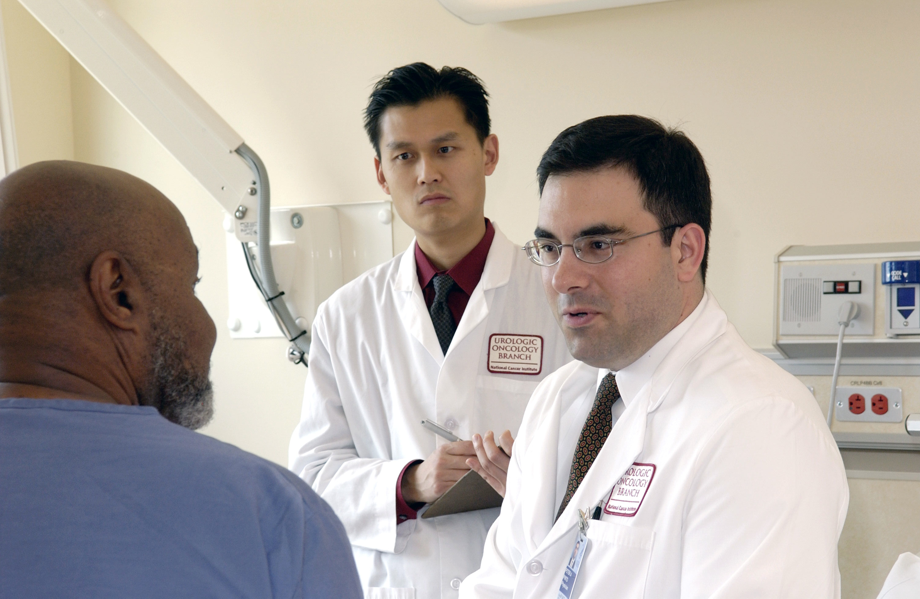
Lesson 8.8: Teach-Back method
Obj. 8.8: Demonstrate the teach-back method to communicate health information.
Module 8: Pharmacy
Notes:
Overview: This lesson will expose students to the teach-back method, a strategy shown to be highly effective in clinical medicine. Students will begin by reflecting upon their own learning preferences. Then they will identify similarities in teach-back method statements. After learning the basics of the method, students will analyze a video with examples, practice by role playing, and critique written scenarios.
Image source: National Cancer Institute (http://commons.wikimedia.org/wiki/File:Doctor_consults_with_patient_(4).jpg)

Slide 2
Do Now
How do you learn? Explain the best methods, strategies, or types of learning that you have found to be the most personally effective.
Notes:
Students might be visual, audio, or kinesthetic learners. They might have particular preferences like studying with flashcards, or with music, or in total silence, or with friends. The goal with this question is to get them thinking about how people learn.

Slide 3
Physician Communication
With a partner, read through the three statements below that might be made by a pharmacist, physician, or other health care professional. What do they have in common?
“I want to be sure that I explained your medication correctly. Can you tell me how you are going to take this medicine?”
“We covered a lot today about your diabetes, and I want to make sure that I explained things clearly. So let’s review what we discussed. What are three strategies that will help you control your diabetes?”
“What are you going to do when you get home?”
Source: http://www.nchealthliteracy.org/toolkit/tool5.pdf
Notes:
A large portion of this lesson, including these statements, are borrowed from the resource link listed here, from the Health Literacy Universal Precautions Toolkit (http://www.ahrq.gov/professionals/quality-patient-safety/quality-resources/tools/literacy-toolkit/healthliteracytoolkit.pdf). The teach-back method is tool #5.

Slide 4
The “Teach-Back” Method
Studies have shown that 40-80 percent of the medical information patients receive is forgotten immediately (1) and nearly half of the information retained is incorrect. (2) One of the easiest ways to close the gap of communication between clinician and patient is to employ the “teach-back” method, also known as the “show-me” method or “closing the loop.” (3) Teach-back is a way to confirm that you have explained to the patient what they need to know in a manner that the patient understands. Patient understanding is confirmed when they explain it back to you. It can also help the clinic staff members identify explanations and communication strategies that are most commonly understood by patients.
Source: http://www.nchealthliteracy.org/toolkit/tool5.pdf
Notes:
Ask students how they think these first few research findings (40-80% forgotten immediately, half of info retained is incorrect) compares to the learning that happens in school. This will likely elicit some negativity (general attitudes of many teens toward school…) but will offer a great way for them to connect with this topic. You can even ask during or at the end of the lesson, “How many of your teachers would you say use the teach-back method? Do you think they should use it more?”

Slide 5
Basic Communication Tips:
Always:
Use plain language.
Slow down.
Break it down into short statements.
Focus on 2 or 3 most important concepts
Check for understanding using teach-back.
Source: http://www.nchealthliteracy.org/toolkit/tool5.pdf
Notes:
Ask two students to come up to the front to model a conversation or lesson that demonstrates these tips, and two students to demonstrate non-examples. Use volunteers so that the students at the front are confident and comfortable improvising. This will be an engaging (and probably humorous) way to draw all students in.

Slide 6
So what is Teach Back?
Asking patients to repeat in their own words what they need to know or do, in a non-shaming way.
NOT a test of the patient, but of how well you explained a concept.
A chance to check for understanding and, if necessary, re-teach the information.
Source: http://www.nchealthliteracy.org/toolkit/tool5.pdf
Notes:
Ask students to elaborate on the second bullet point. What would be the harm in making the patients feel they are being “tested.” Why is it important to convey to them through word choice that they are not being tested.

Slide 7
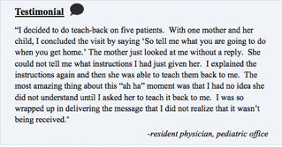
Does it work?
Source: http://www.nchealthliteracy.org/toolkit/tool5.pdf
Notes:
Ask one student to read aloud. Ask students, “What percentage of doctors do you think regularly use teach-back?” “Have you ever experienced a physician visit where teach-back was used? How did it go?”

Slide 8
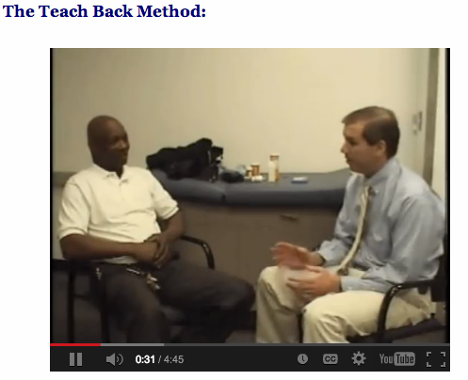
Video: Teach-Back Examples
How did the teach-back method go in these examples? What went well? What could be improved?
Video: http://nchealthliteracy.org/teachingaids.html
Notes:
Video: http://nchealthliteracy.org/teachingaids.html
Run time: 4:45
Another great source for examples of the teach-back is at the end of this longer video on health literacy from the AMA (the short version of this was used in lesson 8.7): https://www.youtube.com/watch?v=cGtTZ_vxjyA

Slide 9
Role Plays
Teach a simple piece of information to your partner & have them teach back.
Directions:
1. Plan a SIMPLE lesson. Choose a hobby, interest, skill, or recent lesson topic from school and select two pieces of information about it that you want to teach. Write them down.
2. Explain the information to your partner. Try to be as interactive as possible by using questions.
3. Ask your partner to repeat the information back to you. (i.e. “I want to be sure I explained this clearly, could you tell me....”)
4. Determine whether your partner “got it” or not. If not, re-teach or re-explain the information.
5. Switch roles & repeat!
Notes:
Walk around as students are role playing. Listen for excellent examples and have one or two demonstrate for the class when finished.

Slide 10
Improving Communication Using the Teach-Back Method
How could the health care professional could improve the communication?
Scenario #1: Eliza, an 8-year-old patient, is diagnosed with asthma. Her pharmacist is filling a prescription for her first inhaler. He says to her mother, “You can show her how to use it. If you have any questions, check the pamphlet” and hurries her along so he can get to the next patient standing in line.
Scenario #2: Jim, a 68-year-old man who has prostate cancer, is about to start chemotherapy and radiation. His doctor quickly explains what the process will look like and then says, “I know it’s a lot of information, but don’t worry too much about the details. We will handle everything.”
Notes:
Example answer (will vary):
Pharmacist should have demonstrated the inhaler use for patient and mother and had each of them show and explain to him how to use it so he could verify that they got it. The pamphlet might be a good way for them to double check or get more information, but it shouldn’t be the primary teaching tool.
The doctor should figure out the 2-3 most important parts of his treatment plan and explain in clear terms. Then he should have the patient repeat his version of what is going to happen.

Slide 11
Homework: Teach-Back Practice
Practice the teach-back method by choosing any topic, preparing a short and simple lesson, finding a volunteer to be your “pupil” and engaging in the teach-back process. When you finish, write a short reflection (1 paragraph) about how it went. Did it work? What went well? What would you improve upon next time?
Notes:
The purpose of this lesson is to help students translate their learning to a different context, setting, or topic.

