Slide 1

Lesson 8.1:
Intro to Pharmacy
Obj. 8.1: Identify the roles pharmacists and pharmacy technicians play in providing health care.
Photo by Rhoda Baer (National Cancer Institute)
Module 8: Pharmacy
Notes:
Overview: This lesson will give students a taste of pharmacy through engaging learning about the role of pharmacy professions. Students will begin by watching a video and reflecting upon the challenges, rewards, and personal interest in the field of pharmacy. Next students will read an overview of the role of pharmacy in healthcare and the changing landscape. Finally, students will examine the specific roles of a pharmacist and pharm tech and determine which role is being represented in short scenarios.
Image source: National Cancer Institute (via Wikimedia Commons: http://commons.wikimedia.org/wiki/File:Man_consults_with_pharmacist_(1).jpg)

Slide 2


Do Now
1. How has the Pharmacy role changed over the years?
2. What are some examples of different roles Pharmacists play?
3. What are issues Pharmacists consider before giving patients medicine?
4. Why do you think Pharmacists roles may change over time?
Video Source: https://www.youtube.com/watch?v=SANWMoTXY-k
Notes:
Allow students to partner up for a few minutes after the short video to discuss answers.

Slide 3

Challenges & Rewards:
1. What do you think the challenges of a career in pharmacy or as a pharmacy technician might be?
2. What about the rewards?
3. Would you be interested in these careers? Why or why not?
4. What questions do you have about a career in Pharmacy?
Notes:
Pharmacy may likely be a health profession students have not yet considered (even those in the health professions). Arranging a field trip to a local pharmacy setting could be a great enrichment opportunity for interested students. Offer extra credit to incentivize participation if interest is not immediate and this fits with school and course policies.

Slide 4

The Role of Pharmacy:
Read the overview of the role of pharmacy and changes in the profession over time.
Take notes or mark up (annotate) the text as you read.
Notes:
The passage is a summary of a variety of background sources. It does not go into depth on many interesting issues such as the history of the pharm profession, MTM automation, computerization, etc. Some of these topics will be covered later in the module, in varying depth, but it might be helpful for students to start a running list in a visible place in the classroom documenting the interesting and essential issues in the pharm profession that they can expect to learn more about.

Slide 5

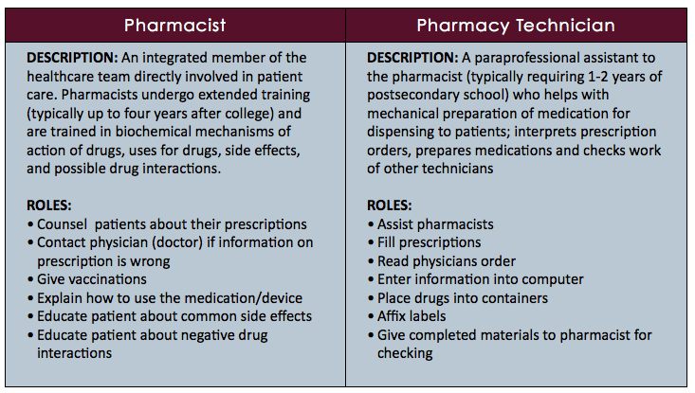
Pharmacist VS. Pharm Tech
Notes:
A short (1m) video on the Pharm Tech profession can be found at: https://www.youtube.com/watch?v=I94t0ZGQrX0

Slide 6

Pharmacist OR Pharm Tech?
Arturo goes to the local CVS because he has an infection, and his doctor prescribed some medication. When he approaches the counter, he is met by a woman in a white coat who asks him several questions about whether he has any other medical problems. When Arturo responds that he has Asthma, the woman behind the counter asks him several additional questions and then explains exactly how and when Arturo should take the medication. What is the role of the woman behind the counter?
Notes:
Answer: Pharmacist

Slide 7
Pharmacist OR Pharm Tech?
Jack works at the local Walgreens. His job is to fill the bottles with pills and put the correct label on the bottles. What is his role?
Notes:
Answer: Pharmacy Technician

Slide 8
Pharmacist OR Pharm Tech?
During November through January, Lisa is very busy giving flu shots and vaccinations. What is Lisa’s role?
Notes:
Answer: Pharmacist

Slide 9
Pharmacist OR Pharm Tech?
Maya goes to the pharmacy at Jewel to complain about some of the side effects she’s been getting from her medication. She begins talking to Jim, but when Jim understands the problem, he tells her to hold on and that he needs to get Janice. What is Janice’s role? What is Jim’s role?
Notes:
Answers: Jim is the Pharmacy Technician; Janice is the Pharmacist.

Slide 10

Assess:
Complete each sentence by describing the role of each member of the pharmacy team:
  1. A day on the job of a pharmacist might involve…
  2. A day on the job of a pharmacy technician might involve...

Slide 11

Homework: Pharm vs. Tech Scenarios
Write TWO short scenarios about a pharmacist and TWO short scenarios about a pharmacy technician.
Do NOT write whether the people in your scenarios are pharmacists or technicians. You will be giving your scenarios to a classmate to test their knowledge, so write the answers on a SEPARATE SHEET OF PAPER
  Choose the name of your character.
  Decide if he/she will be a pharmacist of a technician.
  Decide which activities (i.e., counting pills, labeling bottles, counseling patients) he/she will do in your scenario.
  Write the scenario.
Notes:
The purpose of this homework assignment is to give students the reigns in imagining the career of a pharmacist or pharm tech. Encourage them to apply their scenarios to real diseases or issues they are interested in or have a personal connection with.

