Slide 1
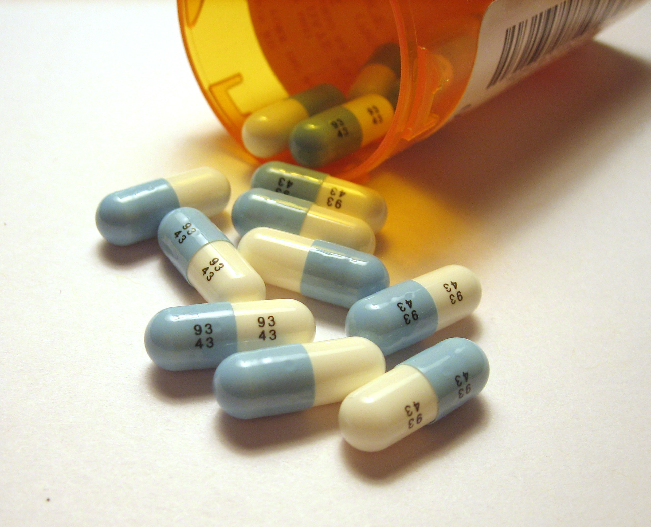
Lesson 7.9: The Plan (SOAP)
Obj. 7.9: Develop a plan to attain health goals for a patient that addresses strengths, needs, and risks.
Module 7: Violence
Notes:
Overview: This lesson will challenge students to grapple with the large scale of medical knowledge that exists today and how clinicians work to deliver the most effective treatments to patients. Students will begin with some reflecting and discussing, then they will read about the SOAP Note Plan and critique an example. Finally. students will learn about a vast array of considerations that should be made when crafting the Plan.
Image source: http://en.wikipedia.org/wiki/Fluoxetine

Slide 2
Medical Error & Malpractice
Medical clinicians (primarily physicians, nurse practitioners, and physician assistants) are held accountable for consistently making correct, evidence-based decisions about the diagnosis and treatment of disease for their patients. When they make serious errors, they are often sued for malpractice. Why do you think the rates of medical error and malpractice are becoming commonplace in today’s medical system?
Notes:
Some possible reasons (there are many, many more!):
-More availability of tests, meds, diagnoses leads to some cases being VERY complex
-We don’t know everything, there is always a certain degree of risk, error, and unexpected outcomes
-Doctors are burdened by larger patient loads, less time with each patient
-Doctors are specialized and increasingly patient care is fragmented
-Electronic medical records are time-consuming to create, manage, and update
-Many patients are more empowered and have better information, expectations increase

Slide 3
The Complexity of Medicine Today
According to Atul Gawande in his book, “The Checklist Manifesto,” the ninth edition of the WHO’s international classification of diseases has grown to distinguish more than 13,000 different diseases, syndromes, and types of injury.... Clinicians now have at their disposal some 6,000 drugs and 4,000 medical and surgical procedures, each with different requirements, risks, and considerations.” What impact do you think this explosion of possible diseases and treatments has clinicians and the quality of care they can provide?

Slide 4
The SOAP Note Plan
The “Plan” is what the health care provider will do to treat the patient's concerns - such as ordering further labs, radiological work up, referrals given, procedures performed, medications given and education provided.
Source: Wikipedia, “SOAP Note” (http://en.wikipedia.org/wiki/SOAP_note#Plan)

Slide 5
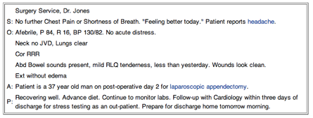
The SOAP Note Plan
Source: Wikipedia, “SOAP Note” (http://en.wikipedia.org/wiki/SOAP_note#Plan)

Slide 6
A Comprehensive Plan
1. Review the Plan in the note above. Would you consider it comprehensive, meaning that it covers all aspects of the patient’s care that should be addressed? Why or why not?
2. How would you improve the Plan? (Consider mental, social and physical health; short-term vs. long-term care, any medication, procedures, or follow-up care; communication and education for the patient, etc.)
Notes:
IF students are stuck on this question, refer them to the list on the following page which shows a variety of possibilities. Ask students, “What competing interests do doctors face that impact what becomes a part of the plan?” (i.e., time crunch—seeing the next patient, vs. spending time with current patient; cost vs.quality; ability to manage and provide resources, etc.)

Slide 7
Creating a Comprehensive Plan
Patient’s strengths
Patient’s needs
Patient’s risk factors
Mental health
Social health
Physical health
Short-term
Long-term
Medication
Tests
Procedures
Follow-up care
Communication
Patient education
Notes:
Ask students to think of an example for each category using a different disease; for example: asthma, diabetes, cancer, etc.

Slide 8
Assess:
1. What is the purpose of the Plan in the SOAP Note?
2. Name 3 elements that should be included in the Plan for a patient.

Slide 9
Homework:
Select any disease, illness, or condition. Research the disease to determine its possible treatments or therapies. Many disease will have multiple options for treatment that may be more or less appropriate for an individual patient based on their characteristics. Summarize the disease below and list at least 3 different ways the it could be treated along with the factors that influence which treatment method is selected.
Notes:
The purpose of this homework assignment is to get students to realize the great complexity involved in making diagnoses and treatment plans and realize that medicine is a very individualized endeavor.

