Slide 1
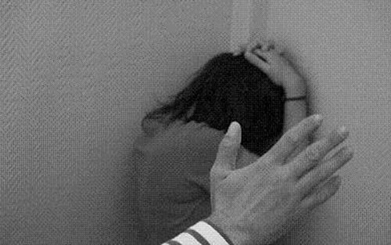
Lesson 7.4: Intimate Partner Violence
Obj. 7.4: Identify risk factors, consequences, and prevention methods for intimate partner violence.
Module 7: Violence
Notes:
Overview: Students will begin by analyzing statistics on intimate partner violence (IPV) in order to realize the extent of the problem. Then they will be exposed to new statistics on IPV among the LGBT population and discuss the implications of this research. Next, students will learn a definition of IPV and hear from a researcher who engages in IPV work at the CDC. Students will complete a reading on teen dating violence and analyze scenarios to determine risk factors, consequences, and prevention for IPV.
Image source: http://en.wikipedia.org/wiki/Domestic_violence

Slide 2
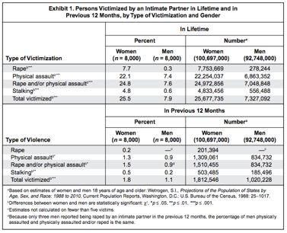
Do Now: IPV by the Numbers…
Source: U.S. Department of Justice (https://www.ncjrs.gov/pdffiles1/nij/181867.pdf)

Slide 3
Do Now: IPV by the Numbers…
1. What percentage of women and men, respectively, have experienced rape in their lifetime?
2. What percentage of women have experienced stalking in the previous 12 months?
3. What percentage of men have experienced physical assault in their lifetime?
4. Which type of victimization is most common for women?
5. Do you think most people are aware of the rates of these acts of intimate partner violence? Why or why not?
6. What are the implications of the level of awareness you believe exists around intimate partner violence?
Source: U.S. Department of Justice (https://www.ncjrs.gov/pdffiles1/nij/181867.pdf)
Notes:
Answers:
7.7% (women); 0.3% (men)
0.5%
7.4%
Rape and/or physical assault
Answers will vary
With lack of knowledge/awareness, those experiencing the violence may feel isolated, those near to them may not recognize signs or suspect the possibility of the violence occurring, and resources in their community & environment may not be available for support in the process of ending the violent relationship and remaining safe

Slide 4
Victimization by Sexual Orientation
Sexual minority respondents reported levels of intimate partner violence at rates equal to or higher than those of heterosexuals.
44% of lesbian women, 61% of bisexual women, and 35% of heterosexual women experienced rape, physical violence, and/or stalking by an intimate partner in their lifetime.
26% of gay men, 37% of bisexual men, and 29% of heterosexual men experienced rape, physical violence, and/or stalking by an intimate partner at some point in their lifetime.
Approximately 1 in 5 bisexual women (22%) and nearly 1 in 10 heterosexual women (9%) have been raped by an intimate partner in their lifetime.
How might greater awareness of intimate partner violence experienced by lesbian, gay, and bisexual men and women improve health outcomes?
Source: CDC, NISVS (http://www.cdc.gov/violenceprevention/pdf/cdc_nisvs_victimization_final-a.pdf)
Notes:
Explain to students that the LGBT community has been neglected in many areas of research, but that things are *slowly* starting to change in *some* fields. The 2010 survey from which this data came was the first of its kind and represents an important step forward in a focus on LGBT health issues.

Slide 5
What is IPV?
Intimate partner violence (IPV) is a serious, preventable public health problem that affects millions of Americans. The term "intimate partner violence" describes physical, sexual, or psychological harm by a current or former partner or spouse. This type of violence can occur among heterosexual or same-sex couples and does not require sexual intimacy. IPV can vary in frequency and severity. It occurs on a continuum, ranging from one hit that may or may not impact the victim to chronic, severe battering.
Source: CDC, IPV Definitions (http://www.cdc.gov/violenceprevention/intimatepartnerviolence/definitions.html)
Notes:
Ask students, “Where do you see IPV portrayed in the media—music, internet, artists, movies, social media, TV, books, etc.?” “How is IPV portrayed?”

Slide 6
“When Closeness Goes Wrong”
Listen to the A Cup of Health with CDC podcast, “When Closeness Goes Wrong” (Runtime: 8:22) about IPV with Dr. Michelle Black. As you listen, answer the questions below:
What are the effects of IPV?
Is IPV usually a one-time event?
Are victims of IPV willing to talk openly about the issue?
Why might IPV be linked with chronic disease?
CDC A Cup of Health Podcast on IPV source link: http://www2c.cdc.gov/podcasts/player.asp?f=7993
Notes:
--CDC A Cup of Health Podcast on IPV source link: http://www2c.cdc.gov/podcasts/player.asp?f=7993
--Another shorter Podcast from the CDC on sexual violence (Run time: 2:03) can be found at: http://www2c.cdc.gov/podcasts/player.asp?f=6284956
--As a supplement or challenge to advanced students, connect IPV with the Social-Ecological Model (from Module 6). The CDC Grand Rounds talk features a nice slide (slide #22) at the following link: http://www.cdc.gov/about/grand-rounds/archives/2012/pdfs/GR_Partner_Violence_Jun19.pdf

Slide 7
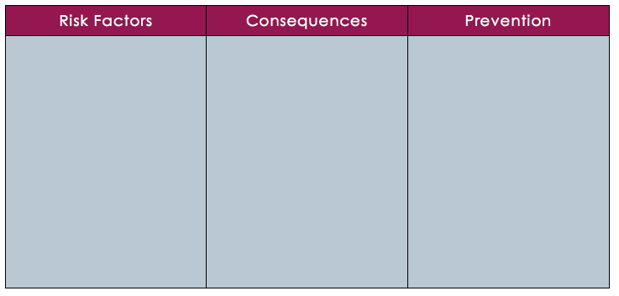
Teen Dating Violence
Read the handout entitled “Understanding Teen Dating Violence” and use the information to complete the chart below on teen dating violence.

Slide 8
Teen Dating Violence: Scenario 1
Julisa has recently been diagnosed with clinical depression. She goes out and binge drinks nearly every weekend with her boyfriend and friends. When she drinks, her boyfriend often pressures her to have sex, even when she doesn’t want to. He also make rude an inappropriate comments about her in front of all of their friends, which make her feel bad about herself. Julisa recently started a health course in school and learned about the signs of being in an abusing teen dating relationship. She now realizes she should get out of the relationship.
Notes:
Answers:
RFs: depression; substance abuse
Consequences: low self-esteem
Prevention: program in school about teen dating violence

Slide 9
Teen Dating Violence: Scenario 2
Ryan suffers from severe anxiety, but has learned to cope with the symptoms in his teen years. He recently came out to his friends and family. He has not had a close relationship with another boy before, but decided to go on a date with another boy, Paul, who expressed interest in a relationship. He quickly realized that the relationship would not work, and tried to end things. But since then, Paul has not stopped calling, texting, and seems to track his every movement on social media. He asks Paul to lay off, but this only makes him pursue Ryan even more. Ryan’s mom notices something is wrong and reports the boys behavior to his parents and school officials.
Notes:
Answers:
RFs: anxiety; LGBT status (not in CDC PDF but students should recall the statistics from the Discuss exercise earlier in the lesson)
Consequences: not directly listed, but we can infer that Ryan would have anxiety, fear, and disruption to his normal life from the stalking behavior that Paul is displaying
Prevention: parental supervision, education on dating violence, and intervention

Slide 10
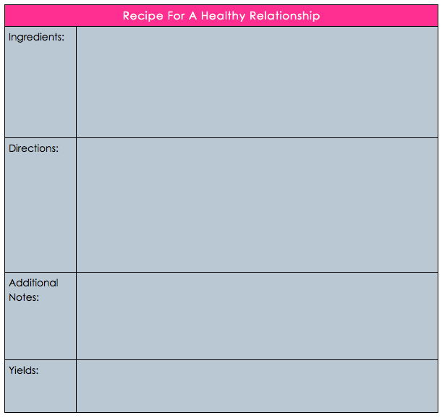
Homework:
Create a “recipe” for a healthy relationship.
Consider the risk factors, consequences, and prevention strategies for teen dating violence and creatively incorporate them into your recipe.
Notes:
The purpose of this homework assignment is to give students an opportunity to creatively review the material on teen dating violence, with a focus on the risk factors, consequences, and prevention methods they learned about. Students can be given the opportunity to share their recipes or display them on a bulletin board in the following class period.

