Slide 1
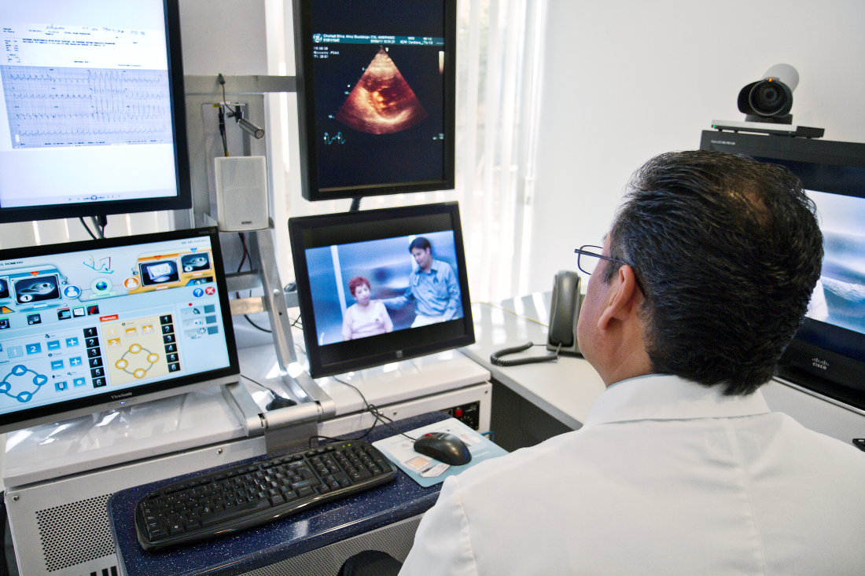
Lesson 6.8: Telemedicine
Obj. 6.8: Evaluate the impact of technology on rural mental health care outcomes
Module 6: Rural Health
Notes:
Overview: Students will examine the changing role of technology on healthcare with a specific focus on mental healthcare for rural populations. Students will reflect upon analogies to the way the information age is changing medicine, examine how this technology might impact themselves personally, learn the basic terminology in this emerging field, and analyze one study of patient satisfaction in telepsychiatry. After gaining this foundation, students will infer how telemedicine might impact various elements of the healthcare provider-patient interaction.
Image source: http://commons.wikimedia.org/wiki/File:Telemedicine_Consult.jpg

Slide 2
Do Now: Automobile & Internet
How is the invention of the Internet similar to the that of the automobile? How is it different?
Notes:
Possible ideas: Automobile changed transportation world—suddenly goods, services, people, and ideas traveled further, faster, more often. Internet does the same thing on a large scale (moving information, ideas, services, and enabling people to facilitate travel or delivery of products).

Slide 3
Just Like Skyppe…?
You are getting used to life in the country by now, but you still love to Skyppe and FaceTime with your friends from Chicago, where you grew up in until age 14. You are starting to make new friends, your parents and siblings all seem happy, and you are doing well in school. But you just can’t shake a feeling of hopelessness that has been bothering you for many months. You start to sleep in late into the day on weekends because it is so difficult to get out of bed. You haven’t told anyone about your feelings; after all, no one wants to hear about a sad, lonely teenager. And then you start cutting yourself. You cannot figure out why you are doing it and the frustration makes things even worse. But it is the only way you feel better, even if it is fleeting. Your mother confronts you and takes you in to the only clinic in the small town. There is no mental health care practitioner on staff, but the nurse practitioner suggests you use their new “telemental health room” to connect on a video screen with a psychiatrist in a larger city just a few hours away. The nurse must have noticed your look of surprise, because she says, “It is no big deal, just like Skypping your friends. But it’s secure and private.” You ask to go to the bathroom and sit down in the stall for a moment to gather your thoughts.
What do you think about the idea of “Skypping” with a doctor?
What are the pros and cons of seeing a mental health professional in this way?
Who might this technology appeal to most? Least?
Notes:
Explain that this is just one example of how telemedicine can be used—for one-on-one mental health visits for diagnoses and treatments. There are many other ways that we will examine briefly, but we will focus primarily on this particular use for this lesson.

Slide 4
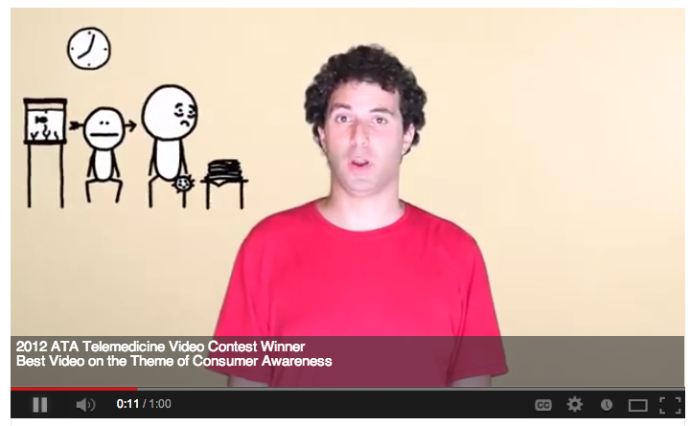
Telemedicine: It’s a No Brainer
Video: http://www.youtube.com/watch?v=c6AT1FLM8yk
Notes:
Video: 1 minute

Slide 5
What is telemedicine?
telemedicine: The use of medical information exchanged from one site to another via electronic communications to improve a patient’s health status. Telemedicine includes a growing variety of applications and services using two-way video, email, smart phones, wireless tools and other forms of telecommunications technology. (American Telemedicine Association)
Notes:
Telemedicine really took off in the 90’s but still have not become standard practice. It has had its fits and starts, and ultimately depends on a variety of factors including policy, funding, resource allocation, medical education & continuing medical education, and the resistance or adoption by practitioners and patients. For more info on telemed, see: http://en.wikipedia.org/wiki/Telemedicine

Slide 6
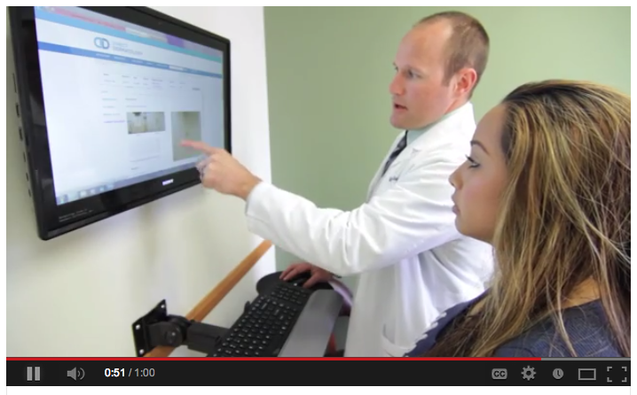
Telehealth Technologies
Video :http://www.youtube.com/watch?v=azXV5-obOAQ
Notes:
Video: 1 minute

Slide 7
What is telemental health?
telemental health: The use of telecommunications (video conferencing) technology to provide mental health services (also known as telepsychiatry)
Examples:
providing direct mental health care consultations through two-way interactive systems
providing health workers in remote areas with continuing education on mental health
videoconferencing on mental health cases using a “virtual” case management team
Notes:
This will be the focus of the upcoming population-based case study!

Slide 8
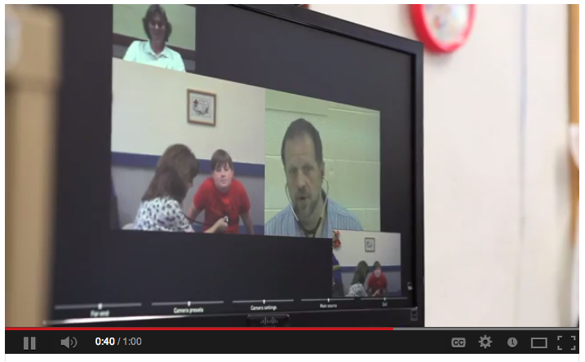
School-based Telemedicine
Video: http://www.youtube.com/watch?v=2C1HEWMvVu8
Notes:
Video: 1 minute

Slide 9
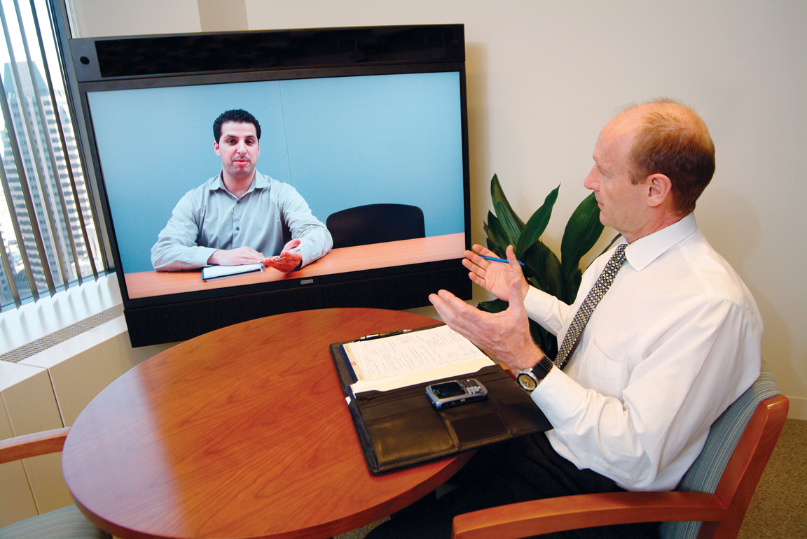
Benefits of Telemedicine
Improved Access
Cost Efficiencies
Improved Quality
Patient Demand
Notes:
Ask students, why would access improve? Why would it be less costly? Why might quality improve? Do you think patients would demand this type of care. When might they prefer it, even if an in-person option was available?
Image source: http://en.wikipedia.org/wiki/Telepresence

