Slide 1
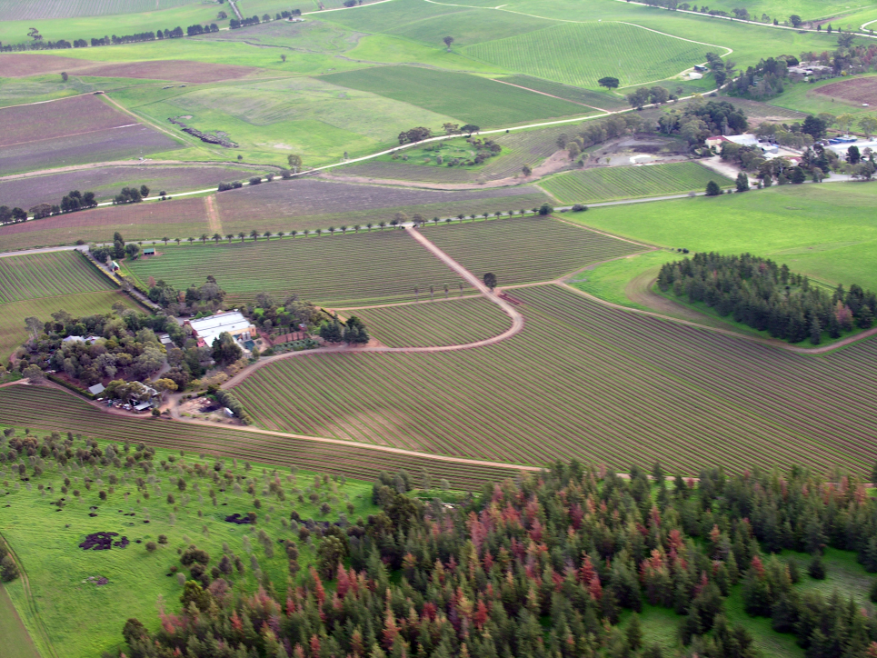
Lesson 6.1: Rural Health
Obj. 6.1: Identify a community’s assets and needs related to rural health.
Module 6: Rural Health
Notes:
Overview: This lesson will engage students in thinking about what rural health is, by examining their own community and health experiences, focusing on both the positive assets of the community as well as the challenges and disparities, and reading a call to action from the leader of our nation. Students will begin with a fun exercise in brainstorming, where they’ll design instagram photo squares representing one aspect of rural health. Next they will get grounded in a few basic definitions, followed by a chance to identify assets and challenges relating to rural health in three vignettes and an opportunity to create their own vignette. Finally, they will read a letter from the President describing more of the assets and challenges common in rural health.
Image source: http://www.flickr.com/photos/28549294@N05/3224708424/in/set-72157612891773241/

Slide 2
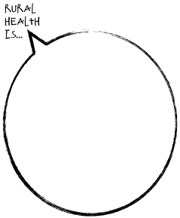
Do Now
Goal: Collectively portray rural health using a series of representative images.
Notes:
Provide specific timeframes and set a timer (some students will want all class period to work on their art!) Suggestion: 3 min. for brainstorming, 1 min. for the rough sketch, and 3-5 min. for the final drawing. Provide colored pencils, crayons or markers if you want students to color their images (note: this may add time).

Slide 3
Present your Instagram!
Reflect:
1. Which ideas were most surprising or unique?
2. What were the most common themes?
3. Do you think any of the ideas presented are stereotypes about rural health?
4. What proportion of the ideas had a positive versus negative association?
Notes:
Have a spot on the wall prepared for each class, with materials for them to quickly affix their square to the wall prepared.
These questions are very important for uncovering students’ pre-conceived notions about rural health, and may start some very interesting discussion.

Slide 4
What is Rural Health?
Differences in geography, population, economy, infrastructure, policies, resources, and ecosystems can all influence health
Rural communities have assets and challenges:
rural: geographic area located outside of cities and towns; usually having low population density
health disparity: a type of difference in health that is closely linked with social or economic disadvantage
assets: a useful or valuable thing, person, or quality
Notes:
Tell students that we will focus on domestic (within the U.S.) rural health in this module, but global rural health has many parallels.
Ask students: What are some health disparities you know about? What are some things that could be considered assets for your family? For our school?

Slide 5
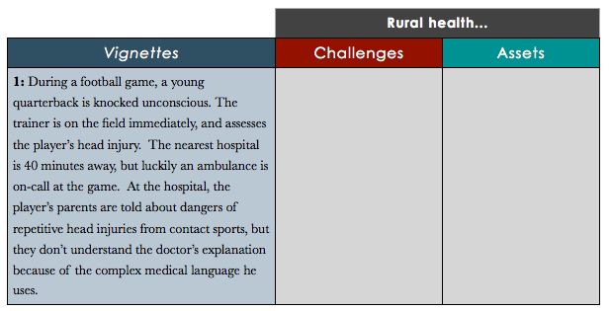
Challenges & Assets:
Goal: Consider the needs and assets in a community that may influence health.
Notes:
Instruct students to work individually, in pairs, or teams as appropriate. Each vignette should take approximately 3-5 minutes. Consider starting a running list of challenges and assets on the board or on butcher paper, by choosing a student recorder. Later, when they read the letter from Obama, they can add to this list.

Slide 6
Vignette #1:
1: During a football game, a young quarterback is knocked unconscious. The trainer is on the field immediately, and assesses the player’s head injury. The nearest hospital is 40 minutes away, but luckily an ambulance is on-call at the game. At the hospital, the player’s parents are told about dangers of repetitive head injuries from contact sports, but they don’t understand the doctor’s explanation because of the complex medical language he uses.
Notes:
Possible answers:
asset: youth are getting exercise (through sports); access to trainer and paramedics for sporting events
challenge: distance to hospital; health literacy; health care provider communication

Slide 7
Vignette #2:
2: June is a single-mother raising two children on a farm. Her husband died four years ago in a farming accident. June provides her children with fresh fruits and vegetables from a small garden she planted years ago for the family. But managing the farm has become difficult without her husband. June does not have health insurance and struggles to pay the bills every month. Despite all her struggles, whenever June gets too stressed, she takes long walks around in the woods surrounding the farm. The clean air, wildlife, and nature have a way of calming her.
Notes:
Possible answers:
asset: healthy diet--produce, clean air and access to outdoor spaces
challenge: poverty, lack of insurance, farm accidents

Slide 8
Vignette #3:
3: Dennis is a single middle-aged man, working as a custodian. He has dealt with mental health issues his whole life, but recently his bouts of depression seem to be coming more often and lasting longer. He has never been diagnosed or treated, but his family and neighbors have long suspected and they tend to help him through his most difficult times with small gestures of kindness. Dennis is also obese. He limits his trips to the grocery store to every six weeks (due to distance) and doesn’t have another source for fresh produce.
Notes:
Possible answers:
asset: close-knit & supportive community,
challenge: lack of mental health care, distance to grocery stores, obesity

Slide 9
Write Your Own Vignette!
Write another vignette related to your community. Include at least one asset and one challenge. Then exchange vignettes with a partner and have them identify the challenge(s) and asset(s).
Notes:
Students can choose to make it personal or generic/random. Ask for a few volunteers to read aloud to the class after partners have exchanged vignettes.

Slide 10
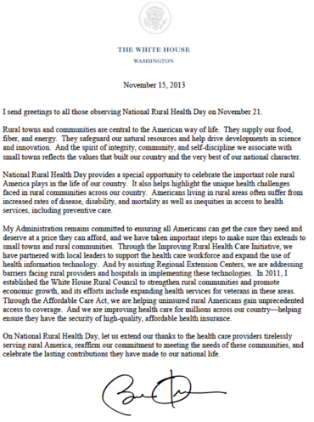
Letter from Obama:
Highlight to indicate:
positive factors (assets)
disparities and challenges (needs)
Notes:
Consider having students read twice: 1st read: Teacher (or strong reader) stands and reads letter aloud to the class, but all writing utensils are down and students are just listening. 2nd read: Students in pairs or as individuals can re-read to mark for assets and needs. After they finish, new assets and needs can be added to the board or butcher paper.

Slide 11
Assess:
Choose one asset and one need that you found most compelling and explain why each is significant in rural health.
Share your answers with a partner.
Notes:
The recall of one asset and one need is the primary form of the assessment, but the added layer is articulating the significance. WHY is this an important asset or need? Students may not have evidence on hand (although if time and technology permit, they could be allowed to look up a statistic or fact), but they can use logic or their experiences to rationalize.

Slide 12
Homework: Instagram or Interview?
Choose one of the options below for your homework assignment:
Instagram:
Take 3 photos that capture the spirit of rural health in your community.
They can portray the assets or challenges, and you are encouraged to be creative.
For each photo, write a short caption explaining it.
Interview:
Interview someone in the community about the assets and challenges they observe related to health in your community.
Record the questions you ask and a summary of their responses on a separate paper.
Notes:
The purpose of this assignment is to encourage students to consider exploring what rural health is all about in an engaging way.
Instruct students on HOW to share photos if they choose the first option. Here are some ideas:
EMAIL: have all students email you their 3 photos and captions;
COURSE SITE OR FACEBOOK PAGE: have them upload to a course site or a facebook page created for the class (excellent option for sharing with their fellow classmates)
HASHTAGS ON INSTAGRAM: have them add a unique hashtag (ex: #ruralhealthimages) and search through the hashtags for users who uploaded (Warning: this option is also great for sharing, but may make it a bit more cumbersome to grade; also, some students (and you) may be hesitant about connecting on Instagram, so use your discretion or school policies as they apply.)

