Slide 1
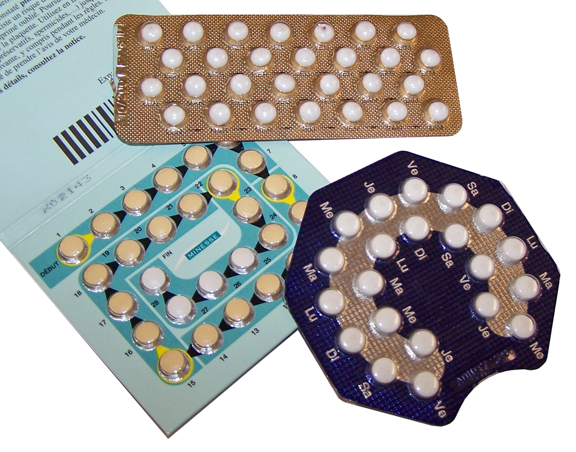
Lesson 4.6: Contraception
Obj. 4.6: Compare the efficacy of various contraceptive methods.
Module 4: Sexual Health
Notes:
OVERVIEW: This lesson follows the abstinence lesson by providing students with accurate and unbiased information on various contraceptive methods. Students will engage in discussion, analyze a CDC chart comparing efficacy of various methods, interpret data on various racial groups’ use of these methods, and create a chart with the advantages and disadvantages of various methods.
Image source: http://en.wikipedia.org/wiki/Birth_control_movement_in_the_United_States

Slide 2
Do Now
Why might providing education on contraception in schools be a controversial issue?
Notes:
Follow up questions: Do you believe schools should adopt abstinence-only or comprehensive sexual education? Why? What potential risks might there be in providing education on contraception? (ex: inaccurate information; reducing likelihood of students to seek medical advice; giving teens a false sense of reassurance) What are the benefits of providing education on contraception? (ex: build awareness and understanding of options; provide a foundation and level of comfort with the subject so teens are more comfortable talking to parents and health care practitioners, giving teens an accurate sense of the risks still involved even when contraception is used—failure rates, etc.)

Slide 3
Discuss
In Illinois, the following law regulates birth control accessibility for minors:
BIRTH CONTROL: Doctors may provide birth control services and information to minors (under the age of 18 years), without the consent of parents or guardians, if they are married, a parent, pregnant, or referred for birth control services by a physician, clergyman, or a planned parenthood agency, or where a serious health hazard would be created by the failure to provide such services.
1. Why would some people support this law?
2. Why might some people disagree with this law?
Notes:
Emphasize to students that they CAN get confidential services regarding birth control, STIs, pregnancy testing, etc. (although it’s often easiest through agencies like Planned Parenthood), however the law can be confusing so it’s important to ask a trusted adult or someone from an agency that works in these areas what the best way to seek out these services. Often, students will not have a close relationship with their doctor (unfortunately), but that is the most direct route if they do have one, or feel comfortable seeking out a physician.

Slide 4
Facts:
For sexually active people who do not use birth control, the chance of the woman getting pregnant is 85-90% in the first year.
A pregnancy can happen the 1st time a girl has sex.
Abstinence is the only 100% effective method for preventing pregnancy.
Condoms are the only birth control that also provide protection against STIs.
Notes:
Emphasize the point: Oral contraception does not provide STI protection! (And repeat, repeat, repeat!)

Slide 5
More Facts:
Choosing to have sex is a choice that requires careful thought.
If you do choose to become sexually active, there are a number of ways to protect yourself from pregnancy and STI’s.
A provider can help you choose a method(s) that is most appropriate for you.
Notes:
Ask student to reflect upon the “What If’s” to effectively convey the risk involved in sex, even when contraception is used correctly:
WHAT IF…
-Condom breaks
-A pill is missed
-Patch falls off
-You missed a shot
-Ring falls out
-Diaphragm slipped

Slide 6
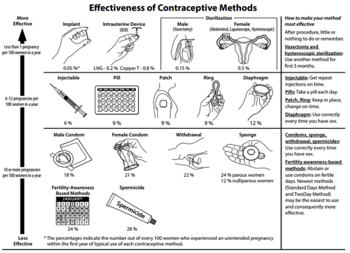
Notes:
Ask students, WHICH of the methods on this chart are targeted at the male side of the equation. (Male condom, withdrawal, vasectomy—and abstinence, although it is not on this chart). While men can take part in helping a partner use the other methods of contraception (ex: asking about correct use of contraception, applying spermicidal gel, using female condoms with partner, etc.) a lot of burden does fall on the female. Ask students their reactions and reflections on this fact. Ask about how this affects the relationship, and the outcomes that may result from sex.

Slide 7
Questions:
1. Besides abstinence (which is 100% effective), which methods of contraception are most effective?
2. For users of male condoms, how many out of every 100 women would experience an unintended pregnancy within the first year of typical use?
3. For users of the pill, how many out of every 100 women would experience an unintended pregnancy within the first year of typical use?
4. Which two methods are least effective when used exclusively?
5. For users of the withdrawal method, how many out of every 100 women would experience an unintended pregnancy within the first year of typical use?
Notes:
Answers:
Implant, IUD, & Male-Female Sterilization
18
9
Fertility-Awareness based methods and Spermicide
22

Slide 8
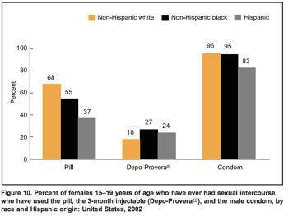
Use of Contraceptives:
Notes:
Source: http://www.cdc.gov/nchs/data/series/sr_23/sr23_024.pdf

Slide 9
Questions:
1. Which racial group uses the condom as a contraceptive method the least frequently?
2. Which racial group uses the pill as a contraceptive method most frequently?
3. Which type of birth control (of these three methods) is the least commonly used among all races?
4. Of the three types of contraceptives in the graph above, which is the most reliable (use the chart from the previous page)?
5. Based on this data, which racial group is using the most reliable form of contraception most often?
6. Based on this data, which racial group is using the least reliable form of contraception most often?
Notes:
Answers:
Hispanic
Non-Hispanic white
3-month injectable (Depo-Provera)
Shot (6%) vs. Pill (9%) and male condom (18%)
Non-Hispanic black
Non-Hispanic white

Slide 10
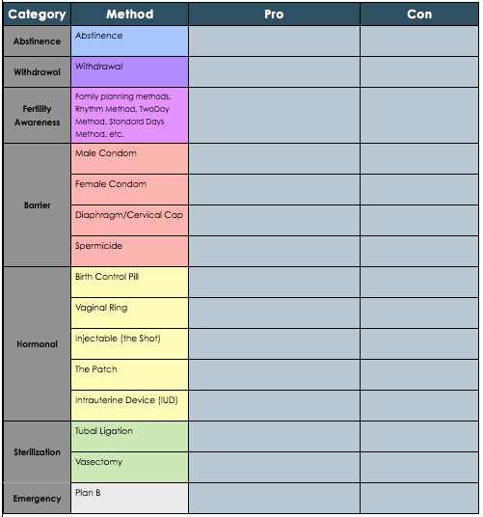
Pros & Cons:
Notes:
Remind students that there is no BEST form of birth control. While we obviously wan the ones that fail the least or are most effective, other factors are important to for each individual (lifestyles, habits, goals for the future, relationship status, etc.)
One good websites to direct students to is: http://www.womenshealth.gov/publications/our-publications/fact-sheet/birth-control-methods.html

Slide 11
Discuss:
Is there a specific contraceptive method that is best for teenagers? Why or why not?
Notes:
This was probably already internalized by students, but it is good for them to repeat it in their own words. There is no SINGLE BEST form of contraception for teens who choose to be sexually active, but some are indeed better than others. Ultimately, it comes down to all those factors discussed before (lifestyle, etc.), and is an individual decision between the teen, his/her partner, and aided by the health care provider. This is also a good time to remind students that hormonal contraception does not protect against STIs, so when it is used it should be in conjunction with condoms.

Slide 12
Assess:
1. Which of the following methods is most effective in preventing pregnancy?
A. Male condom
B. IUD
C. Birth Control Pill
D. Abstinence
2. Which of the following methods of contraception is most effective in preventing the spread of STIs?
A. The Shot
B. Spermicide
C. Condom
D. Cervical Cap
Notes:
Answers: 1.D; 2. C

Slide 13
Homework:
You are a pediatrician and have a 17-year-old female patient at your clinic for a routine annual physical. During the course of the interview, she asks you about birth control options. She tells you that she has only had one partner, but neither she nor her partner have been tested for STIs. She is extremely busy with school and extracurricular activities, and has a hard time keeping track of everything in her life.
What contraceptive method(s) would would recommend for this patient? Why?
Notes:
The purpose of this homework is for students to review what they have learned and explain it (the teach back method).

