Slide 1
Lesson 4.2: Male Reproductive System
Obj. 4.2: Explain the anatomy & physiology of the male reproductive system.
Module 4: Sexual Health
Notes:
This lesson will provide a basic background of the male reproductive system, focusing on the structures and functions of the main reproductive organs. Students will complete a labeling exercise, a short reading, and note-taking.
Image source: http://pixabay.com/en/dance-people-boy-happy-man-guy-32193/

Slide 2
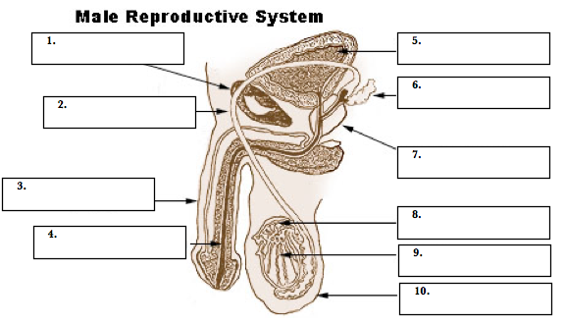
Do Now
Pubic bone
Bladder
Seminal vesicle
Ductus deferens
Prostate gland
Penis
Epididymis
Spongy urethra
Testis
Scrotum
Notes:
Revisit the conversation on norms (from lesson 4.1) before beginning this lesson.
There is more to the male reproductive system than many students think. Ask students if they are aware of illnesses or dysfunctions of the male reproductive system (ex: prostate cancer, testicular cancer, erectile dysfunction, etc.)

Slide 3
Male System Parts
Part | Description
1. Pubic bones | Make up the anterior (front) portion of the pelvis
2. Ductus deferens | Tube sperm travel through from epididymis to seminal vesicle
3. Penis | Fleshy extension used in intercourse
4. Spongy urethra | Tube for semen & urine flow out of the penis
5. Bladder | Storage chamber for urine
6. Seminal vesicle | Adds fluid to semen providing a source of energy for sperm
7. Prostate gland | Adds fluid to semen the protects the sperm
8. Epididymis | Collects & stores sperm
9. Testis | Produces sperm & testosterone
10. Scrotum | Pouch of skin holding the testicles
Notes:
The ductus deferens is the same anatomical part as the vas deferens. Ask students if they know what a vasectomy is? (What part in particular is cut?)

Slide 4
Read
Male reproductive organs: both inside and outside the pelvis.
Male genitals include:
the testicles
produce sperm and testosterone
the duct system, which is made up of the epididymis and the vas deferens
the accessory glands, which include the seminal vesicles and prostate gland
the penis

Slide 5
Functions, Sex Cells & Puberty…
1. FUNCTIONS: What are the 3 main functions of the male reproductive system?
1. Produce sex hormones (testosterone)
2. Produce & store sperm
3. Deliver sperm to female reproductive system
2. SEX CELLS: What are the male sex cells and how are they delivered?
Sperm: (spermatozoa) cells that carry male’s genetic material
Semen: fluid leaving penis during ejaculation; millions of sperm in each drop of semen
Pre-ejaculate: released from an erect penis immediately, may contain sperm
PUBERTY: What are some changes males undergo during puberty?
Shoulders widen, testes drop/grow, increase of body/pubic hair, increase of body oil, voice deepens
Notes:
Ask students if they know what testosterone is responsible for?
Testosterone is a steroid hormone from the androgen group and is found in mammals, reptiles,^{[1]} birds,^{[2]} and othervertebrates. In mammals, testosterone is secreted primarily in the testicles of males and the ovaries of females, although small amounts are also secreted by the adrenal glands. It is the principal male sex hormone and an anabolic steroid.
In men, testosterone plays a key role in the development of male reproductive tissues such as the testis and prostate as well as promoting secondary sexual characteristics such as increased muscle, bone mass, and the growth of body hair.^{[3]}In addition, testosterone is essential for health and well-being^{[4]} as well as the prevention of osteoporosis.^{[5]} (From wikipedia)

Slide 6
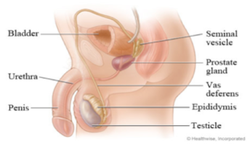
Assess:

Slide 7
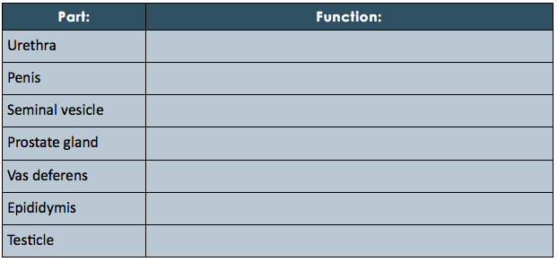
Assess:
Notes:
Answers:
Urethra: transports semen and urine out of body
Penis: acts as a conduit for sperm to enter vagina during intercourse
Seminal vesicle: secrete fluid containing nutrients for sperm
Prostate gland: secrete an alkaline (basic) fluid to counter the acidity of vagina, protecting sperm
Vas deferens: Transport system for sperm; propels sperm forward
Epididymis: Storage reservoir for sperm, where they will mature and become activated
Testicle: Production of sperm and testosterone

Slide 8
Homework:
Research embryonic sex development to find out when and how sex is determined in the womb. Write a short explanation, citing your sources.
Notes:
The purpose of this homework assignment is for students to discover the parallels between the male and female reproductive systems. Ultimately, students should learn that, “ In the first weeks of life, a fetus has no anatomic or hormonal sex, and only a karyotype distinguishes male from female. Specific genes induce gonadal differences, which produce hormonal differences, which cause anatomic differences, leading to psychological and behavioral differences, some of which are innate and some induced by the social environment.” (from wikipedia)

