Slide 1
Lesson 4.10: Interviews
Obj. 4.10: Demonstrate professionalism and effective interviewing technique.
Module 4: Sexual Health
Notes:
Overview: This lesson will introduce students to the idea of interviewing someone as a source of data and information on their upcoming case study project. In reality, the students may be in a class setting with an expert (group interview!) or in a small group visiting a site, but these are practical skills to develop for application in a variety of settings. First, students will reflect on their experience and knowledge with interviewing. Then they will role play an interview. Next they will read information on professionalism in interviews and brainstorm pros/cons of different types of interviews.
Image source: http://en.wikipedia.org/wiki/Handshake

Slide 2
Do Now
1. Have you ever been interviewed or conducted an interview? What were the positive and negative aspects of this experience?
2. Many websites will share lists of Do’s and Don’ts for interviewing. Write your own tips. Try to include at least 3 Do’s and 3 Don’ts.
Notes:
Compile Do’s and Don’ts on butcher paper (choose student recorders), an a PowerPoint slide, etc. These will be handy reminders for the future!

Slide 3
Discuss
1. With a partner, each take one of the following roles:
MANAGER (Interviewer): You are the manager of an indie rock band. You’ve just held tryouts to fill the position of drummer and now you are interviewing one of the top three contenders to see if the band should select him to join.
DRUMMER (Interviewee): You are looking to join an indie rock band and successfully advanced to the next round after the tryouts. Now you are ready to interview.
2. Prepare: To prepare for the interview. the manager should jot down at least 4 questions and the drummer should prepare answers to questions he anticipates the manager might ask.
3. Conduct the interview: Act as authentically as possible in your roles.
4. Reflect: How did it go? What were the strengths and weaknesses of the interviewer and interviewee.
Notes:
Allow students to switch roles and do it again, if time permits. This will allow them to practice incorporating the constructive feedback they gave into their new roles. If desired, the scenario can be switched to almost anything (job interview, college interview, etc.)

Slide 4
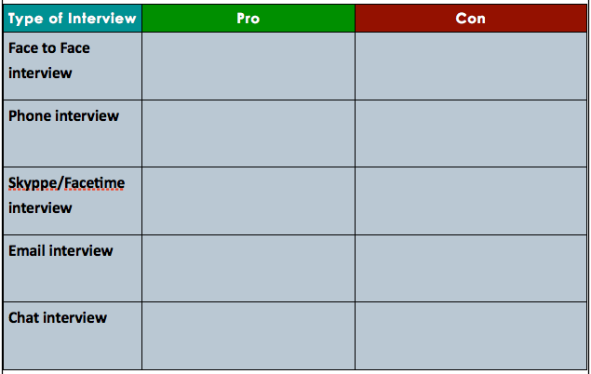
Types of Interviews:
Notes:
Possible answers:
Face to face: PRO: personal, can read body language, can develop closer relationship CON: may be difficult if distance/time pose problems, can be uncomfortable for those who are nervous/anxious
Phone interview: PRO: Able to write/type without worrying about eye contact; convenient CON: impossible to read body language
Skyppe/Facetime: PRO: body language, more personal; convenient; CON: possible problems w/ tech
Email: PRO: flexible, gives interviewee time to think about answers CON: some prefer not to type long answers; can’t convey emotion/tone in text, etc.
Chat: PRO: more interactive than email; gives each party time to process/think between typing; CON: possible tech issues; misinterpreting tone

Slide 5
Professionalism in Interviews:
Before:
Setting it up
Preparing
During:
Listen
Formality
Recording
After:
Thanking
Processing info
Which of these guidelines do you find most helpful? least helpful?
What would you add to this list?
Notes:
Ask students: Which guidelines do you find most helpful? Least helpful? What would you add to this list? (add any additional tips to butcher paper or board, along with the other dos and don’ts for display in room)

Slide 6
Questioning:
Brainstorm questions you would ask a social worker who handles a caseload of pregnant teenagers and teen mothers and fathers. Write your questions below:
Notes:
These questions may end up being applicable to the students’ actual interactions with the health professionals for Case Study 4.11.

Slide 7
Assess:
Write down one way to be professional before, during and after an interview:

Slide 8
Homework:
Research your community. Find at least three people or sites (clinics, organizations, agencies, etc.) who do work related to adolescent sexual health. List them, along with their websites (if available) and contact information:
1.
2.
3.
Notes:
The purpose of this homework assignment is to help prepare for the case study 4.11 by giving students a chance to research the resources in their communities. Even if the case study is set up with the instructor assigning sites, bringing in one expert/organization, or some other way, having a list of resources will equip students to seek even more information on their own. Consider offering extra credit for this (if documentation of interview and signature is provided), if your policies permit.

