Slide 1
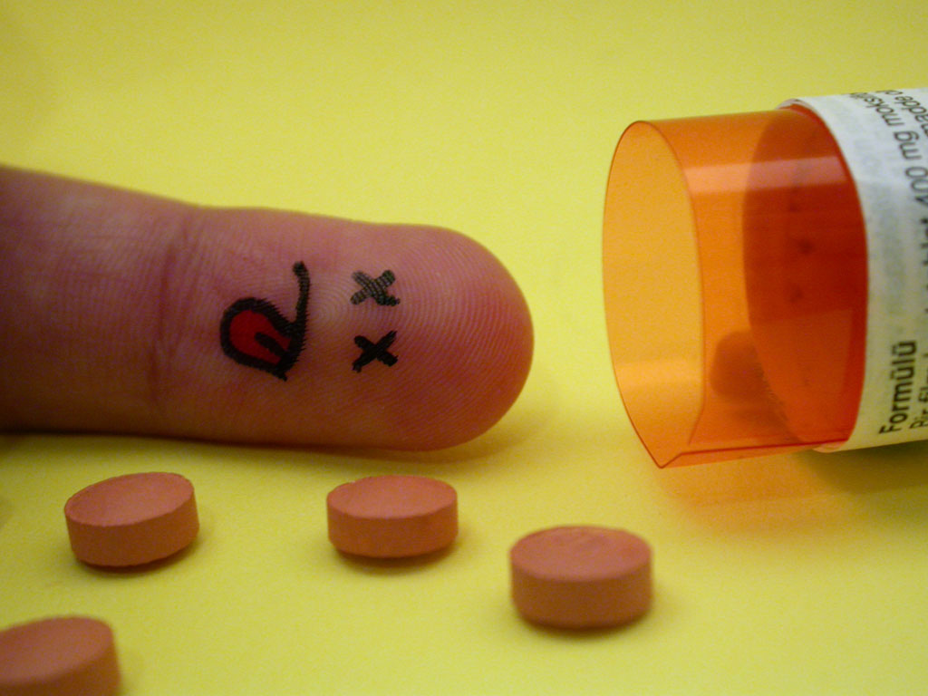
Lesson 3.9: Substance Abuse Treatment
Obj. 3.9: Explain the spectrum of substance use, abuse, and addiction and the Developmental Model of recovery
Module 3: Drugs & Addiction
Notes:
This lesson will expose students to some background on the identification of substance abuse issues and different stages of recovery that an addict can be in. This will help with the case study on Alexandria. First, students will examine a myth/truth table and reflect upon what they read. Then students will read about the spectrum of substance use, abuse, and addiction and try to identify where character’s are on the spectrum. Finally, students will read about the Developmental recovery and identify where a person is in a scenario on the path to recovery.

Slide 2
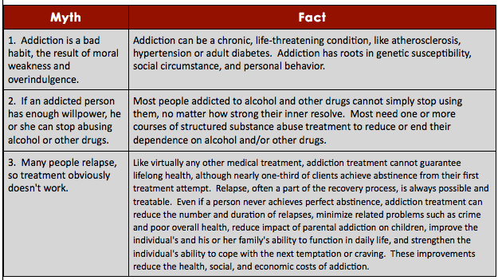
Do Now
Which myth is most prevalent in society?
What are some possible negative consequences of these myths?
Notes:
Source: Government report, at http://aspe.hhs.gov/hsp/subabuse99/chap2.htm
Answers will vary

Slide 3
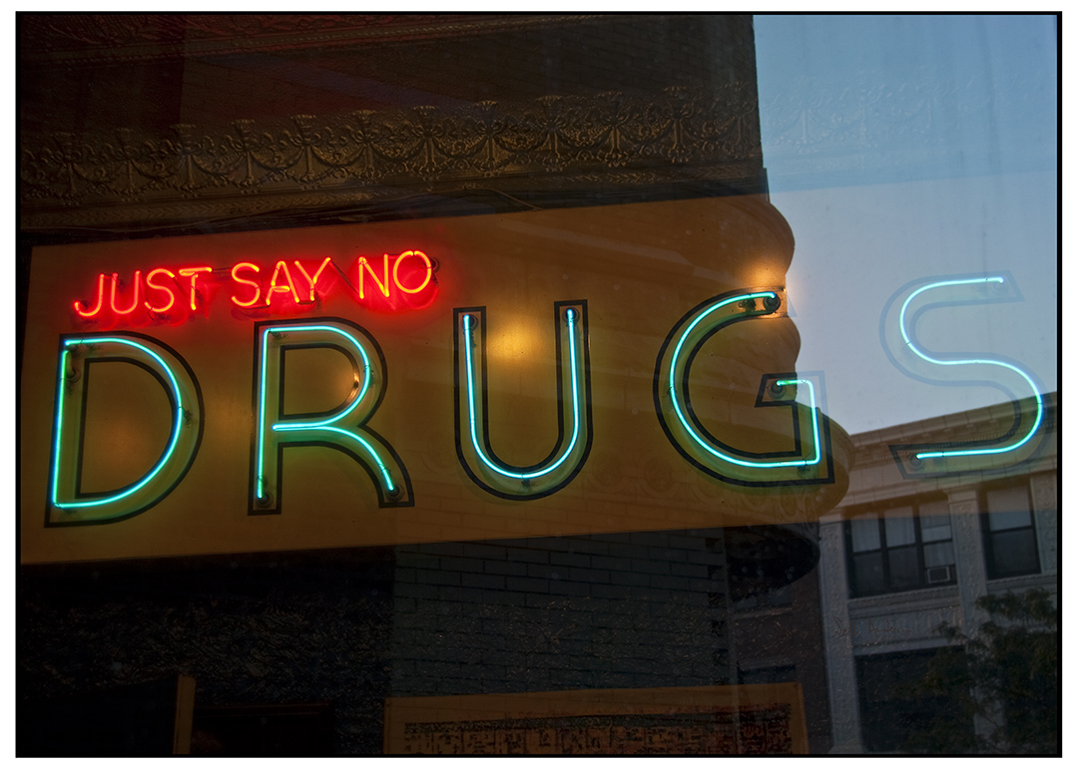
Discuss
Who suffers negative consequences of substance abuse? (ex: individuals, hospitals)
How do they suffer? (ex: financial burden)
Notes:
Substance abuse affects and costs the individual, the family, and the community in significant, measurable ways including loss of productivity and unemployability; impairment in physical and mental health; reduced quality of life; increased crime; increased violence; abuse and neglect of children; dependence on non-familial support systems for survival; and expenses for treatment. (source: http://aspe.hhs.gov/hsp/subabuse99/chap2.htm)
Image source: Seth Anderson, http://www.flickr.com/photos/swanksalot/3916151288/

Slide 4
The Spectrum of Drug Use & Abuse
1. Drug experimentation
2. Social use of drugs
3. Binge drinking
4. Substance abuse
5. Addiction or Chemical Dependency
Notes:
The American Society of Addiction Medicine describes drug dependence as having two possible components: 1) psychological dependence and 2) physical dependence. Psychological dependence centers on the user's need of a drug to reach a level of functioning or feeling of well-being. Due to the subjective nature of this term, it is not very useful in making a diagnosis. Physical dependence, however, refers to the issues of physiologic dependence, establishment of tolerance, and evidence of an abstinence syndrome or withdrawal upon cessation of alcohol or other drug use. Tolerance, dependence, and withdrawal develop differently depending on the particular substance (HHS/SAMHSA, 1994). (source: http://aspe.hhs.gov/hsp/subabuse99/chap2.htm)

Slide 5
Scenario 1
1. Jean is a college sophomore who has gotten quite involved in the party scene. She usually drinks one day per weekend, but consumes 8-12 drinks throughout the night on those occasions. Although she has a pretty severe hangover the following day, she tries to carry on with her college life activities as much as possible.
Drug experimentation, Social use of drugs, Binge drinking, Substance abuse, OR Addiction/Chemical Dependency?
Notes:
Binge drinking

Slide 6
Scenario 2
2. Brett is a 26 year-old who uses heroin. After several harmful events transpired, his family staged an intervention recently to try to get him to stop but his withdrawal sickness was so bad that his intense irritability and stomach pain were too much for his family to handle.
Drug experimentation, Social use of drugs, Binge drinking, Substance abuse, OR Addiction/Chemical Dependency?
Notes:
Addiction/Chemical Dependency

Slide 7
Scenario 3
3. Marcus is curious about marijuana, so he tries smoking it with some friends over the weekend. This was his first time using it and he’s not sure whether or not he wants to continue yet.
Drug experimentation, Social use of drugs, Binge drinking, Substance abuse, OR Addiction/Chemical Dependency?
Notes:
Drug experimentation

Slide 8
Scenario 4
4. Julia always carries a pack of cigarettes in her purse, but the only time she takes one out to smoke is when she is with friends at a bar. She loves to step outside into the cold (or warm) air and converse with her drinking buddies as they puff on the smokes.
Drug experimentation, Social use of drugs, Binge drinking, Substance abuse, OR Addiction/Chemical Dependency?
Notes:
Social use of drugs

Slide 9
The Developmental Model
Stages of Long-term Recovery:
Transition
Stabilization
Early recovery
Middle recovery
Late recovery
Maintenance
Notes:
Substance abuse treatment may be based on one of several traditional approaches: the Medical Model which focuses on the recognition of addiction as a bio/psycho/social disease, the need for life-long abstinence, and the use of an ongoing recovery program to maintain abstinence; the Social Model which focuses more on the need for long-term abstinence and the need for self-help recovery groups to maintain sobriety; and the Behavioral Model which focuses more on diagnosis and treatment of other problems or conditions that can interfere with recovery (HHS/SAMHSA, 1996a). Many programs use a combination of some aspects of the various models in order to facilitate the most appropriate treatment for the individual and to give patients options. Others also include innovative non-traditional models of treatment such as acupuncture and traditional healing practices associated with specific cultural groups. (source: http://aspe.hhs.gov/hsp/subabuse99/chap2.htm)

Slide 10
Case #1
1. Mary has been drinking for seven years. She usually has 4-6 drinks per day on most weekdays, and much more on the weekends. Her relationships have all fallen apart and she is depressed most of the time. When her sister talks to her, yet again, about her problem, Mary’s reply is, “Not everyone can be perfect like you. I am totally fine with how much I drink, so stop saying I have a problem. If you really won’t leave me alone about talking with that counselor I will, but I’m not saying I’m going to change.”
Transition, Stabilization, Early recovery, Middle recovery, Late recovery, OR Maintenance?
Notes:
Transition

Slide 11
Case #2
2. Bernard has been drug free for eighteen years. He is a member of Narcotics Anonymous (NA), and has recently become a sponsor for a young man who is trying to eliminate drugs from his life. Bernard has many close friends who support his drug-free lifestyle, and took many years to repair damage to relationships with his family. He knows how much he has changed and views his former “drug addict self” as a distant memory now.
Transition, Stabilization, Early recovery, Middle recovery, Late recovery, OR Maintenance?
Notes:
Maintenance

Slide 12
Case #3
3. Jose just entered a substance abuse rehabilitation clinic one week ago, when he finally came to terms with his cocaine addiction. He is still experiencing withdrawal symptoms and is feeling pretty miserable, but everyone keeps telling him it will get easier every day. One big accomplishment that his case worker wanted him to celebrate was removing his two closest friends who use drugs from his contact list and screening their calls.
Transition, Stabilization, Early recovery, Middle recovery, Late recovery, OR Maintenance?
Notes:
Stabilization

Slide 13
Assess #1
1. Paul started using methamphetamine five months ago and is quickly spiraling out of control. He is now at the point where it is the first thing he thinks of when he wakes up, and the last thing he wants to do before going to bed. He just lost his job, his girlfriend broke up with him, and the worst part is that he doesn’t seem to care as long as he can get his daily meth high.
Drug experimentation, Social use of drugs, Binge drinking, Substance abuse, OR Addiction/Chemical Dependency?
Notes:
Addiction/Chemical Dependency

Slide 14
Assess #2
2. Luciana has made a New Year’s resolution to quit smoking. It is January 8th and she has not had a cigarette yet, but she is struggling with pounding headaches and feels like she will throw-up every few hours. She is also extremely depressed. She is hoping she can keep it up, but is starting to have some doubts.
Transition, Stabilization, Early recovery, Middle recovery, Late recovery, OR Maintenance?
Notes:
Stabilization

Slide 15
Homework:
Research a substance abuse treatment philosophy, program, or organization (ex: Alcoholics Anonymous, Narcotics Anonymous)
Write a short description of the one you choose and answer the questions: How does it identify stages of recovery? How does this compare to the Developmental Model?
Notes:
The purpose of this homework assignment is to help students translate what they learned about substance abuse and recovery into the real world, by researching interventional substance abuse programs already existing.

