Slide 1
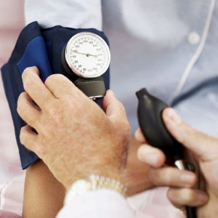
Lesson 2.9: Vital Signs
Unit 2: Nutrition & Fitness
Notes:
Overview: This lesson will provide students with a basic foundation in the 4 common vital signs: pulse, respiration rate, blood pressure, and temperature. They will begin by assessing their own background knowledge and applying it to an emergency scenario. Next, they will read about each vital sign and study tables of the normal value ranges broken down by age group. For practice, they will assess people of varying ages in four scenarios to determine if their vital signs are high, low, or normal. A similar format for assessment will follow along with a homework assignment to take their own pulse and respiratory rate before, during, and after exercise.
Image source: http://bloodpressuremonitorsnow.com/category/blood-pressure-monitor-cuffs/

Slide 2
Do Now
What signs would you look for to know if someone was alive?
If you knew a person was alive, but were not sure if they were healthy or not, what signs would you look for?
When you go the doctor, what are some of the things they measure at the beginning of the visit?
Notes:
Students will most likely name pulse and breathing. These are the two main indicators of life. The ABC’s are used to assess an unconscious person: A = Airway, B = Breathing, C = circulation. Students may be less likely to mention blood pressure or pulse. That’s okay, because these vital signs are taken later once airway, breathing, and circulation is established.
Image source: www.nursinguniforms.net

Slide 3
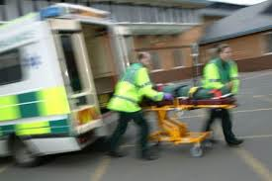
Discuss
You are a paramedic team responding to a call. You arrive at the scene to find a woman who has a gunshot wound to the leg. As you approach her she is lying on the ground with her eyes closed and a pool of blood is forming around her leg. What are the steps you would take to ensure she is alive and getting the proper emergency care before she arrives at the hospital?
Notes:
Any answers are acceptable; this is just a thinking exercise. Allow small groups to share answers aloud, if time permits. One way to do this is to have the first team present, and each subsequent group only explains what they would do differently. Instruct them to focus on major differences.

Slide 4
4 Common Vital Signs
(1) Pulse
(2) Respiratory Rate
(3) Blood Pressure
(4) Temperature
Notes:
These are the common vitals taken in a clinical setting. A paramedic would actually look for a slightly different set of vitals: pulse (rate & pattern), respirations (rate & pattern), blood pressure, skin condition (color, temperature, condition..), and pupils.
Image source: http://www.epmonthly.com/whitecoat/2010/05/florida-verdict-threatens-ems-availability/ambulance-2/

Slide 5
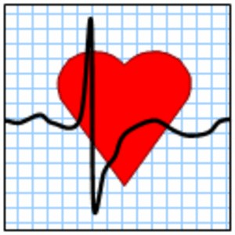
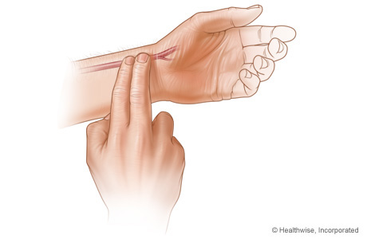
(1) Pulse
Notes:
How to check pulse: Use your fingers when finding a pulse. Don't use your thumb when finding it, as it has its own pulse.
Find the radial pulse. This is also known as the pulse on the inside of the wrist. Use the pads of two fingers. Place these just below the wrist creases at the base of the thumb. Press lightly until you feel a pulse (blood pulsing under your fingers). If necessary, move fingers around until you feel the pulse.
Find the carotid pulse. To feel a pulse on the side of the neck, place two fingers, preferably your index and middle finger, in the hollow between the windpipe and the large muscle in the neck. Press lightly until you feel a pulse.
(From http://www.wikihow.com/Check-Your-Pulse)
Image source: www. healthyheartexperts.com & webmd.com

Slide 6
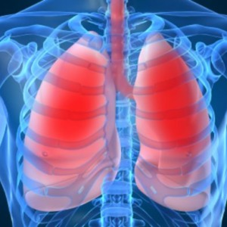
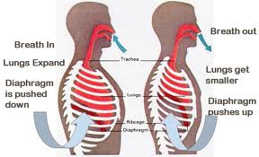
(2) Respiratory Rate
Notes:
How to check respiratory rate: Observe the rise and fall of the victim's (or patient’s) chest and count the number of respirations out loud for one full minute. One respiration consists of one complete rise and fall of the chest, or the inhalation and exhalation of air. (From: http://www.wikihow.com/Measure-and-Record-Respiratory-Rate)
Image source: http://blog.corewalking.com/perfect-posture-part-2-breathe-fully/

Slide 7
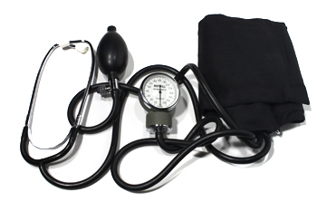
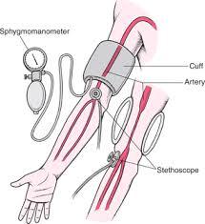
(3) Blood Pressure
Notes:
Taking blood pressure requires a sphygmomanometer (blood pressure cuff) and is a bit more complex. For more information on how to take blood pressure, look online. One step-by-step tutorial can be found at: http://www.webmd.com/hypertension-high-blood-pressure/monitoring-blood-pressure
Image source: http://www.whiteriverclinic.com/Our_Providers.html AND http://www.merckmanuals.com/home/heart_and_blood_vessel_disorders/high_blood_pressure/high_blood_pressure.html

Slide 8
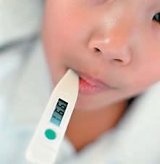
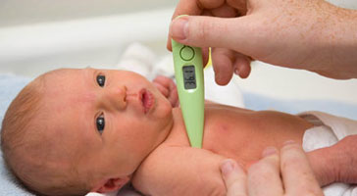
(4) Temperature
97.8 - 99.1 degrees Fahrenheit
Average: 98.6 degrees Fahrenheit
Notes:
Using a digital thermometer: You can use a digital thermometer in three ways: Oral (in the mouth), Rectal (in the bottom), or Axillary (under the arm)
Taking your temperature orally with a digital thermometer: Wash your hands with soap and warm water. Use a clean thermometer, one that has been washed in cold water, cleaned with rubbing alcohol, and then rinsed to remove the alcohol. Do not eat or drink anything for at least five minutes before you take your temperature. You should keep your mouth closed during this time. Place the thermometer tip under the tongue. Hold the thermometer in the same spot for about 40 seconds. Readings will continue to increase and the F (or C) symbol will flash during measurement. Usually, the thermometer will make a beeping noise when the final reading is done. If you are keeping track, record the temperature and the time. Rinse thermometer in cold water, clean it with alcohol, and rinse again.
(From: http://my.clevelandclinic.org/symptoms/fever/hic_how_to_take_your_temperature.aspx)
Image source: http://jespyhouse.org/flutemp.htm ANDhttp://www.nhs.uk/Conditions/pregnancy-and-baby/Pages/how-to-take-your-babys-temperature.aspx

Slide 9
High, Low, or Normal?
1. A female infant spikes a 102.1 degree Fahrenheit fever. When she is taken to the emergency room, her heart rate is 124 beats/min, respirations are 38 breaths/min and her blood pressure is 85/60.
Notes:
Temp: High; Pulse: High (slightly); Resp: Normal; BP: Normal
Image source: http://newsfeed.time.com/2013/09/17/a-dj-school-for-babies-in-brooklyn/

Slide 10
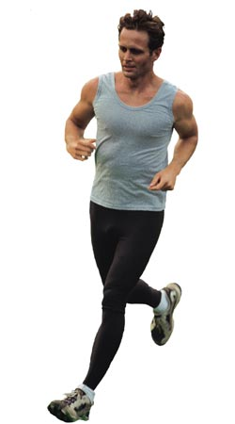
High, Low, or Normal?
2. A 21-year-old athlete runs track in college. He visits the doctor for a routine physical and his vital signs are taken as: pulse: 54 beats/min, respiratory rate: 12 breaths/min, blood pressure:120/80.
Notes:
Pulse: Low (slightly; but this can be normal for an athlete); Resp: Normal; BP: Normal
Image source: http://goddard.littletonpublicschools.net/Default.aspx?tabid=2458

Slide 11
High, Low, or Normal?
3. An eighty-three-year-old man has a history of heart disease and diabetes. In his assisted living home, a nurse monitors his vitals daily. Today he has a temperature of 98.8 deg F, a pulse of 102 beats per minute, a respiratory rate of 15 breaths per minute, and a blood pressure of 140/90.
Notes:
Temp: Normal; Pulse: High (slightly); Resp: Normal; BP: High

Slide 12
High, Low, or Normal?
4. An six-year-old girl develops a sore throat, but still begs her mom to let her go outside. Her mom, a trained nurse, agrees as long as her vitals are normal. Her temperature is 99.5 deg F, her blood pressure is 100/70, her pulse is 76 beats per minute her respiratory rate is 20 breaths per minute.
Notes:
Temp: Normal; Pulse: Low (slightly); Resp: Normal; BP: Normal
Image source: http://www.sxc.hu/photo/655108

Slide 13
High, Low, or Normal?
1. Pulse of 65 beats per minute in a 34-year-old female:
2. Respiratory rate of 18 breaths per minute in a 6-month-old baby:
3. Temperature of 99.8 deg F in a 15-year old male:
4. Blood pressure of 86/52 in a 7-year-old female:
5. Pulse of 85 beats per minute in a 3-day-old newborn:
6. Respiratory rate of 26 breaths per minute in a 74-year-old male:
7. Temperature of 101.4 deg F in an 80-year-old female:
8. Blood pressure of 150/100 in a 45-year-old male:
Notes:
Answer Key:
1. Normal; 2. Low; 3. Normal; 4.Low (diastolic only); 5. Low; 6. high; 7. High; 8. High

Slide 14
Homework:
Pulse: Use the pads of two fingers. Place these just below the wrist creases at the base of the thumb. Press lightly until you feel a pulse (blood pulsing under your fingers). If necessary, move fingers around until you feel the pulse.
Respiratory Rate: Count the breaths you take in one minute. One inhale plus one exhale counts as one total breath.
Notes:
The purpose of this homework is for students to practice taking the basic vital signs that do not require any equipment. It will also give them a sense of one of the factors that affects these vitals (exercise) and how the vital changes with that factor.

