Slide 1
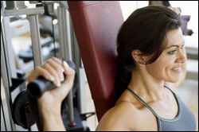
Lesson 2.7: Exercise
Unit 2: Nutrition & Fitness
Notes:
This lesson focuses on physical activity principles for adolescents. Students will begin using their scientific reasoning skills to interpret a complex graph depicting calorie expenditures and intakes for various workout types. They will then read a story depicting the evolution of one young girls’ fitness and physical health. Next, students will review the benefits of exercise and discuss why so many people do not exercise. After reviewing the FITT principle, the components of physical fitness, and the CDC’s recommendations for physical activity for adolescents, students will take a short assessment and then come up with their own FITT plan.
Image source: http://www.cdc.gov/physicalactivity/everyone/guidelines/adults.html

Slide 2
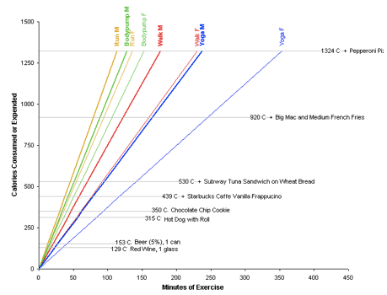
Do Now
Notes:
Answers: 1. Approx 650-700 2. 530 + 439 = 969 3. 920, 600 4. Approx 225 5. 350 + 315 = 665 cal, Approx 70min
Questions:
1. Approximately how many calories does a female expend doing 200 minutes of yoga?
2. How many calories are consumed by eating a Subway tuna sandwich and a vanilla frap combined?
3. How many calories are consumed by eating a Big Mac and medium fry and expended when a male runs for 1 hour, respectively?
4. Approximately how many minutes of walking would a female need to do in order to burn off a pepperoni pizza?
5. Approximately how many minutes of body pump would a male need to do in order to burn off a hot dog and chocolate chip cookie?

Slide 3
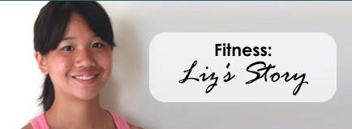
Liz’s Story
I have to admit that I wasn't always physically fit. I was a scrawny little kid who was always the shortest and most petite in my class. My mom had always feared that if I played competitive sports; I'd get hurt by aggressive players. So I wasn't very athletically involved during my childhood…..
Source: Kids Health, http://kidshealth.org/teen/food_fitness/exercise/fitness_liz.html#cat20512
Notes:
Some options for reading: Snake around the room in order, toss a soft ball to the next reader, independently read, partner read-aloud (quietly), or read for homework.

Slide 4
Post-Reading Questions:
What were some of the physical, mental & social effects of Liz’s decision to get into shape?
Does being physically fit happen naturally or quickly? Why or why not? Use evidence from the story?
Can you relate to Liz’s story at all? Why or why not?
Notes:
Answers will vary. The purpose of this story is to give students a personal connection so that they remember that the concepts they are studying (fitness & exercise) are a very direct and real part of their lives. This would be a great opportunity to ask a few students to share their own personal fitness histories or stories.

Slide 5
Benefits of Physical Activity:
According to the CDC, the following benefits can be achieved by getting the regular amount of recommended exercise:
Control weight
Reduce risk of cardiovascular disease
Reduce risk for Type 2 diabetes and metabolic syndrome
Reduce risk of some cancers
Strengthen bones & muscles
Improve mental health and mood
Improve ability to do daily activities (and prevent falls), for older adult
Increase chances of living longer
Notes:
Ask: Can you think of other benefits you have heard or read about that are not listed here? What are the possible negative effects of exercise? (injury, time commitment, danger if exercising in unsafe area or with unsafe equipment, etc.)

Slide 6
Discuss:
Given all of these health benefits, why does the average American still struggle to get in an adequate amount of exercise?
For adolescents, in particular, which of the health benefits above would be most important? Can you think of any other health benefits not listed that would appeal more to a younger person?
A friend argues that exercise doesn’t matter and claims that the best way to lose weight is just to focus on a balanced and healthy diet that does not exceed your recommended number of daily calories. What would you say to this friend?
Notes:
Answers will vary! Question #3 can be addressed as a group, especially if there is disagreement among students or they cannot seem to find evidence for their answer. Explain that the very simple equation that governs weight loss is: Calories Burned > Calories Eaten = Weight Loss. Then ask students what the opposite of this equation would be. So in summary, what we eat is a bigger contributor for many people to their overall weight. However, the other benefits of exercise AS WELL as the accumulation of calorie burning from a very active lifestyle still do make exercise just as important as diet for overall health.

Slide 7
The FITT Principle
If your goal is to improve your physical fitness level, would the FITT Principle be helpful to you? Why or why not?
Notes:
A good resource to expand a bit on this is at: www.ode.state.or.us/teachlearn/subjects/pe/curriculum/fittprinciple.pdf‎

Slide 8
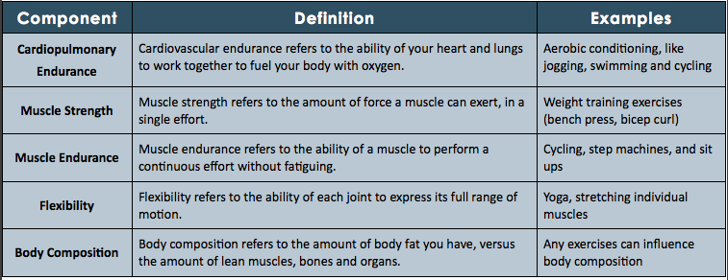
The 5 Components of Fitness
Which components of fitness do you think health experts recommend that children and adolescents get the most?
Adapted from www.fitday.com
Notes:
The information at the URL listed here provides a guide for someone who may be going to a gym to join as a member or starting a training period with a new personal trainer and gets these components measured in their initial evaluation.
http://www.fitday.com/fitness-articles/fitness/body-building/the-5-components-of-physical-fitness.html#b

Slide 9
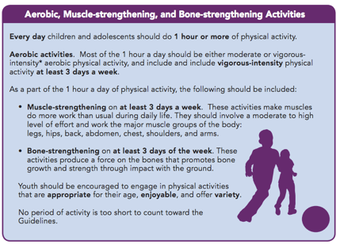
Physical Activity Recommendations
Children & Adolescents should get:
Source: CDC.gov
Notes:
For more information go to: http://www.cdc.gov/physicalactivity/everyone/health/index.html

Slide 10
Assess:
1. What are the 5 components of physical fitness?
2. What does muscle endurance mean?
3. In the FITT principle, what does Intensity mean?
4. Which of the following is not a benefit of physical activity?
Notes:
ASSESS Answers:
1. A; 2. C; 3. D; 4. B

Slide 11
Homework:
Create a FITT plan for one week
Do the exercises (at LEAST once!)
Answer the following questions when you are done:
How did you feel before working out? Physically, mentally, and socially?
How did you feel after working out? Physically, mentally, and socially?
What were the immediate benefits of working out? Eventual benefits?
What were the immediate challenges of working out? Eventual challenges?
Why might it be a challenge to keep up your FITT plan daily?
Notes:
The purpose of this homework is to take the principles of physical activity and apply them to their own life. This assignment will be easy for the active students in the class and may pose slight challenges for inactive students. Encourage students to find a “workout buddy” if they need someone to help them stay motivated and accountable. Additionally, this may make the assignment more fun.

