Slide 1
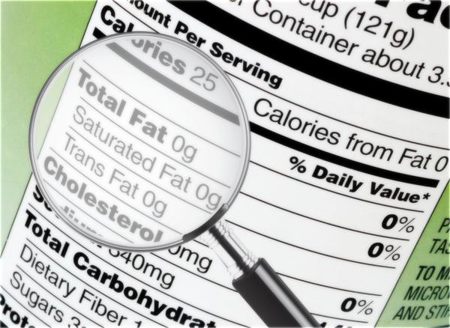
Lesson 2.3: Food Labels
Unit 2: Nutrition & Fitness
Notes:
This lesson provides a breakdown of the food label, an often misunderstood and underutilized tool for health literacy, by focusing on four components of the label: serving size, calories, percent daily values, and ingredient lists. Students will warm up by guessing how many calories are contained in some common foods and burned during activities. They will complete a short reading and/or thinking activity for each of the four components of the label. They will practice putting all these parts together in the practice assessment at the end and complete more analysis of labels for homework.
Image Source: https://www.healthtap.com/user_questions/891769-the-nutrition-facts-on-a-food-has-carbs-and-then-sugar-do-they-mean-the-simple-sugars-aka-monosacharides-glucose-fructose-and-galactose

Slide 2
Do Now
How many calories are in…
1. an apple? ______
2. a slice of pizza? ______
3. a scoop of ice cream? ______
4. a cup of broccoli? ______
5. a bagel?
How many calories does your body use when you…
6. run a mile?
7. walk a mile? ______
8. laugh? ______
The average person should intake _______ calories everyday to maintain their current weight.
Notes:
Answers:
110; 2. 375; 3. 200; 4. 40; 5. 230; 6. 125; 7. 90; 8. 2
(2000 calories; emphasize that this is the AVERAGE, so that means the majority will need more or less depending on age, body size, and activity level)
Image source: http://eofdreams.com/apple.html

Slide 3
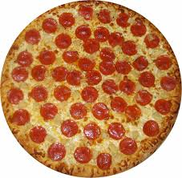
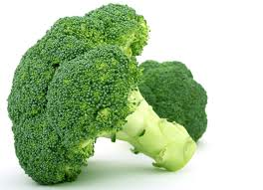
Discuss
Compare your estimates with a partner.
For which questions were your estimates furthest apart?

Slide 4
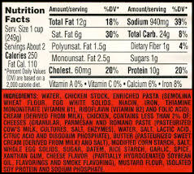
4 COMPONENTS OF FOOD LABELS
WHERE IS IT ON THE FOOD LABEL?
Serving size
Calories
Percent Daily Values
Ingredients

Slide 5
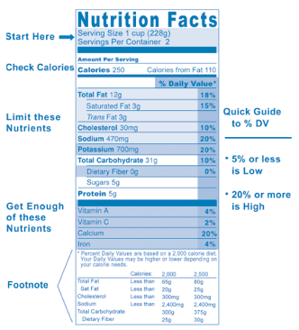
FOOD LABEL PREVIEW:
Notes:
Tap into students’ background knowledge here. Also, connect to the 3 classes of nutrients. Have them identify where carbs, fats, and proteins are located.

Slide 6
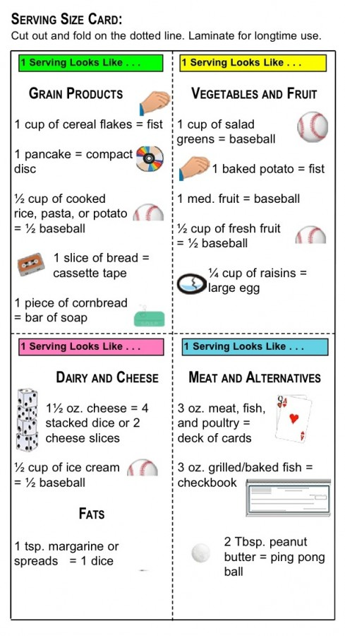
1. SERVING SIZE
Portion
Serving
Single portion, multiple servings

Slide 7
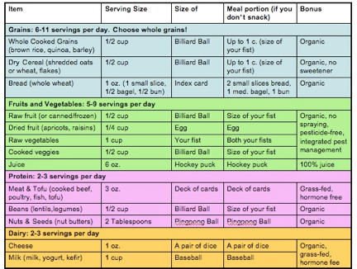
What’s in a Serving Size?
Notes:
What is the size of 1 serving of dry cereal? ½ cup (billiard ball)
What is the size of 1 serving of bread? 1 oz (1 small slice, index card) About how many servings of bread are in a typical sandwich? 2
How much is 1 serving of raw fruit? ½ cup (billiard ball)
What is the size of 1 serving of juice? 6 oz (hockey puck)
How much is 1 serving of raw vegetables? 1 cup (fist) How much is 1 serving of cooked vegetables?1/2 cup (billard ball)
What is the size of 1 serving of meat? 3 oz (deck of cards) How many servings of meat are in a typical hamburger? 2
What is the maximum amount of milk a person should drink in 1 day, in cups? 3 cups
What is the maximum amount of nuts a person should eat in 1 day, in tablespoons? 6 tablespoons

Slide 8
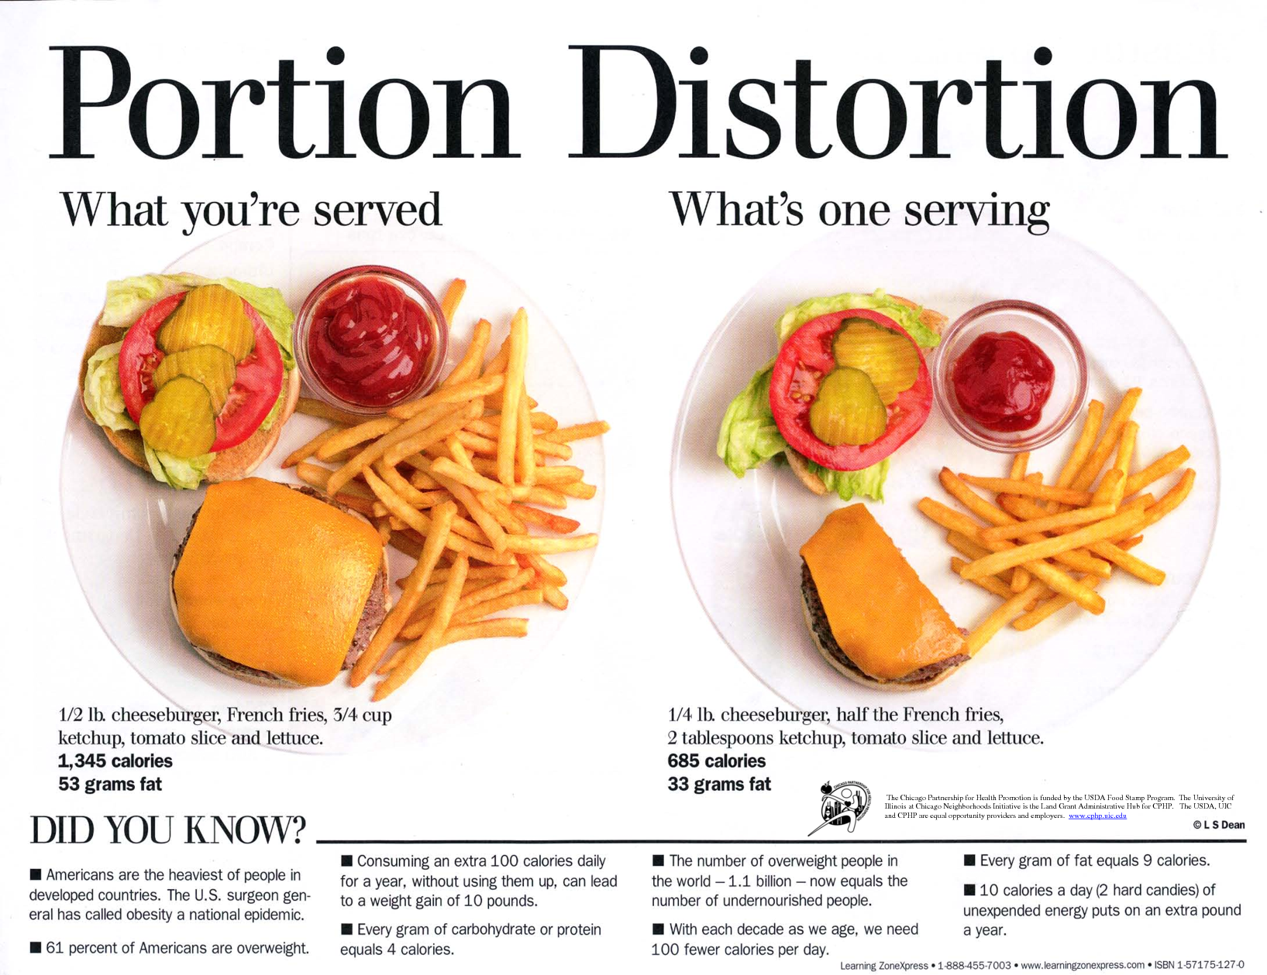
Discuss:
What was most surprising to you about the true nature of serving sizes?
Do you follow these serving sizes? Why/why not? Which food was most surprising to you?
Why are the objects above given as examples of serving sizes?
Notes:
Image source:http://www.appforhealth.com/2012/09/perfect-portions/

Slide 9
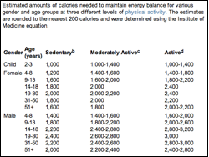
2. CALORIES
How many do YOU need?
I am a ____ year old __________ (gender) who is _________________ (activity level) so I need approximately ________ calories per day.

Slide 10
3. PERCENT VALUES
based on a 2,000-calorie diet for healthy adults
General guide:
If a food has 5 percent or less of a nutrient, it's considered to be low in that nutrient.
If it has 20 percent or more, it's considered to be high in that nutrient.
FDA has not set a Daily Value for trans fat, and health experts recommend avoiding trans fat to lower your risk of cardiovascular disease.
Similarly, there is no established Daily Value for sugar.
Use Percent Values to choose foods high in vitamins, minerals and fiber — and to limit foods high in fat, cholesterol and sodium.

Slide 11
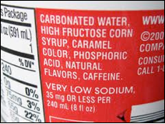
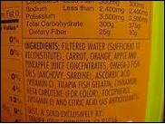
4. INGREDIENTS
Product #1
Product #2
Notes:
Questions & Answers:
1. What products do you think these ingredient lists are for? Coke, OJ
2. What ingredients are present in these products in the largest quantity? Carbonated water, filtered water
3. Are there any ingredients that you’ve never seen in real life before? List them here:
4. Would you recommend either of these products to a friend who is trying to maintain a nutritious diet? Why/why not?
5. Which of these products do you think is the healthier choice? Why?
6. Where might your find nutrition information for foods without labels (produce, fast foods)? (can ask at store/restaurant, can go online)

Slide 12
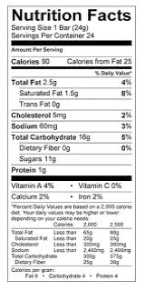
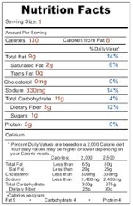
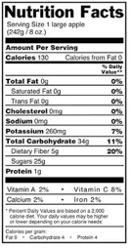
Assess:
Snack #1: Flamin’ Hot Cheetos
Snack #2: Chewy Granola Bar
Snack #3: Apple
Notes:
Questions & Answers:
Which of the snack choices is the best source of Vitamin C? Apple
Which of the snacks would you choose to help regulate your digestion? Why? Apple (fiber)
Which of the snacks would provide you with the 2nd highest amount of energy for working out? Why? Chewy (carbs)
Which of the snacks would provide with the most muscle building power? Why? Cheetos (protein)
Order the snacks from least likely to give you high blood pressure, to most likely to give you high blood pressure. Cheetos, Chewy, apple (sodium)
Which of the snacks would you recommend to a friend who is trying to adhere to a nutritious diet? Why? Apple (fiber, slow release of blood sugar, vitamins, few calories, etc.)

Slide 13
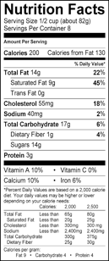
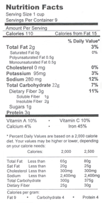
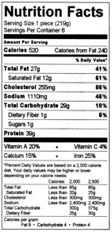
Homework:
LABEL #1
LABEL #2
LABEL #3
Notes:
Questions & Answers:
For labels 1 and 2, how many cups are equal to one serving? ½ cup, 1 cup
How many calories would be in 1 cup of food according to label 1? 400
According to each label, one serving provides what percent of recommended total fat intake for a person eating a 2,000 calorie diet? 22%, 3%, 41%
Which type of food (#1, #2, or #3) provides the highest percent of daily value for each of the following? Vitamin A? #3 Fiber? #2 Cholesterol? #3 Sugar? #1
Order the foods from lowest to highest, respectively. Total Fat? 2,1,3 Total Carb? 1,2,3 Sugar? 2=3, 1 Sodium? 1,2,3
Keeping in mind all of the information on the food label, order the foods from healthiest to least healthy. #2, #1, #3

