Slide 1
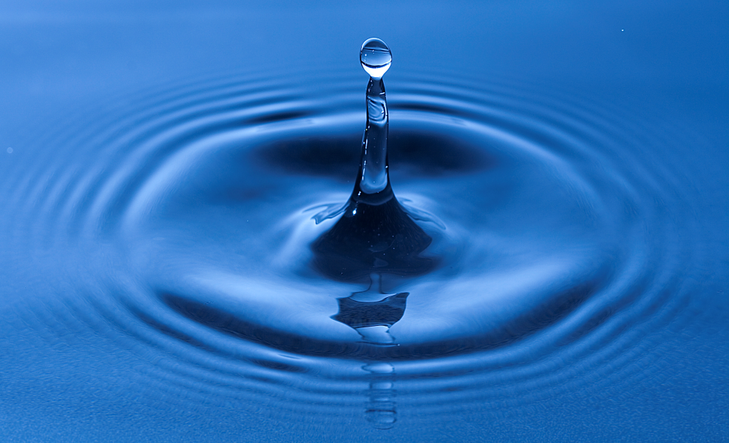
Lesson 13.3: Clean water
Obj. 13.3: Discuss costs, limitations, and benefits of possible interventions for global health issues.
Module 13: Global Health
Notes:
Overview: Students will demonstrate an understanding of the global clean water crisis upon completion of this lesson. Students will begin by grappling with some statistics, identifying causes and effects of unclean water. Next they will reflect upon their level of awareness and power (or perceived powerlessness) to address this global health issue. Finally, they will engage in a “roundtable” discussion where they will bring some basic background research on a particular clean water related topic to the conversation.
Image source: http://commons.wikimedia.org/wiki/File:Water_drop_impact_on_a_water-surface_-_(1).jpg

Slide 2
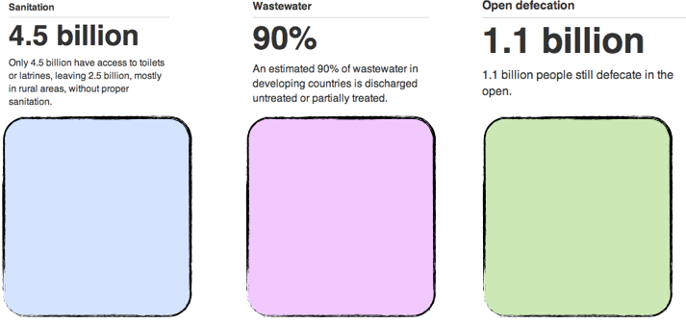
Do Now: The Global Water Crisis
List some causes and health effects you think might result from each of the WHO statistics below. (Source: http://www.who.int/water_sanitation_health/sanitation/action/en/)
Notes:
Check students background understanding on the following: define a latrine, what is wastewater?, untreated vs. partially treated wastewater (why do we need to “treat” it and what does this mean?), what does “defecate in the open” mean?

Slide 3
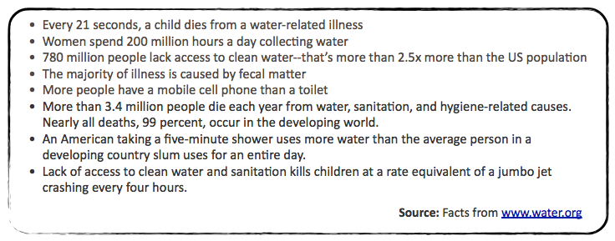
Out of Sight, Out of Mind?
With a partner, read through the additional statistics below and discuss the following questions: Were you aware of this global health crisis? How do you feel after reading these statistics? Why don’t you think our global society has collectively taken more action to improve safe drinking water and sanitation in our world?
Notes:
Very few students, if any, may already be aware of the extent of the global water quality problem. Use this opportunity to get them to also reflect on the reasons Americans are often unaware of global realities.

Slide 4
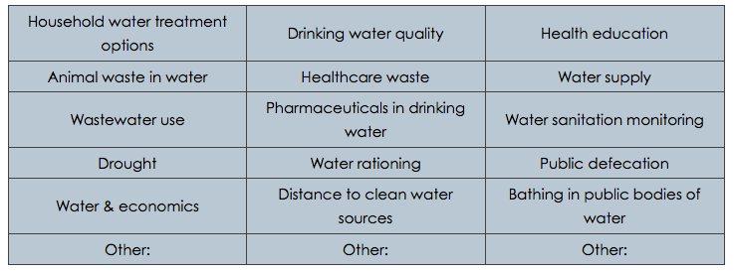
Water Issues Roundtable
Choose ONE of the following issues to bring to a class roundtable discussion on water issues. You will have approximately 1 minutes total to report out on your issue, and then you will pose a thought-provoking question to the audience and there will be a brief discussion. In your initial summary of the issue consider briefly addressing: WHAT the issue is, WHO is affected, WHEN it began or worsened, WHERE people are most affected, WHY it has not yet changed, and HOW we can change it in the future for people affected in the world. Then address the costs, limitations, and possible benefits of proposed solutions.
Notes:
Students can also propose their own topics. The type of information and understandings students will bring to the “roundtable” will vary greatly, as the prompt is fairly open ended. That is okay! It will add depth, variety, and context to the discussion. If the class conversation seems to ramble or jump around at the start, pause students and say something like: “When you present, try to make connections to previous topics or comments made by other students.

Slide 5
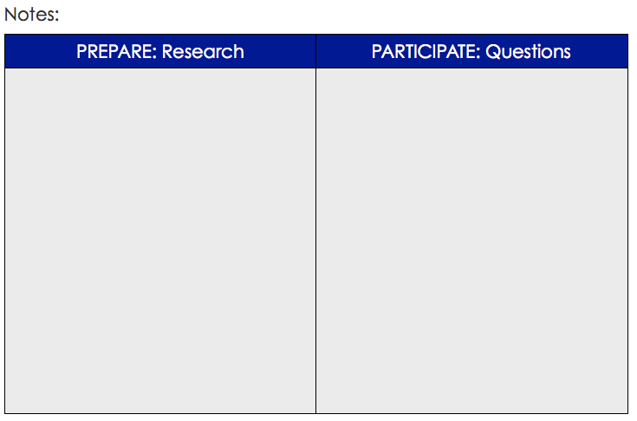
Water Issues Roundtable

Slide 6
Homework: Taking Action
Research ways that you can take action to help improve global drinking water and sanitation issues. Compare two different possible actions you could take, listing the costs, limitations, and possible benefits of each. Then write a final reflection about how you feel as a result of this lesson.
Notes:
The purpose of this homework assignment is to give students a chance to practice critiquing interventions in terms of cost, limitations, and benefits. For example, if a student finds an organization that sells water bottles for $35 but gives $10 of that cost to community efforts in villages in Africa to support development of clean drinking water infrastructure, what are the costs, benefits, and limitations of this action?

