Slide 1
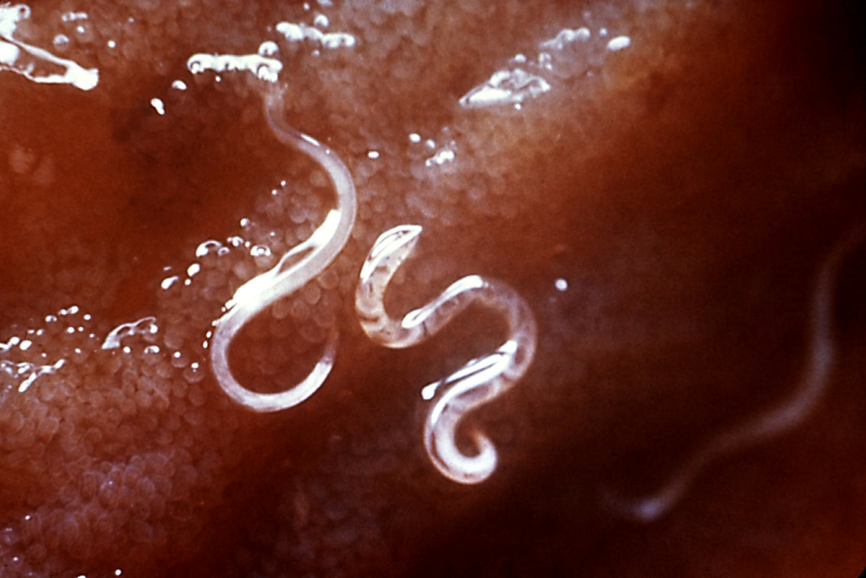
Lesson 13.2: Parasitic Infections
Obj. 13.2: Identify the types and characteristics of common parasitic infections.
Module 13: Global Health
Notes:
Overview: Students will explore the variety and nature of parasitic infections. They will begin by brainstorming any parasites they have heard of. Then they will discuss why certain countries or region experience a greater burden of parasitic infections. Next, students will read some background on parasitic infections and conduct their own background research on malaria and four other neglected tropical diseases (NTDs).
Image source: http://en.wikipedia.org/wiki/Helminths

Slide 2
Do Now: Dreaded Parasites
A parasite is an organism that lives on or in a host organism and gets its food from or at the expense of its host. Have you ever had a parasitic infection? (You don’t have to answer or give details!) In the bug below, list as many parasitic infections as you can think of. If you aren’t sure, take some guesses.
Notes:
Students may be able to come up with a few common ones like fleas, lice, tapeworm, etc. If many in the class get stuck, have them take a step in a different direction by thinking about what they think defines a parasite.

Slide 3
The Geography of Parasitic Disease
Why do you think certain countries experience a greater burden of parasitic infections than others? Discuss and list as many reasons as you can hypothesize in the space below.
Notes:
Possible reasons: Climate, sanitation (standing water for mosquito breeding, public bathing in bodies of water, etc.), lack of basic hygeine access (handwashing/soap, etc.), crowded living conditions, etc.

Slide 4
What are Parasitic Infections?
Read the following overview of parasitic infections from the CDC:
A parasite is an organism that lives on or in a host and gets its food from or at the expense of its host. Parasites can cause disease in humans. Some parasitic diseases are easily treated and some are not. The burden of these diseases often rests on communities in the tropics and subtropics, but parasitic infections also affect people in developed countries. There are three main classes of parasites that can cause disease in humans: protozoa, helminths, and ectoparasites.
Notes:
If a computer & projector are available, google some basic images of the different types as the students read about each one. These are likely to draw lots of “oohs and ahhs” and keep students engaged.

Slide 5
What are Parasitic Infections?
Protozoa are microscopic, one-celled organisms that can be free-living or parasitic in nature. They are able to multiply in humans, which contributes to their survival and also permits serious infections to develop from just a single organism.
Helminths are large, multicellular organisms that are generally visible to the naked eye in their adult stages. Like protozoa, helminths can be either free-living or parasitic in nature. In their adult form, helminths cannot multiply in humans.
Ectoparasites can broadly include blood-sucking arthropods such as mosquitoes (because they are dependent on a blood meal from a human host for their survival), but this term is generally used more narrowly to refer to organisms such as ticks, fleas, lice, and mites that attach or burrow into the skin and remain there for relatively long periods of time (e.g., weeks to months).

Slide 6
What are Parasitic Infections?
Parasitic infections cause a tremendous burden of disease in both the tropics and subtropics as well as in more temperate climates. Of all parasitic diseases, malaria causes the most deaths globally. Malaria kills approximately 660,000 people each year, most of them young children in sub-Saharan Africa.
The Neglected Tropical Diseases (NTDs), which have suffered from a lack of attention by the public health community, include parasitic diseases such as lymphatic filariasis, onchocerciasis, and Guinea worm disease. The NTDs affect more than 1 billion people—one-sixth of the world's population—largely in rural areas of low-income countries.
Source: CDC <http://www.cdc.gov/globalhealth/ntd/>

Slide 7
Know Your Bugs
In the table on the following page, identify the basic facts below about each parasitic infection, all of which are NTDs besides malaria. Use the www.CDC.gov and any other credible health information sites to find your information.
Acquired: How do humans commonly come in contact with and acquire the parasitic infection?
Transmitted: How is the parasitic infection passed on from one human to another? Are there intermediary hosts or environments involved?
Life Cycle: How does the parasite grow and reproduce? How long does it survive in each phase of it’s life cycle and where does it live in these stages?
Epidemiology: Where is the parasitic infection clustered geographically? What is common among those most likely to acquire it? Why is it more easily spread in these conditions?
Other: What other important or interesting information did you learn about this parasite?
Notes:
Computer/tablet & internet access will be needed Consider allowing students to work in groups and divide and conquer if they prefer. They could each take one parasite or each take one category. Some students may prefer to work in groups all together on the same pace, in pairs, or on their own. These decisions may be limited based on technology available

Slide 8
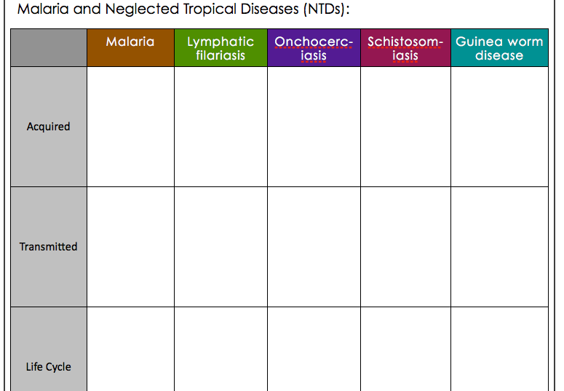
Know Your Bugs
Notes:
The CDC website is a great launch point for students’ research. Direct them to:
Malaria: http://www.cdc.gov/malaria/
NTDs: http://www.cdc.gov/globalhealth/ntd/

Slide 9
Homework: Neglected Parasitic Infections (NPIs) in the U.S.
The CDC has identified five NPIs in the U.S. that have been targeted for action based on the number of people infected, severity of the disease, and ability to prevent and treat the disease. Select one of the five diseases below and visit the CDC website (http://www.cdc.gov/parasites/npi/index.html) and other credible sources to learn more. Then design a billboard PSA informing the public about the NPI.
Chagas disease
Cysticercosis
Toxocariasis
Toxoplasmosis
Trichomoniasis
Notes:
Although this module is global health focused, this homework assignment will help students relate the learning to problems on a domestic level as well. It will also give them perspective on health in the US vs. other poor nations. They should realize that although the NPIs in the U.S. are definitely a concern, the extent of the impact on total population health pales in comparison with the global health burden of parasitic infection.

