Slide 1
Lesson 13.1: Intro to Global Health
Obj. 13.1: Discuss the problem of global health disparities.
Module 13: Global Health
Notes:
Overview: Students will discuss global health disparities through a variety of exercises. First, they will identify the global health issues they have heard of. Then they will read one definition of global health. Next they will engage in a discussion on the shifts in the way we speak about countries, focusing on the terms developed/developing. Finally, they will select a country and investigate its health issues in order to present to peers in a “Forum on Global Health.”
Image source: Flickr, https://www.flickr.com/photos/truthout/4005634583/

Slide 2
Do Now: What do you know about global health?
List global health issues that you have heard of (i.e. unsafe drinking water, HIV/AIDS, etc.) in the spaces around the globe in the box below. List as many as you can think of.
Notes:
If students are “stuck,” ask them to think about news stories, commercials (i.e. Save the Children), and issues in our own country’s health care system that they may have heard about in reference to other countries as well.

Slide 3
What is Global Health?
Global health is the health of populations in a global context; it has been defined as "the area of study, research and practice that places a priority on improving health and achieving equity in health for all people worldwide.”
Koplan JP, Bond TC, Merson MH, et al. (June 2009). "Towards a common definition of global health". Lancet 373 (9679): 1993–5.
Notes:
Ask students if they have anything to add to the definition of global health presented here.

Slide 4
Naming Countries: Developed vs. Underdeveloped/Developing
There has been recent controversy about the continued use of the terms “developed” (for Western nations which typically have advanced economies, less poverty, and better healthcare) and “developing” or “underdeveloped” (for countries with high rates of poverty, less advanced infrastructure/economies, & poor health outcomes). Why do you think these terms, which were coined in the 1960’s are falling out of favor?
Notes:
The opinion piece “CHanging world: why developing vs. developed is now meaningless” by Hans Rosling. <http://www.cnn.com/2013/12/10/opinion/gapminder-hans-rosling/> has an interesting and useful perspective on this issue.

Slide 5
Investigating Health Around the World
Challenge: Gather research on a country with great health needs in order to present information at a worldwide “Forum on Global Health.”
1. With a partner, select a country (each country should only be chosen by ONE pair in the class) The country should be classified by the world bank as a low-income or lower-middle income economy.
Link: http://data.worldbank.org/about/country-classifications/country-and-lending-groups.
2. Locate the country on the map and place a pin or marker on it.
3. Research the health landscape & health status of populations in that country.
a. What are the major health issues that lead to morbidity (illness) and mortality (death)?
b. What populations are most vulnerable?
c. Does the country have any POSITIVE health measures or outcomes, as compared to other nations with similar income?
d. What previous initiatives, programs, or interventions have been used in the past or currently to improve health outcomes? Were they successful or not? Why?
e. What health infrastructure & services are lacking or needed?
4. What 3 top priorities should the country focus on to improve the health of its population? Why?
Notes:
Help moderate the country selection by giving students an easy process (i.e. coming up to board to write/declare chosen country, or something similar) to ensure student pairs are not doubling up on countries.

Slide 6
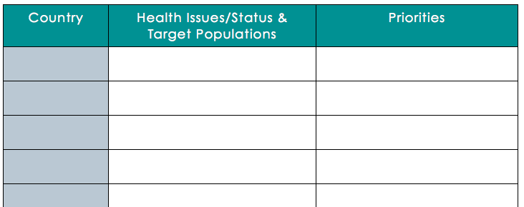
A Forum on Global Health
You are representing the country you investigated at a forum on global health disparities. Present your findings to your peers in a clear, compelling, and professional way. Use the following table to take notes on other countries as you listen to presentations.
Notes:
If possible, rearrange the room into a circular “roundtable” type configuration. Have students quickly make a tri-fold sign to place in front of them with their country name. Encourage students to use an additional sheet of paper to take further notes.

Slide 7
Greatest Priority
Based on the data and evidence in the presentations you heard, select ONE country you would most urgently prioritize for taking action to improve health. Outline your reasons in a 1-2 paragraph journal entry.
Notes:
The purpose of this homework assignment is to help students close the loop on the learning activity from class by reflecting up the notes they took and summarizing the best arguments. Students may quickly realize when doing this assignment that choosing just one country out of many with urgent health needs is difficult to impossible. This realization will help them better appreciate the difficulty inherent in the size and magnitude of global health disparities.

