Slide 1
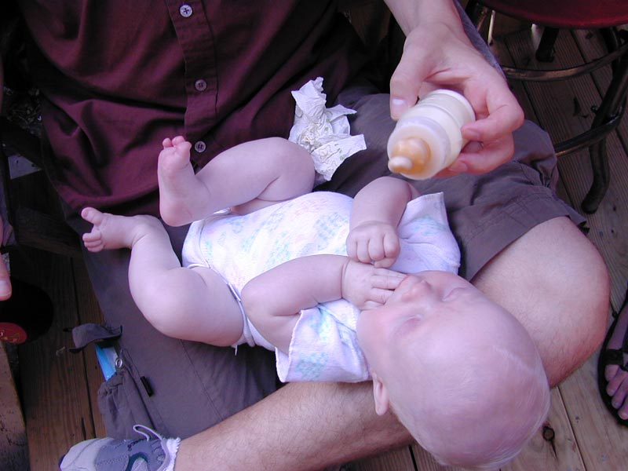
Lesson 12.3: Infant & Child Health
Obj. 12.3: Identify trends in child health and infant mortality using charts and graphs.
Module 12: Health Disparities
Notes:
Overview: This lesson will help students begin to piece together the puzzle of health disparities through analysis of data on infant & child health. Students will begin by brainstorming the causes of infant mortality and how these are linked to barriers & risk factors for different populations. Then they will analyze three sets of data to form conclusions. Finally, they will put all this together for come to one final, overarching conclusion about infant/child health & disparities.
Image source:

Slide 2
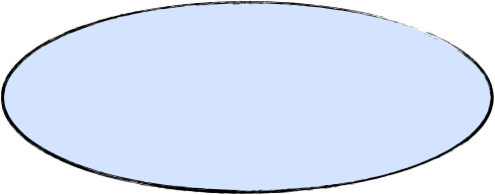
Do Now: Infant Health
Suppose you are a pediatrician You have decided to try to make a positive impact on health outcomes of your infant patients by addressing the most common causes of infant mortality (death) among your patients. You think that holding new parent education seminars might be the best way to prevent these deaths. In the circle below, brainstorm the top FIVE topics you would cover in these seminars. (NOTE: Your decision should be evidence-baed, of course, but for now just brainstorm the topics you think would be most important).
Notes:
DO NOW:
Provide a few examples to students who may be stuck getting started.
Examples: CPR, water/pool safety, nursing/feeding, choking, starting solids, sleeping & crib safety, home baby hazards, childproofing, navigating daycare, bathing, cold/flu signs, reasons to go to ER or call doctor, how to take temperature, immunizations, care seat safety, etc.

Slide 3
Discuss: Roots of Health Disparities
Assume you have carried out your five seminars for a group of 20 parents. Now brainstorm why these families still may be in danger of having an infant die from one of the main causes of infant mortality. In other words, besides education on health topics, what ADDITIONAL factors might influence the health of these families? Brainstorm with a partner, and list your ideas in the bubbles below.
Notes:
Examples: Education level (overall years of school/degrees) & ability to read (overall literacy); Income; Family/peer support; Health insurance status; Partner support; Other children/siblings in home; Neighborhoods/community safety; Proximity to grocery store, etc.

Slide 4
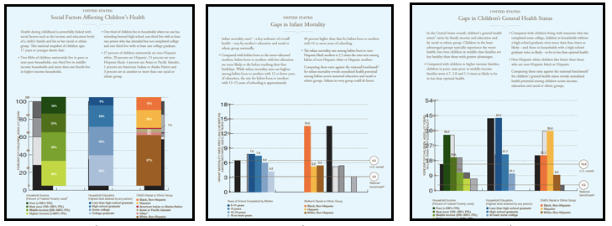
Trends in Infant Mortality & Children’s Health
Examine the 3 handouts with data on infant mortality and children’s health below. Use the data to answer the questions that follow and write a final conclusion.
Notes:
Data is compiled by Robert Wood Johnson Foundation and linked to Unnatural Causes site. It can be found in the handouts included in the lesson files or at:
PDF #1: http://www.commissiononhealth.org/PDF/fig1_78.pdf
PDF #2: http://www.commissiononhealth.org/PDF/fig2_78.pdf
PDF #3: http://www.commissiononhealth.org/PDF/fig3_78.pdf

Slide 5
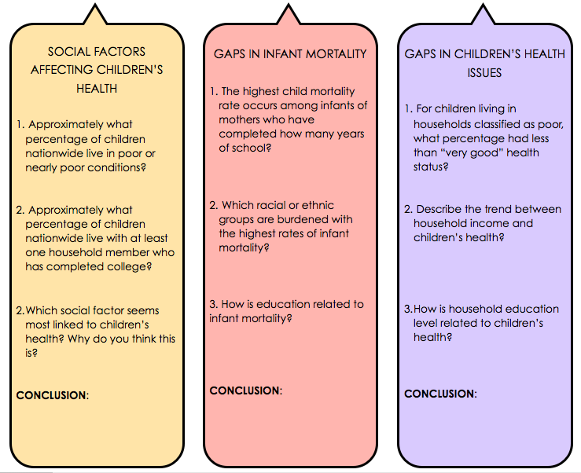
Trends in Infant Mortality & Children’s Health

Slide 6
Assess: Conclusions
Review your evidence-based conclusions from the graph analysis activity on the previous page. Write one overall conclusion tying in common themes from all three.

Slide 7
Homework: Specific Causes of Infant Mortality
Conduct research online to uncover the specific causes of infant mortality and answer the questions below.
1. List 3-5 most common causes of infant mortality from your research? (i.e. drowning)
2. How does this compare with your brainstormed list during the Do Now activity of this lesson?
3. Which causes were most & least surprising to you?
4. In what ways might income, education, and race/ethnicity linked to the main causes of child mortality?
5. What do you think should be done about this problem? At the individual level? Community level? City/state/national level?
Notes:
The purpose of this homework assignment is to help students bring the lesson back full circle. The lesson began with brainstorming reasons for infant mortality, then student explored the larger factors at play beyond specific details about infant mortality. This assignment will help them review these pieces of the puzzle as they conduct some additional brief research online.

