Slide 1
Lesson 11.6: The Underinsured
Obj. 11.6: Identify health insurance policy components that lead to financial burden and ‘underinsured’ status.
Module 11: Health Policy
Notes:
Overview:
Image source: http://openclipart.org/detail/70165/home-insurance-by-netalloy

Slide 2
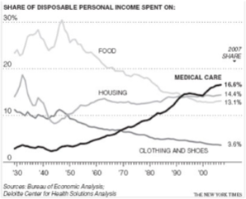
Do Now: Healthcare Spending
The Bureau of Economic Analysis tracked what Americans were spending their personal income on from 1930 to 2007 to determine the effects of health care costs on Americans. Write a conclusion for the graph below. Underline and identify your claim (C)-evidence (E)-warrant (W).
CONCLUSION:
Notes:
Ask students, “What factors do you think have led to the rising costs of medical care for Americans?” Consider using a Think-Pair-Share for this question.

Slide 3
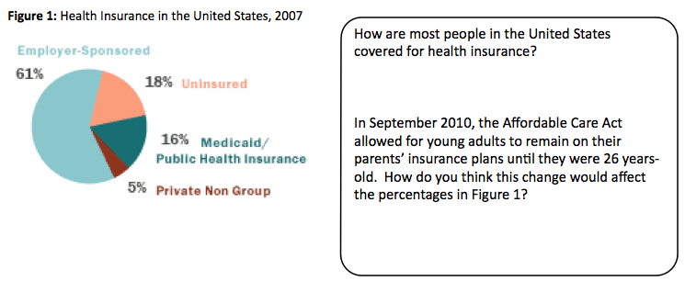
Do Now
Look at the following graph for the current state of health insurance in the United States.
Notes:
Ask students, “Where do you think the UNDERINSURED fit into this pie chart?”

Slide 4
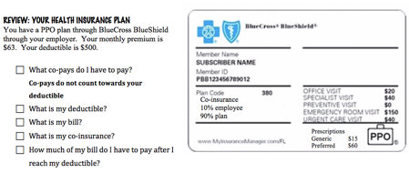
Discuss
Notes:
Ask students, “How many of you carry a health insurance card? How many have seen or examined your parents or guardians?”

Slide 5
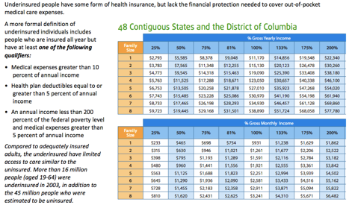
What defines the “Underinsured” status?
Notes:
There are many great websites with additional background information on the problem of the underinsured:
PBS: http://www.pbs.org/healthcarecrisis/uninsured.html
NPR: http://www.npr.org/blogs/health/2013/12/31/258670193/despite-health-law-many-people-may-be-left-underinsured
Kaiser: http://www.kaiserhealthnews.org/stories/2009/september/28/underinsured-explainer.aspx
The Commonwealth Fund: http://www.commonwealthfund.org/News/News-Releases/2011/Sep/Insured-and-Still-at-Risk.aspx
CDC: http://www.cdc.gov/nchs/fastats/hinsure.htm

Slide 6
Underinsured Scenarios
Mary’s medical expenses totaled $2,000. She makes $11,170 a year. Would Mary be considered underinsured? Explain.
2. Jose and his wife make $26,300 a year. Last year their total medical expenses totaled $2,000. Would Jose be considered underinsured? Explain.
Notes:
% = $2,000/11,170 = 0.17 = 17% (She is underinsured because her medical expenses are greaterthan 10% of her income.)
$2,000/26,300 = 7.6% (They are underinsured because their income is less than 200% of the poverty level & their medical expenses are greater than 5% of annual income)
)

Slide 7
The Impact of Underinsured
Overall, approximately 35 percent of adults in the United States are under- or uninsured. Both under- and uninsured adults are more likely to forgo (go without) needed care than those who have adequate coverage.
Rates of financial stress for the underinsured are similar to those for the uninsured. As the population of under- and uninsured patients has grown, the burden of caring for medically indigent (needy) patients has fallen primarily on state-supported or university referral hospitals, community health clinics, and other government-supported healthcare facilities.

Slide 8
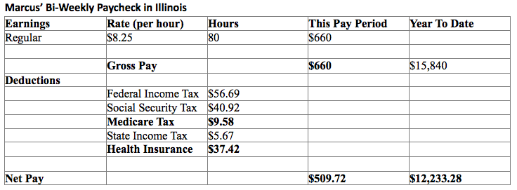
Marcus’ Story:

Slide 9
Marcus’ Story:
Marcus grew up in a small town in Texas. He is now in graduate school in Chicago where he is finishing his masters and working full-time at the university’s diversity office to pay for rent and other expenses before he gets a job. Since he is no longer eligible for his mother’s insurance, he has opted into a PPO insurance plan at the university. Marcus has a $500 yearly deductible. After meeting his deductible, he must pay 20% co-insurance on the remaining cost, while the insurance company pays the remaining 80%. However, Marcus must also contribute additional co-pays for specific services. His doctor visit co-pay is $20, his emergency room co-pay is $80, and his hospital co-pay is $130 for pre-approved admissions. His co-pays for prescription medications are $14 for generic drugs and $28 for preferred drugs. Marcus does not have paid time off work.
Monthly rent and utilities for Marcus costs $650. He also pays $86 for a 30-day CTA pass each month. This brings his average monthly expenses to $736.

Slide 10
Marcus’ Story: Analysis Questions
1. How much money does Marcus have left over each month to spend on food, entertainment, and/or savings? (Assume 2 paychecks = 1 month)
2. What percentage of Marcus’ income is spent on health insurance (include Medicare along with Health Insurance). Use his paycheck to calculate this percentage. Use his gross pay for the pay period.
3. Marcus gets an ear infection and must go to the doctor for treatment. The doctor prescribes him a generic drug to treat his infection. How much will this cost him?
In addition, Marcus misses 2 days of work. How much additional money does this cost him (1 day of work = 8 hours)?
4. Later in the year, Marcus is playing basketball when he slips and breaks his wrist. Marcus goes to the emergency room. There, they treat Marcus’ wrist. The procedure to reset his wrist and add a cast costs $3,200. Marcus will be responsible for his deductible, co-insurance (after deductible), and co-pays. Additionally, Marcus must return for 4 doctor visits throughout the next 2 months. How much will this cost him total?
All of his medical treatments cause him to miss 7 days of work. How much additional money does this injury cost him?
Notes:
Total earnings each month = 509.72x2 = 1019.44
Total expenses in one month = 736
Total money left each month = 283.44
2. % = ($9.58 + $37.42)/$660 = 0.0712 = 7.12%
3. Cost = $20 + $14 = $34
Missing work = 16x$8.25 = $132
4. Deductible $500; Bills 3200 – 500 = 2700 x .2 = 540; Patient pays: ER copay = $80; Dr co=pay = 4x$20 = $80; Deductible = $500; Bill = $540
Insurance pays: $2700x0.80 = $2160
Hours = 7x8 = 56 hours; $462

Slide 11
Homework: Marcus’ Story Discussion Questions
5. How might Marcus’ health costs and financial situation add to the number of health risk factors he encounters daily? (Ex. type of food he buys, exercise, stress, etc.)
6. Would you consider Marcus to be “underinsured”? Explain why or why not.
7. Why might someone in Marcus’ situation choose to not pay for insurance at all (to be uninsured)?
8. What can Marcus do, within his financial constraints, to promote his own health and prevent illness?
9. What are some things Marcus’ college/employer could do to help Marcus deal with the cost of health care?
10. What could the community, state, or national government do to help people like Marcus?
11. What can we, as US citizens, do to help those who work hard, but still risk being “underinsured”?
Notes:
The purpose of this homework assignment is to help wrap up the lesson and tie all of the information and concepts back together in the context of Marcus’ case.

