Slide 1
Lesson 11.3: Health Insurance
Obj. 11.3: Calculate the cost of health care based on health insurance plan.
Module 11: Health Policy
Notes:
Overview: Students will begin by attempting to identify common health insurance payment terms. Then they will read about how citizens are insured in the U.S., answering comprehension questions along with the text. Next students will take a look at the most common types of insurance plans and learn about the typical payment terms. Finally, students will analyze an example health insurance “menu” from an employer and make a decision about which type of insurance they would choose.
Image source: StockMonkeys.com (via Flickr “free to use & share” https://www.flickr.com/photos/86530412@N02/8225598402/)

Slide 2
Do Now: Health Insurance Lingo
Have you ever heard of the following insurance terms? Make a guess about what they mean.
Premium:
Deductible:
Co-pay:
Out-of-pocket expense:
Notes:
Ask students: “Where else have you heard these terms before?” (example; car insurance!)

Slide 3
How are we insured in America?
Health Insurance: Payment sharing of health expenses offered through private, public, and non-profit entities.
A Look at How We Are Insured in America
Employer-sponsored (61%)
While the majority of Americans -- 59-61 percent -- are insured through their employer, there has been a nearly 10 percent drop in employment-based coverage over the past 20 years. The decline has been attributed to fewer employers offering insurance, reliance on part-time or contract workers who are not offered insurance, and rapidly rising health insurance premiums. Over the past five years, the average annual increase in health insurance premiums for small firms has been 15 percent, according to the National Coalition on Health Care. Rising premiums has become the main reason cited by all small firms for not offering coverage. Some companies have tried to share that increase with their employees, which has led to more people declining insurance. Employee spending for health insurance coverage (employee's share of family coverage) has increased 143 percent between 2000 and 2005, according to the National Coalition on Health Care. In addition, the loss of manufacturing jobs, which traditionally have offered extensive benefits, has pushed workers into the service industries, which generally offer fewer benefits. Studies have found that the movement of workers from the manufacturing sector to the service sector accounts for approximately 10 percent to 15 percent of the decline in employment-based health insurance coverage, according to the Employee Benefit Research Group.
How has the number of people insured by their employer changed over the past 20 years?
What are two reasons for this change?
Notes:
Ask students, “Why do you think employers cover health insurance? How did our health care system get this way?”

Slide 4
How are we insured in America?
'Individual' private insurance (5%) Unlike an employer-sponsored plan that has to accept everyone at the same price, private plans in most states are underwritten based on age, weight, smoking status and health history. Applicants often have to undergo a medical exam and preexisting conditions can increase premiums or even make it impossible to get coverage in some states, such as California and Florida. In places like New York, New Jersey and Vermont, insurers must offer coverage to every applicant, regardless of age or health status, but that has resulted in exorbitant premiums, which can top $20,000 for a family of four. The high premiums, deductibles and co-payments have kept the number of people with private individual insurance down to around 5 percent, with many individuals and their families unable to afford insurance.
What can increase the premiums of private insurance plans?
Notes:
Ask students, “What factors would influence a person’s decision to BUY or NOT BUY individual private insurance?

Slide 5
How are we insured in America?
Medicaid and other public insurance (16%) Medicaid covers some, but not all, of the low-income and disabled uninsured. Medicaid is larger than any single private health insurer, covering 13 percent of the non-elderly population and over 40 percent of the poor, according to the Kaiser Foundation. It provides health coverage based on both income and categories of eligibility, primarily covering four main groups of non-elderly, low-income people, pregnant women and individuals with disabilities. Medicaid covers one in five people with severe disabilities; however, eligibility in most states is limited to disabled people with incomes below the federal poverty level. The State Children's Health Insurance Program is designed to cover children who are low-income but whose family incomes are too high to qualify for Medicaid. In 2005, it covered 6 million children.
Who does Medicaid cover?
What are the four main groups that are covered by Medicaid?
Notes:
Ask students, ‘What do you think some of the drawbacks and barriers/challenges to relying upon Medicaid or Medicare might be?”

Slide 6
How are we insured in America?
Employer-sponsored (61%)
'Individual' private insurance (5%)
Medicaid and other public insurance (16%)
The uninsured comprise the remaining 18% of the population! (Lesson 11.6)

Slide 7
A Look at Insurance Plans
HMO: An organization that provides access to a network of physicians and hospitals who have agreed to perform services at a customary rate. A Primary Care Physician must be selected for this plan and there is no out of network coverage. (A Primary Care Physician is the physician who is selected to provide oversight of care and partnership in making decisions in the case of referrals to a specialist)
PPO: An organization that provides access to a network of physicians and hospitals who have agreed to perform services at a customary rate, but also provide payment of services rendered by physicians and doctors outside of the network; typically at a higher rate.
Medicaid: Insurance program funded jointly by the federal and state governments for individuals and families with limited incomes or resources. Each state determines its eligibility requirements.
Medicare: Federal health insurance program for individuals over age 65 and the disabled. There are no financial or income eligibility requirements.
Notes:
Ask for a show of hands for how many think they KNOW what they and/or their family have? (including if uninsured is the answer!) Don’t ask them what they actually have, just do the public poll about whether or not they know what kind they have (or don’t have) or not. This will give them a sense of realization of how informed (or uninformed) they are at this point in their lives. Remind them that in a few years in college and/or the real world, the decisions about health care coverage will be up to them.

Slide 8
Check Point #1 Questions:
Sally is forty-five and has five children. She makes $9,000 per year, which is well below the poverty level. What type of insurance is she most likely to have?
Sam is seventy years old and has his medical care covered by the federal government. What type of insurance does he most likely have?
Susan has insurance through her employer but must visit physicians within the network of her coverage in order for the fees to be covered. What type of insurance does she most likely have?
William has insurance through his employer. He has a doctor within the network that he usually visits, but can visit specialists outside the network for a higher rate. What type of insurance does he most likely have?
Notes:
ANSWERS:
Medicaid
Medicare
Employer-sponsored - HMO
Employer-sponsored - PPO

Slide 9
Insurance Payment Terms
Co-Insurance: System in which an insured person is required to pay a percentage of covered medical costs.
Co-payments: A flat fee paid by an insured individual for a covered health service. For example, the insured individual might pay $20 for a doctor visit and the insurance company would pay the rest of the bill.
Premiums: The amount paid, usually monthly, for health insurance.
Deductibles: The amount an insured person must pay each year for medical expenses before the insurance policy begins to pay.
Out-of-pocket expense: Payment for health services not covered by an individual's health plan.

Slide 10
Check Point #2 Questions:
You pay $89 every three months for health insurance, even if you don’t use any health services during that period.
You pay $100 for a surgery, before the insurance would pay for the rest.
You decide to see a chiropractor to get an adjustment for your back that relieves tension, however your insurance company will not cover this medical service.
You pay $15 for every routine doctor’s visit and $75 for any emergency room visit, while the insurance pays for the remaining portion.
After meeting your deductible, you pay 10% of the bill while the insurance company pays 90%.
Notes:
1. Premium
2. Deductible
3. Out-of-pocket expenses
4. Co-pay
5. Co-insurance

Slide 11
Assess:
For each of the following examples, identify which of the following insurance components you are paying for:
premium
deductible
co-pay
out-of-pocket expense
1. You pay $89 every three months for health insurance, even if you don’t use any health services during that period. This is an examples of a/an: ______
2. You pay $100 for a surgery, before the insurance would pay for the rest. This is a/an: ______
3. You decide to see a chiropractor to get an adjustment for your back that relieves tension, however your insurance company will not cover this medical service. This is an examples of a/an: ______
4. You pay $15 for every routine doctor’s visit and $75 for any emergency room visit, while the insurance pays for the remaining portion. This is an examples of a/an: ______

Slide 12
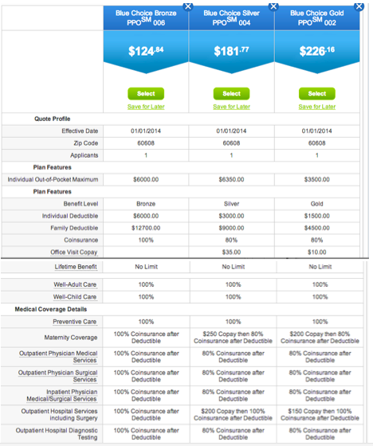
Comparing Health Care Package
Directions: Use the plan comparison package handout to choose your insurance plan.
What type of plans does this company offer?
How much are the insurance premiums per month?
How much are your co-pays:
Primary doctor visits:
Specialist doctor visits:
Preventative exams and related tests:
What is the co-pay for prescriptions?
Generic:
Formulary:
Non-formulary:
Do you have a deductible? If so, how much is it per year?
If you make $50,000 a year, percentage of your income is this deductible?
Based on your insurance, how likely would you be to go to the doctor? Explain your reasoning.
Notes:
See handout file showing options!

Slide 13
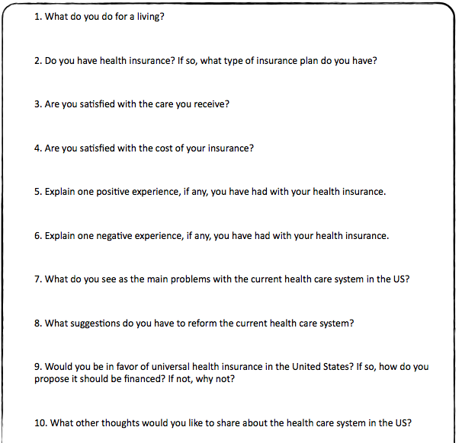
Homework: Health Insurance Interview
Notes:
The purpose of this assignment is to challenge students to begin conversations related to health policy, and specifically health care reform and health insurance.

