Slide 1
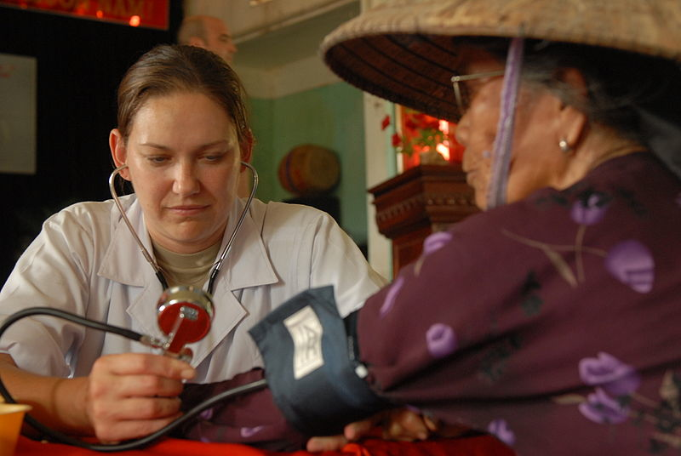
Lesson 11.1: Health Care Access
Obj. 11.1: Describe how Americans access health care and identify groups that have difficulty accessing care.
Module 11: Health Policy
Notes:
Overview: This lesson will introduce students to the deeply complex and challenging issues of access to health care in our country. Students will begin with a data set showing where insurance coverage comes from for Americans and how insurance status varies by race, age, and other variables. Students will work toward making a strong Claim-Evidence-Warrant based conclusion using this data. Next, students will read an overview from a CDC report and then use online research and discussion to determine how things have changed from 2010 until present time with the implementation of the Affordable Care Act.
Image source: http://en.wikipedia.org/wiki/File:Flickr_-_The_U.S._Army_-_MEDRETE_in_the_Bac_Ninh_Province_of_Vietnam..jpg

Slide 2
Do Now: Access to Health Care: The Data
The services offered by health care providers in the United States are perhaps the best offered anywhere in the world. Unfortunately, the services are not accessible to all Americans because they cannot afford them or have other barriers to care. Examine the graph and table below and use the data to complete the Claim-Evidence-Reasoning exercise.
Notes:
Ask students what other barriers besides income might exist. Ask students what they already know about the distribution of access to health care in our country.

Slide 3
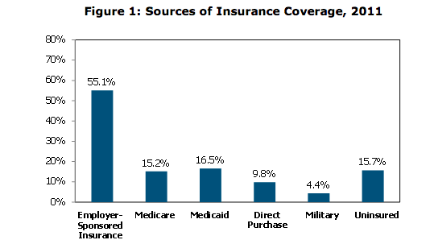
Do Now: Access to Health Care: The Data
[2]Percent of uninsured is the number of uninsured people in the specified category divided by the total uninsured population. For Race/Ethnicity, it is the percent of those that reported Race/Ethnicity in one of the four categories.
[3]Uninsured rate is the number of uninsured people in the specified category divided by the total number of people in that specific category.
Source: http://aspe.hhs.gov/health/reports/2011/cpshealthins2011/ib.shtml
Notes:
Source: http://aspe.hhs.gov/health/reports/2011/cpshealthins2011/ib.shtml

Slide 4
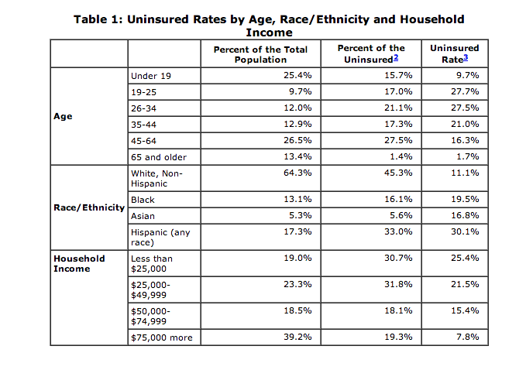
Do Now: Access to Health Care: The Data
[2]Percent of uninsured is the number of uninsured people in the specified category divided by the total uninsured population. For Race/Ethnicity, it is the percent of those that reported Race/Ethnicity in one of the four categories.
[3]Uninsured rate is the number of uninsured people in the specified category divided by the total number of people in that specific category.
Source: http://aspe.hhs.gov/health/reports/2011/cpshealthins2011/ib.shtml

Slide 5
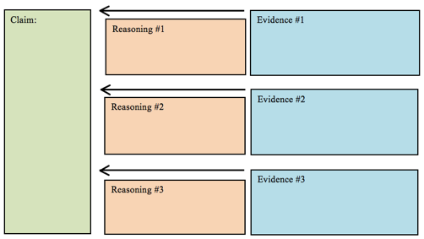
Think: Access to Health Care: Your Conclusion
Do all Americans have the same access to health care?
STEP 1: Find evidence to answer this question
STEP 2: Develop your claim
STEP 3: Organize evidence & reasoning
Notes:
See Lesson 9.10 for a primer on using Claim-Evidence-Warrant for making conclusions. If students have had this lesson before, review briefly. If not, spend a few extra minutes going through the process.

Slide 6
Think: Access to Health Care: Your Conclusion
Do all Americans have the same access to health care?
Conclusion Paragraph (Claim-Evidence-Warrant/Reasoning)

Slide 7
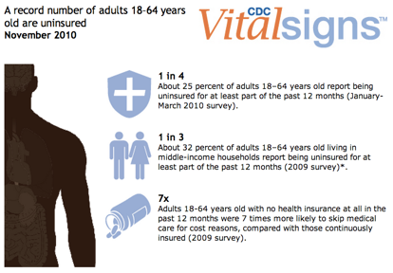
Discuss: Access to Health Care
Read the summary of the CDC MMWR Vital Signs report from 2010. As you read, think about how much has changed since 2010.
Source: http://www.cdc.gov/vitalsigns/healthcareaccess/

Slide 8
Discuss: Access to Health Care
Read the summary of the CDC MMWR Vital Signs report from 2010. As you read, think about how much has changed since 2010.
Source: http://www.cdc.gov/vitalsigns/healthcareaccess/
Notes:
Ask students, “Why might the number of Americans without health insurance be growing (in 2010)? Do you think this is still true today?”

Slide 9
Then & Now...
With a partner, search for news and websites online that provide a more current picture of the state of health care coverage and access in the United States now. Then answer the questions below.
Have there been any significant changes in access to health care? If so, what?
How has the Affordable Care Act (ACA) changed the accessibility to health care so far? What changes are predicted to take place in the future?
Notes:
Warn students that they may come across very mixed reports on the success of the ACA. Encourage them to use unbiased sources and ensure that claims they read are supported by evidence and reasoning.

Slide 10
Assess: Check Your HC Accessibility Know-How
1. Susan is a seventy-year-old retired nurse. Which of the following is most likely her source of health insurance?
A. Medicaid
B. Medicare
C. Employer sponsored
D. Private insurance
2. A forty-year old man had employee-based health care until he became unemployed. He could not afford the cost of his health care plan on his own, therefore, he is uninsured. He has high blood pressure and experiences episodes of shortness of breath. Where is he guaranteed care?
A. Private doctor’s office or Emergency room
B. Emergency room or Veterans hospital
C. Emergency room or public clinic
D. Private doctor’s office or public clinic
Notes:
Answers: 1. B; 2. C

Slide 11
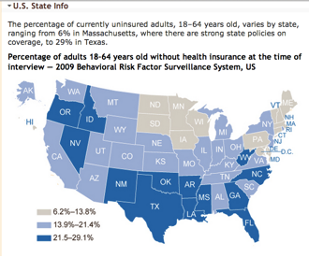
Homework: Uninsured Rates by State
Examine the data below and answer the questions.
Source: http://www.cdc.gov/vitalsigns/healthcareaccess/infographic.html
Notes:
The purpose of this homework assignment is to get students to reflect on how disparities in health care are also geographical. Ask them why these geographical disparities might exist.
Questions:
1. What was the uninsured rate range of your state, according to this map from 2010
2. What factors do you think might influence the great differences among states in rates of uninsured citizens?

