Slide 1
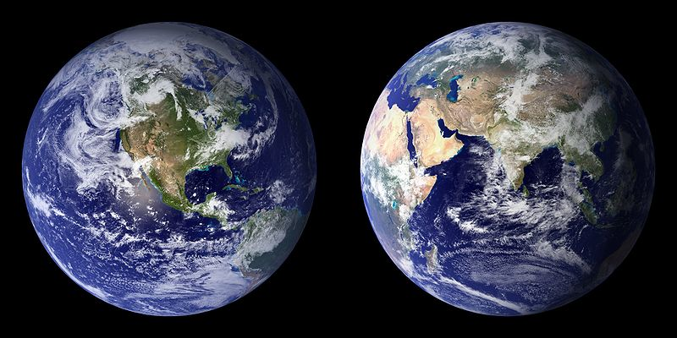
Lesson 10.7: Environmental Justice
Obj. 10.7: Discuss environmental justice and the impact of environmental health disparities.
Module 10: Environmental Health
Notes:
Overview: This lesson will spark students to start thinking and living in a more environmental justice oriented manner. Students will begin by reading some staggering facts about the state of environmental INjustice in our nation. Then they will learn the EPA’s definition of environmental justice. Next, they will read and reflect upon President Obama’s Proclamation from Feb 2014 regarding environmental justice. Finally, students will navigate to a database with all sorts of environmental information, seeking information on the state of their community.
Image source: Wikimedia Commons, http://en.wikipedia.org/wiki/File:BlueMarble-2001-2002.jpg

Slide 2
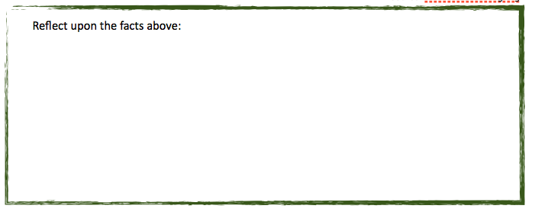
Do Now: The Facts
A Commission for Racial Justice study found that three of the five largest waste facilities dealing with hazardous materials in the United States are located in poor black communities. This study also showed that three out of every five African American and Latinos live in areas near toxic waste sites, as well as live in areas where the levels of poverty are well above the national average.
Source: www.dosomething.org
Notes:
Ask students to share their reflections. Open up a “parking lot” for questions that students have and encourage students to add questions they hope to have answered in the lesson. Be sure to circle back to the questions at the end of the lesson or the following class.

Slide 3
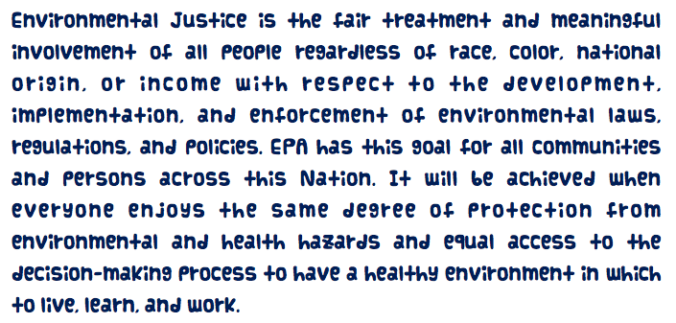
What is Environmental Justice?
Read the EPA definition of environmental justice below. As you read, circle, highlight, underline, or mark up in some way words that stand-out or seem especially important.
Source: EPA, http://www.epa.gov/environmentaljustice/
Notes:
The EPA website has a wealth of additional information on this topic!

Slide 4
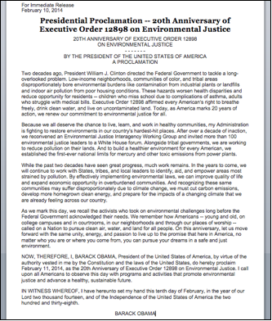
Presidential Proclamation
What are some examples of ways that environmental hazards might reduce opportunities for residents of low-income neighborhoods, communities of color, and tribal areas?
According to President Obama’s Proclamation, what role does the government play in reducing environmental health disparities?
Do you think Obama’s Proclamation was effective? Why or why not?
Notes:
Focus on Q3 to try to spark students reactions.

Slide 5
Data Mining for Environmental Justice in Your Community
1. Team up! Together, navigate online to Scorecard--The Pollution Information Site at:
<http://scorecard.goodguide.com/community/ej-index.tcl>
2. Search for your community using your zipcode.
3. Explore the website and the wealth of data provided. Take notes on what you find!
4. Select the most striking, important, or interesting data you find and prepare to share with the class.
Notes:
This website gives students specific information such as the list of leading polluters (companies) in their state or geographic location. Give students to the autonomy to explore the site and data in the least restrictive manner possible. Whatever they deem important in the data IS indeed important, as long as they can explain a logical rationale or evidence for their prioritization.

Slide 6
Assess: Your Summary
Describe environmental justice and give one example of an intervention or solution that can help reverse environmental health disparities.

Slide 7
Homework: Your Response
After data mining to see what is going on in your community, develop a response to the problems of disparities in environmental health. Think creatively--what could you do to make a small contribution to the environmental justice movement?
Notes:
The purpose of this homework assignment is to get students to feel empowered by the small role they can play in the environmental justice movement.

