Slide 1
Lesson 1.6: STIGMA
Unit 1: Mental Health
Notes:
Overview: This lesson will prepare students to learn about specific mental illnesses with a healthy and respectful attitude and an understanding of the pervasiveness of stigma in mental illness. Students will begin by guessing whether statements about mental illness are true or false. They will then define and make connections to the terms “mental illness” and “stigma.” Next they will complete short readings about stigma and mental illness. After that, students will determine what contributing factors lead to a person developing a mental illness. Finally, they will create brief skits depicting stigma and choose between two homework options: finding representations of stigma OR creating an anti-stigma PSA.
Image Source: http://www.afterdeployment.org/topics-stigma

Slide 2
Do Now
TRUE or FALSE?
All people with mental illness are crazy.
All people with mental illness are dangerous.
If someone has a mental illness, they have that illness for their entire lives.
Teens never have mental illnesses.
No one who has mental illness can function normally.
All people with mental illness suffer from a break from reality.
All people with mental illness think about hurting themselves.
No one recovers from mental illness.
If a parent has a mental illness, the child will automatically be mentally ill.
All mental illnesses are triggered by a nervous breakdown.
Notes:
Answer Key: All are false. It is not necessary to review answers or say that they are all false because later in the lesson it will be revealed. If students seem to find these questions easy, ask them to think about where they see these false beliefs being reinforced. For example, news headlines reinforcing the connection between mental illness and shootings seems to reinforce the idea that “all people with mental illness are dangerous.”
(OPTIONAL) Prior to the Do Now, show clips from any of the following films, posing the question: Are these people normal? Why/why not? (Answer: YES they are all normal. But they all have mental illness)
Shutter Island: Delusional Disorder/Schizophrenia
Virgin Suicides: Depression Donnie Darko: Schizophrenia
Fight Club: Dual Identity Disorder
Sylvia: Bipolar Disorder (true)
As Good as it Gets: OCD
28 Days: Alcoholism
A Beautiful Mind: Paranoid schizophrenia
Memento: Anterograde Amnesia

Slide 3
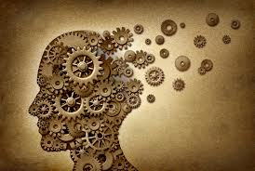
Discuss
Share your answers!
Did you disagree?
Choose one statement and defend your answer.
Notes:
Students should defend their statements with specific evidence, examples, or logical explanation. This is also a great time to set norms: we do not use the words crazy, psycho, lunatic, etc.
Image source: http://segment.com/yasmin-malhotra/

Slide 4
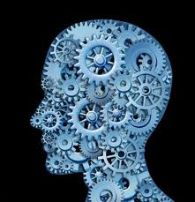
Mental Health & Stigma
Read the definitions & make connections:
Term | Definition | Connection
MENTAL ILLNESS | Medical conditions that disrupt a person’s thinking, feeling, mood, ability to relate to others, and daily functioning
STIGMA | Disapproval, prejudice, or unfair judgment on a person/group based on characteristics that distinguish them from others in society
Notes:
Students can share connections with a partner if time permits. Students should be told that they do not need to share anything personal that they are not comfortable sharing.
Image Source: www. Syracusenewtimes.com

Slide 5
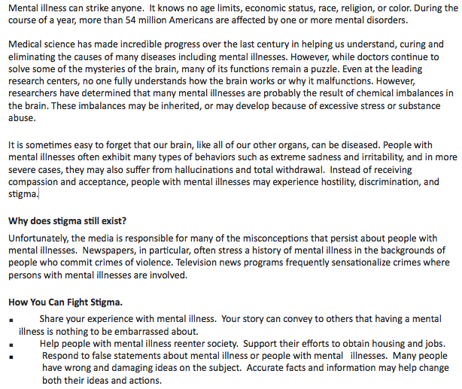
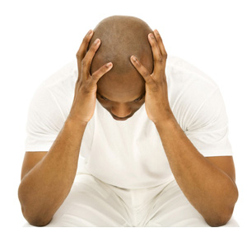
“Stigma: Building Awareness & Understanding”
Notes:
Image source: http://firstpreferredhealthinsurance.com/2013/04/mental-health-insurance-and-you/

Slide 6
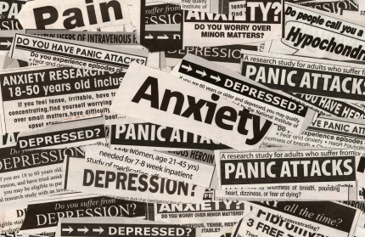
After You Read:
What are some other ways you can fight stigma of mental illness?
What other populations or groups of people face stigma? Why? How can you decrease that stigma?
Notes:
Image source: http://www.theorganicprepper.ca/natures-prozac-nutrition-for-mental-health-02212013

Slide 7
Mental Health Facts:
Important points to remember:
Affects any age, race, religion, income
Serious medical illnesses
Treatable
Affects 25% of adults (in a given year)
Affects 10% of children
Stigma creates barriers to treatment & recovery
Notes:
These bullet points summarize some of the big ideas in this section of the reading.
Source: http://www.nami.org/template.cfm?section=about_mental_illness

Slide 8
How does someone get mentally sick?
Notes:
Possible answers:
Physical factors: injury, tumor, poison, drugs
Heredity: genes can increase the likelihood for mental illness
Early experiences: negative childhood experiences (Freud)
Recent experiences: major recent events, death of loved ones. Most mental illness onset at prime of life (18-25 years)

Slide 9
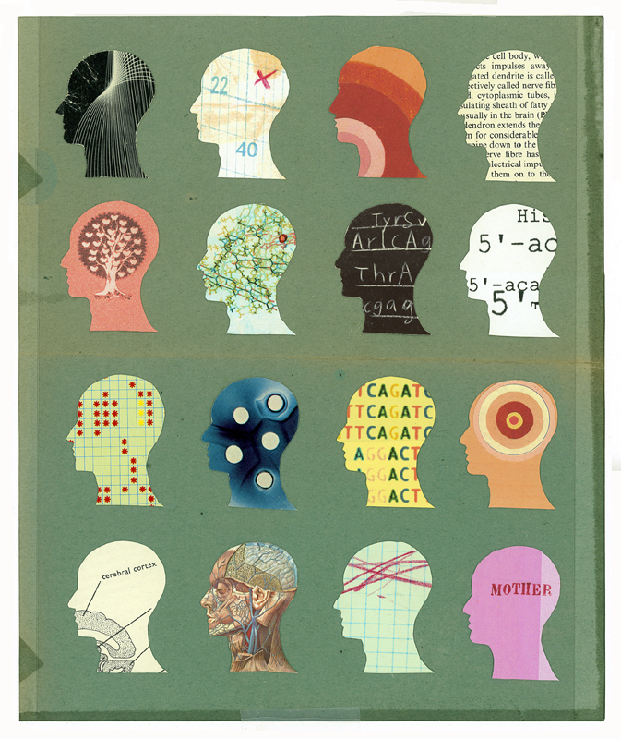
Big Idea:
Do people have control over whether or not they suffer from a mental illness?
Notes:
Guide students to look back at the causes table we just filled in. Can we control any of those?
Image source: Feminspire.com

Slide 10
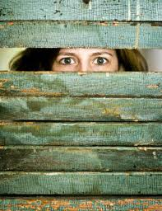
Stigma & Mental Illness
Create a short informal skit that depicts STIGMA relating to mental illness
Notes:
Determine whether to assign students to work in partners or small groups, or whether to give them the choice. Skits can focus on any aspect of stigma, but should depict some form of disapproval, unfair judgment, or prejudice.
Image source: http://joanlandinosays.com/mental-health-stigma/

Slide 11
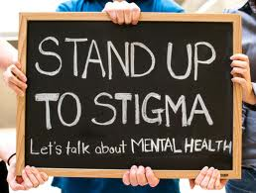
Homework:
Choose one of the following two options:
Find 3 (or more) representations of stigma in the media. These could be in movies/television, magazines, the news, images, etc. Describe each in the space below.
Create a 15-second anti-stigma Public Service Announcement “ad spot” on the radio. Write the script in the space below
Notes:
Goal of the homework: Students will have an opportunity to increase their awareness of stigma in society OR work to creatively address stigma through a solution. In either case, students will have a chance to internalize the definition of stigma and it’s impact on those affected by mental illness.
Image source: http://www.peteearley.com/2013/08/12/do-we-worry-too-much-about-stigma/

