Slide 1
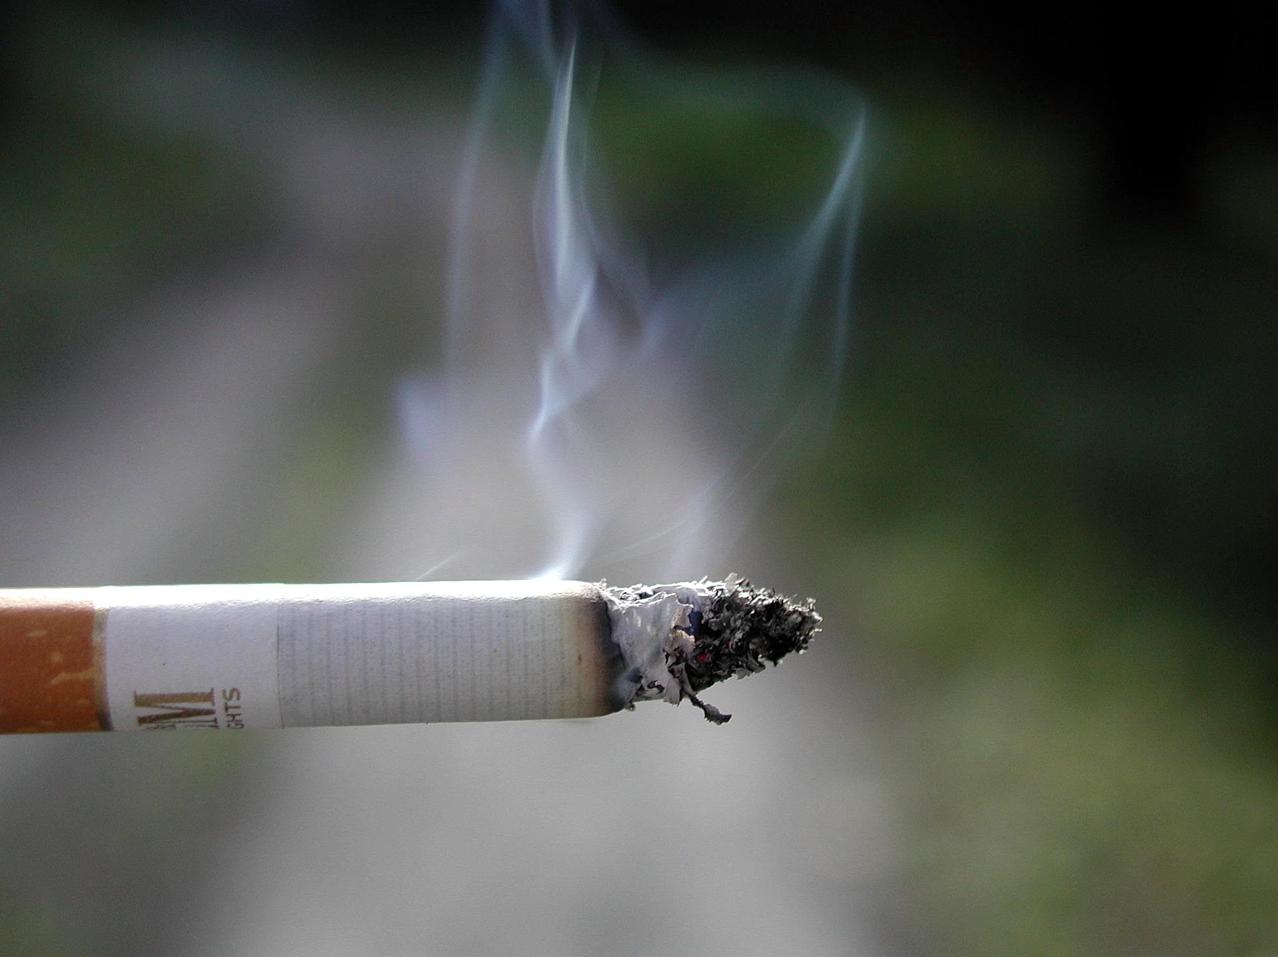
Lesson 9.6: Causation vs. Correlation
Obj. 9.6: Differentiate a causative and correlative relationship between variables.
Module 9: Epidemiology
Notes:
Overview:This lesson will provide students with a basic introduction to the important concept of differentiating relationships between variables that may have causative or correlative relationships. Students will begin by thinking about the causes of obesity and other factors that may be associated with obesity, analyze questions with causative or correlative relationships, and examine a news headline making a causative claim. Next they will watch a Khan Academy video that expertly explains this concept, followed by a reading about five criteria for cause-and-effect relationships.
Image source: http://en.wikipedia.org/wiki/Smoking_in_the_Philippines

Slide 2
Do Now: #1
1. Causal Factors & Correlated Factors
What causes obesity?
What factors, health behaviors, and/or characteristics might be frequently found among individuals who are obese?

Slide 3
Do Now: #2
2. Words Imply Relationships
Circle the questions that imply a cause and effect relationship between variables.
Do diesel fumes from school buses cause asthma?
Does eating chocolate give people acne?
Are males at higher risk of automobile accidents?
Does immunization with the flu shot prevent H1N1?
Does acupuncture result in pain relief?
Notes:
Words Imply Relationships: The only questions that are not circled would be #3 “Are males at higher risk for automobile accident” and #4 “Immunization w/ flu shot prevent H1N1”

Slide 4
Do Now: #2
3. Be Careful What You Imply
A news reporter reads the results of a study on coffee that state, “Coffee drinkers were three times more likely to report positive mental health than non coffee-drinkers.” The reporter decides to write a news story on this study and titles it, “Drink Coffee for Better Mental Health.” Is this an appropriate title? Why or why not?
Notes:
Be Careful What You Imply: Students should explain that coffee drinkers and people with strong mental health may share some other characteristic that influences both. For example, perhaps people who wake up earlier tend to be happier for some reason, but they also tend to drink more coffee. The waking up may be the key variable that influences both.

Slide 5
“Correlation & Causality”
Watch the Khan Academy video, “Correlation & Causality.” (Run time: 10:44).
https://www.khanacademy.org/math/probability/regression/regression-correlation/v/correlation-and-causality
1. What is wrong with the news article title, “Eating Breakfast May Beat Teen Obesity”?
2. What other factors or behaviors (besides eating breakfast) may also gain attention as ways to protect against obesity, when in fact they may only be correlated with non-obesity?
Notes:
The Khan Academy videos are short lectures on various topics that give wonderful insight to learners in a format that is visual and can be paused, slowed down, re-watched, etc.
Students could watch this on their own or it could be projected for the entire class.

Slide 6
Five Criteria for Cause-and-Effect Relationships
In general, five criteria must be met to establish a cause-and-effect relationship:
Strength of association—the relationship must be clear.
Consistency—observation of the association must be repeatable in different populations at different times.
Temporality—the cause must precede the effect.
Plausibility—the explanation must make sense biologically.
Biological gradient—there must be a dose-response relationship.
Source: CDC Excite. Epidemiology in the Classroom. http://www.cdc.gov/excite/classroom/intro_epi.htm
Notes:
NEW INFO:
This background information will help students understand that causal relationships can be understood through a variety of factors.
Ask students, “What is a dose-response relationship?” (Answer: “A dose-response relationship describes the change in effect on an organism caused by differing levels of exposure to a stressor after a certain exposure time. This may apply to individuals, or to populations.” -WIkipedia)

Slide 7
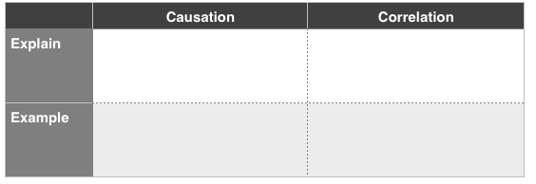
Assess: Causation vs. Correlation
Notes:
ASSESS:
Causation: A cause-effect relationship where one variable creates an outcome in another. The relationship must be clear, repeatable, make sense biological, and follow a dose-response pattern. (Example: Vaccination & prevention of disease).
Correlation: A relationship between two variables that are associated. Correlations indicate a predictive relationship. (Example: Parental height and offspring height).

Slide 8
Homework: Find Those Fraudulent Claims!
Find a news article in which the author makes a “correlation does not imply causality” error. Describe the article and the erroneous claim in the box below.
Notes:
The purpose of this homework assignment is to help students open up their eyes to all of the health news that is shrouded in a confusing correlation vs. causation fog. By finding and analyzing an article of their choosing, students will engage with content that is meaningful to them while practicing identifying the concepts from this lesson.

