Slide 1
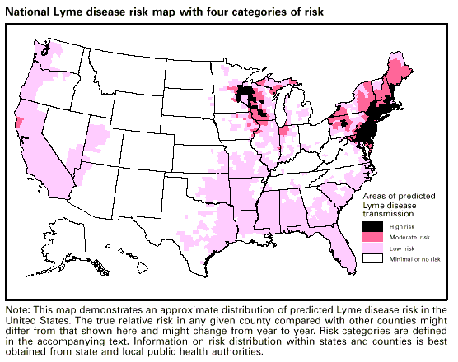
Lesson 9.5: Types of Studies
Obj. 9.5: Compare & contrast different types of epidemiological studies.
Module 9: Epidemiology
Notes:
Overview: This lesson will challenge students to identify the rigorous scientific methods used in the field of epidemiology. Students will begin by predicting what they would do in the case of a possible outbreak of Hepatitis B. Then they will read about epidemiological methods, make inferences based on a set of data from a descriptive study, and learn about the three types of analytical studies.
Image source: http://en.wikipedia.org/wiki/File:Lyme_Disease_Risk_Map.gif

Slide 2
Do Now
In March 1985, a nurse epidemiologist in a county health department noted, while reviewing surveillance data, three cases in a single month of hepatitis B of unusual origin. Hepatitis B, or serum hepatitis, is transmitted through sexual contact and by exposure to infected bodily fluids, but these three patients did not seem to have the usual risk factors. All three people did, however, indicate having received injections at the same health care facility.
The nurse's immediate questions were: Is this a coincidence? Did these three cases occur by chance or is there a link? In this instance, the nurse decided to pursue an investigation. What might the nurse do next?
Source: CDC EXCITE Epidemiology Lesson (http://www.cdc.gov/excite/classroom/intro_epi.htm)
Notes:
Answers will vary. The nurse might report the cases to the CDC, compare the rates with other area health departments, place a notice out to health care providers in the area, and perform statistical calculations on the rate of incidence and prevalence. He or she might also gather more information about the exposures the infected individuals had and identify whether they may have infected other individuals.

Slide 3
Discuss
Predict: What kind of methods do you think epidemiologists might use for studying a health problem?
Notes:
Answers will vary again. Epidemiologists gather information in all sorts of ways (talking to local officials and health care providers, conducting surveys and asset mapping, interviewing individuals and focus groups, mining existing data sets for more clues, and gathering health records. Then, epidemiologists can run a number of statistical calculations on this data, or they might choose to obtain permission to conduct an experiment with a group of people, by following them over time, or asking them about prior exposures. In certain situations, epidemiologists can even work with other health professionals to conduct clinical trials, where a medication or another treatment variable is compared in one group with controls in another group who do not receive it.

Slide 4
Epidemiological Terms:
Study—Epidemiology is the basic science of public health. It's a highly quantitative discipline based on principles of statistics and research methodologies.
Distribution—Epidemiologists study the distribution of frequencies and patterns of health events within groups in a population. To do this, they use descriptive epidemiology, which characterizes health events in terms of time, place, and person.
Determinants—Epidemiologists also attempt to search for causes or factors that are associated with increased risk or probability of disease. This type of epidemiology, where we move from questions of "who," "what," "where," and "when" and start trying to answer "how" and "why," is referred to as analytical epidemiology.
Source: CDC EXCITE Epidemiology Lesson (http://www.cdc.gov/excite/classroom/intro_epi.htm)

Slide 5
Epidemiological Terms:
Health-related states—Although infectious diseases were clearly the focus of much of the early epidemiological work, this is no longer true. Epidemiology as it is practiced today is applied to the whole spectrum of health-related events, which includes chronic disease, environmental problems, behavioral problems, and injuries in addition to infectious disease.
Populations—One of the most important distinguishing characteristics of epidemiology is that it deals with groups of people rather than with individual patients.
Control—Finally, although epidemiology can be used simply as an analytical tool for studying diseases and their determinants, it serves a more active role. Epidemiological data steers public health decision making and aids in developing and evaluating interventions to control and prevent health problems. This is the primary function of applied, or field, epidemiology.
Source: CDC EXCITE Epidemiology Lesson (http://www.cdc.gov/excite/classroom/intro_epi.htm)

Slide 6
Epidemiological Terms:
In the descriptive process, we are concerned with "person" (Who was affected?), "place" (Where were they affected?), and time (When were they affected?).
Once we know the answers to these questions, we can enter the realm of analytical epidemiology and ask how and why these people were affected.
Source: CDC EXCITE Epidemiology Lesson (http://www.cdc.gov/excite/classroom/intro_epi.htm)
Notes:
Ask students to put the differences between these two groups of studies in their own words—descriptive vs. analytical.

Slide 7
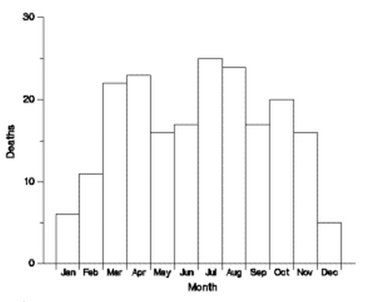
1) Deaths associated with tractor injuries, by month of death, Georgia 1971-1981
Source: CDC EXCITE Epidemiology Lesson (http://www.cdc.gov/excite/classroom/intro_epi.htm)
Notes:
Deaths peaked in the spring and fall months, so they may be related to planting and harvest.

Slide 8
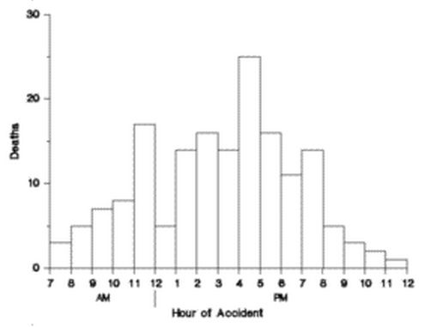
2) Deaths associated with tractor injuries, by time of day, Georgia 1971-1981
Source: CDC EXCITE Epidemiology Lesson (http://www.cdc.gov/excite/classroom/intro_epi.htm)
Notes:
Because deaths peaked just before lunch and during the late afternoon and decrease from 12:00-1:00, they might be related to fatigue. The dip at noon could be because most people are taking a break for lunch. The fact that children are home from school by 4:00 could contribute to the peak in the afternoon.

Slide 9
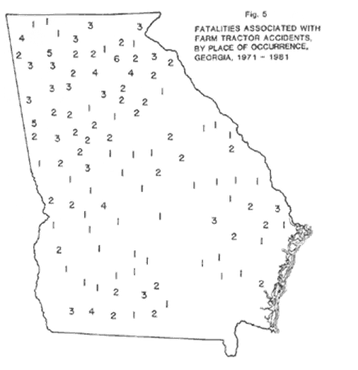
3) Deaths associated with tractor injuries, by place, Georgia 1971-1981
Source: CDC EXCITE Epidemiology Lesson (http://www.cdc.gov/excite/classroom/intro_epi.htm)
Notes:
Most of the deaths occurred in northern Georgia, which is hilly and mountainous; south-central Georgia, where fewer deaths occurred, is much flatter. This distribution might implicate the rugged terrain, but because the map shows numbers of deaths, not rates, we don't know whether the numbers could instead reflect differences in population size or even perhaps the number of tractors being used. As for the prevalence of tractors, south-central Georgia is more agrarian than northern Georgia, so the number of tractors probably isn't a factor. Another possible association is differences in experience and skill in using tractors.

Slide 10
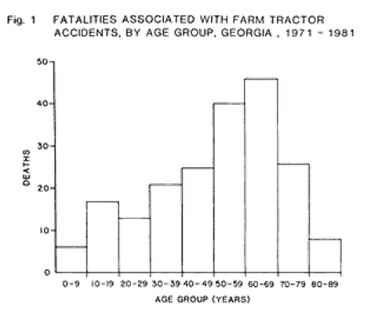
4) Deaths associated with tractor injuries, by age group, Georgia 1971-1981
Source: CDC EXCITE Epidemiology Lesson (http://www.cdc.gov/excite/classroom/intro_epi.htm)
Notes:
The number of deaths is clearly higher in the older age group. This could mean that tractor users are predominantly older, but it could also indicate that older users are less likely to survive an accident.

Slide 11
Analytical Studies: Cross-sectional, Cohort, and Case-control
The first type of design, a cross-sectional study, is basically the same as a survey.
In this type of study, the epidemiologist defines the population to be studied and then collects information from members of the group about their disease and exposure status.
Since the data represent a point in time, it's like taking a "snapshot" of the population.
Cross-sectional studies are good for examining the relationship between a variable and a disease, but not for determining cause and effect, which requires data over time.
Cohort studies and case-control studies are much better suited to examining cause-and-effect relationships.
Source: CDC EXCITE Epidemiology Lesson (http://www.cdc.gov/excite/classroom/intro_epi.htm)
Notes:
Have students create a 3-column table or a triple Venn diagram to take notes on the differences and similarities between the three analytical studies

Slide 12
Analytical Studies: Cross-sectional, Cohort, and Case-control
Cohort studies have several advantages:
You can examine multiple outcomes for a single exposure. For instance, if you select a group based on their smoking exposure, you can look not only at the incidence of lung cancer, but also at the incidence of cardiovascular disease, emphysema, burns, other smoking-related outcomes.
Cohort studies are very useful in examining rare exposures, such as asbestos exposure and lung cancer.
You can directly calculate the incidence of disease for each of the exposure groups.
The temporal sequence is logical: you are starting with exposure and following forward in time to the development of disease.
Source: CDC EXCITE Epidemiology Lesson (http://www.cdc.gov/excite/classroom/intro_epi.htm)

Slide 13
Analytical Studies: Cross-sectional, Cohort, and Case-control
In a case-control study, the epidemiologist is working backward, from the effect to the suspected cause. For this reason, case-control studies are often referred to as retrospective studies.
Participants are selected on the basis of the presence or absence of the disease or outcome in question, so that you have one group of people (case-subjects) with the health problem and one without (controls).
These groups are then compared to determine the presence of specific exposures or risk factors. For example, you could pick a group of people with lung cancer and a group without and then compare them for their history of exposure to smoking.
The relationship between exposure and outcome in a case-control study is quantified by calculating the odds ratio.
Case-control studies have three primary advantages:
You can examine multiple exposures for a single outcome.
They are well suited for studying rare diseases and those with long latency periods.
They require fewer case-subjects and are generally quicker and less expensive to conduct than cohort studies, which makes them well suited for the conditions of an outbreak investigation.
Source: CDC EXCITE Epidemiology Lesson (http://www.cdc.gov/excite/classroom/intro_epi.htm)

Slide 14
Homework:
Find a summary of a health-related research study (news article, abstract of a journal article, etc.) and determine what type of study it is (Cross-sectional, Cohort, or Case-control). Explain the study and provide evidence showing which type of study it is. Then explain WHY you believe the scientists chose that particular type of study method for their research.
Challenge: Try to find one example of EACH type of study!
Notes:
The purpose of this homework assignment is to expose students to the frequency and variety of epidemiological studies that are constantly going on. Chances are, they can find a study in a topic they are interested in (i.e. drinking & driving, teen pregnancy, cancer, etc.) and the challenge will just be to figure out which type it is. If time permits in the next class, have students partner up to share the studies they found and discuss why they determined that the study was one type or another. (Note: Often the abstract or news article will explicitly say what type of study it is, i.e. “a cross-sectional survey was performed…” – this is ok! Students should then be able to explain the evidence showing why it was actually that kind of study)

