Slide 1
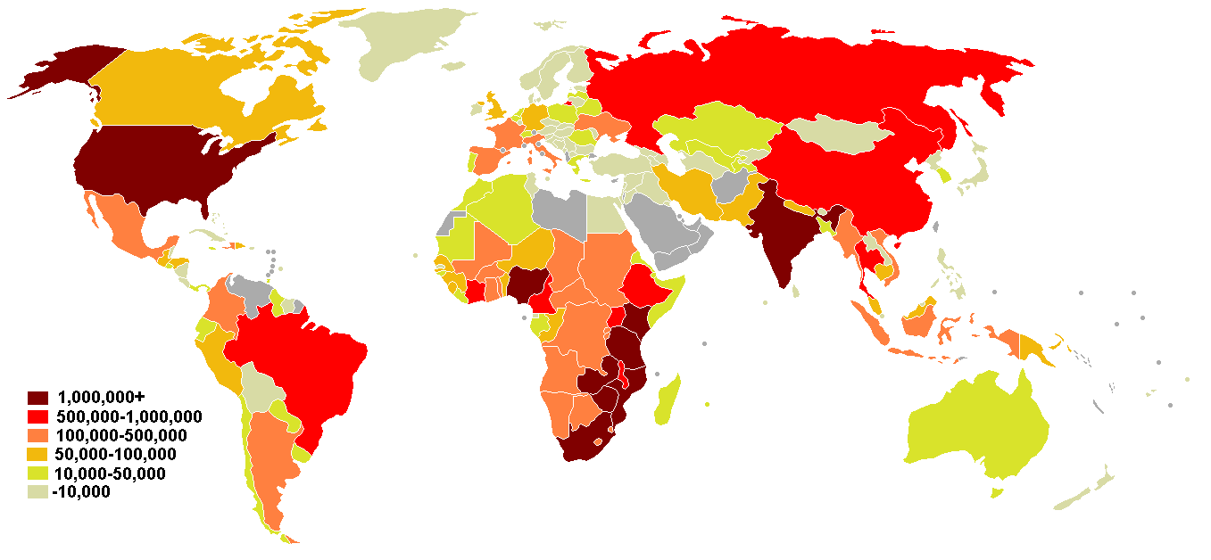
Lesson 9.4: Epidemiology
Obj. 9.4: Identify the roles of an epidemiologist.
Module 9: Epidemiology
Notes:
Overview: This lesson will introduce the specific discipline of epidemiology in a variety of ways. Students will read about how epidemiology is different from medicine, watch a video highlighting the work of epidemiologists, and conduct an interactive online simulation where they take on the role of epidemiologist to solve an outbreak mystery.
Image source: http://en.wikipedia.org/wiki/Epidemiology_of_HIV/AIDS

Slide 2
Do Now: Epidemiologist vs. Physician
What do you think the differences are in the work of an epidemiologist compared with a physician? (List as many differences as you can!)
Notes:
Ask students to recall the definition of “epidemic” (from lesson 9.2. Tell them to use this definition to make inferences about the work of an epidemiologist. Hint: Epidemiology is a PUBLIC HEALTH CAREER (remind them to think of how to solve health problems on an individual vs. population level).

Slide 3
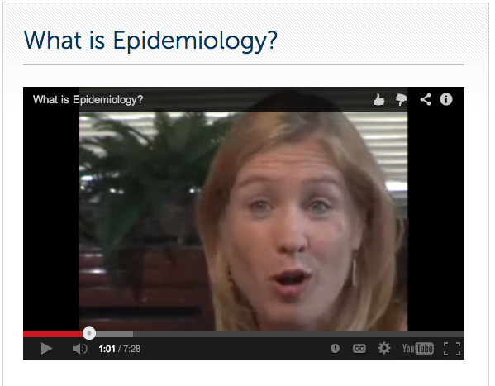
Video: What is Epidemiology?
(Run time 7:29) http://www.rwjf.org/en/about-rwjf/newsroom/newsroom-content/2008/03/is-epidemiology-in-your-future.html#content
Notes:
(Run time 7:29) http://www.rwjf.org/en/about-rwjf/newsroom/newsroom-content/2008/03/is-epidemiology-in-your-future.html#content

Slide 4
Epidemiology vs. Clinical Medicine
What is Epidemiology? the branch of medical science that deals with the incidence, distribution, and control of disease in a population
What comes to mind when we think of Epidemiology?
Individual pt. vs. groups of people
Global impact
Detective work
Social/behavioral science
Predict & prevent instead of respond to disease
Critical thinking, questions, knowing how to find info
Combining doing good with thinking well
Environmental
Lab
Politics
Broad field

Slide 5
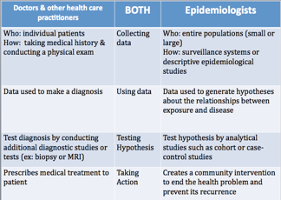
Epidemiology vs. Clinical Medicine
Reading: CDC Excite <http://www.cdc.gov/excite/classroom/intro_epi.htm>
Notes:
The CDC Excite website has a wealth of useful resources on Epidemiology. Some of the material will be referenced in upcoming lessons in this module.

Slide 6
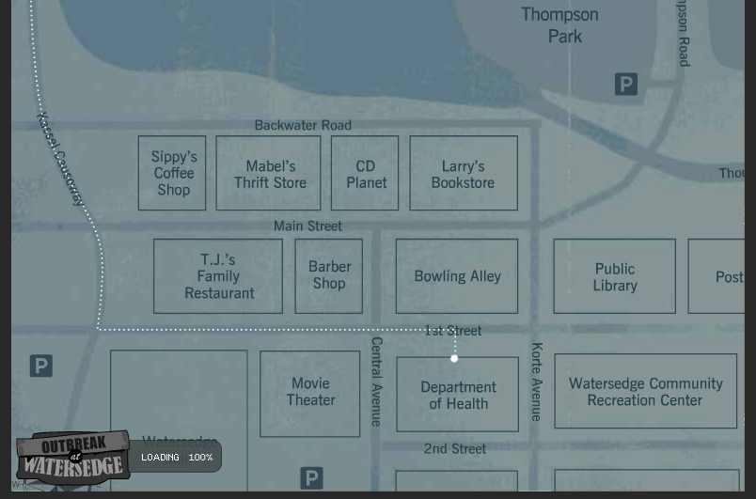
Outbreak at Watersedge
INTRO: Find out your mission!
PART 1: Mapping Interview Data from Interviews with 5 Hospitalized Patients
PART 2: Observations at Thompson Park
PART 3: Mapping Water Access Points in Thompson Part (Interviews # 6 – 10)
PART 4: Taking samples at Thompson Park
CONCLUSION: Review the Data
REFLECTION
Website:
http://www.mclph.umn.edu/watersedge/game.html
Notes:
This online simulation will take approximately 45-60 minutes, so it could be assigned for homework or completed in 1-2 class periods. Students can work in pairs or groups of 3-4 if needed based on technology resources.
Website: http://www.mclph.umn.edu/watersedge/game.html

Slide 7
Homework: An Epidemiology Career
What appeals to you & does not appeal to you about a career in epidemiology? Write a one paragraph reflection about your level of interest in the career.
Notes:
The purpose of this homework assignment is to provide students with a chance to reflect upon their career aspirations and how they would enjoy the public health career they learned about in this lesson. Most high schoolers don’t understand or consider careers in public health because there is less awareness and glamorization of the field. Consider having a local epidemiologist speak with students if time and resources permit.

