Slide 1
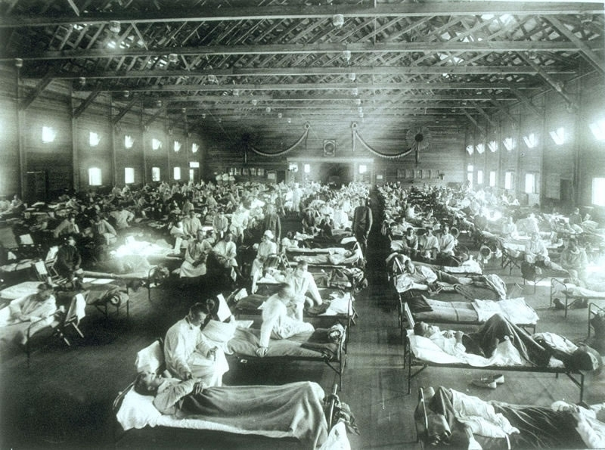
Lesson 9.3: The 1918 Flu
Obj. 9.3: Communicate information to the public regarding prevention of a serious infectious disease epidemic
Module 9: Epidemiology
Notes:
Overview: This lesson will help students delve deeper into one particular devastating pandemic in our recent history--the 1918 flu. Students will begin with a gripping graph showing how the 1918 flu affected young, healthy adults disproportionately (unlike other influenza pandemics). Then students will read a comprehensive overview of the 1918 flu. Finally, they will team up to create a news segment about the 1918 flu.
Image source: http://en.wikipedia.org/wiki/File:CampFunstonKS-InfluenzaHospital.jpg

Slide 2
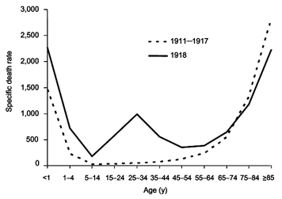
Do Now
The graph below portrays the difference between the influenza mortality age-distributions of the 1918 epidemic and normal epidemics – deaths per 100,000 persons in each age group, United States, for the interpandemic years 1911–1917 (dashed line) and the pandemic year 1918 (solid line).
1) Based on the data in this graph, what was unique about the pandemic flu of 1918?
2) Why do you think the 1918 flu affected the particular age range shown in the graph?
Notes:
Answers:
The 1918 flu affected young adults (especially age 15-44), unlike normal influenza pandemics which affect the young and old disproportionately.
The real answer is that scientists hypothesize that the 1918 flu caused the immune system to go into overdrive, overwhelming the body, so those with stronger immune systems (the young adults) had a stronger reaction than those with weaker immune systems. Students will probably not guess this though, so any logical explanations are acceptable.

Slide 3
Discuss
What factors do you think may have impacted the spread of the 1918 flu?
Notes:
Possible answers: Patterns of social activity, war conditions, health care & public health systems, increasing intercontinental transportation & travel, etc.

Slide 4
Read: INFLUENZA STRIKES!
Read the following overview of the 1918 Flu from the US Department of Health & Human Services Flu.gov website (http://www.flu.gov/pandemic/history/1918/the_pandemic/influenza/index.html)
From Kansas to Europe and Back Again:
Wave After Wave:
The Unfolding of the Pandemic:
Mobilizing to Fight Influenza:
The Pandemic Hits:
Protecting Yourself From Influenza:
Communications During the Pandemic:
Fading of the Pandemic:
By the time the pandemic had ended, in the summer of 1919, nearly 675,000 Americans were dead from influenza. Hundred of thousands more were orphaned and widowed.
Notes:
This is a longer reading taken from the US Dept of Health & Human Services Flu.gov website (http://www.flu.gov/pandemic/history/1918/the_pandemic/influenza/index.html). Students could be directed to the website to read it on their own (at their own pace) and then explore the other great resources and information on the site when finished.

Slide 5
The Flu of 1918 in the News
Challenge: Imagine that television & news programs were widespread in 1918 (full-scale commercial television broadcasting did not actually begin in the U.S. until 1947). Create a 3-5 minute news broadcast segment on the 1918 flu that would have aired in mid-March 1918.
Directions:
Form a team of four and identify roles (two news anchor and two special reporters)
Gather additional informational resources from the website:
http://www.flu.gov/pandemic/history/1918/
Write a script. Be sure to include information on populations most affected, prevention methods, effects and consequences of the epidemic, treatment options, and trends in geographic spread of the epidemic statewide, nationally, and globally.
Record your news segment or rehearse in order to present live in class.
Notes:
The website has a portion dedicated to information on the 1918 flu specific to various states. Have students go to their own state and look up specific information. Encourage students to think about what was known about the 1918 flu pandemic among the general public and what information would help them. Encourage them to think about how the delivery of the information could cause potential widespread panic.

Slide 6
Assess:
1. What percentage of worldwide population was affected by the 1918 flu?
2. Who was most at risk for the 1918 flu? Why?
3. What could be done to do to avoid the 1918 flu?
Notes:
ANSWERS:
1. Estimates show that 3-5% of the population died and a much greater percentage were affected.
2. Young adults were at greatest risk, but no one was excluded from it’s scourge.
3. Any answers related to sensible precautions could be accepted. However, students should be aware that there was no flu vaccine (as we have today) back in 1918. Handwashing, avoiding those who are sick, staying inside or away from the public, etc.

Slide 7
Homework: Stories of the 1918 Flu
Explore the story of one person who was affected by the 1918 Flu. Summarize their story in one paragraph on a separate sheet of paper. Use the following website or any other credible source:
http://www.flu.gov/pandemic/history/1918/biographies/index.html
Notes:
The purpose of this homework assignment is to encourage students to see the flu from a different, more intimate perspective.

