Slide 1
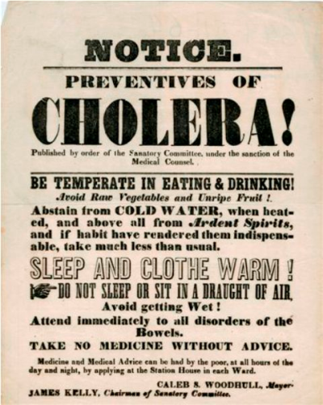
Lesson 9.2: Epidemics
Obj. 9.2: Identify factors shaping historical epidemics & explain their impact on health outcomes.
Module 9: Epidemiology
Notes:
Overview: This lesson will challenge students to trace the history of epidemics on humanity by studying a timeline of historical epidemics and teaming up and teaching the class about one communicable disease and working to make conclusions based on the collaborative knowledge shared.
Image source: http://commons.wikimedia.org/wiki/File:Cholera_Epidemic_poster_New_York_City.jpg

Slide 2
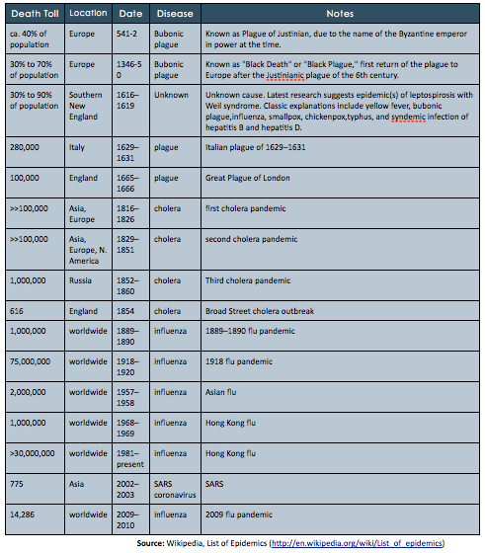
Do Now
1. Which epidemic in the past 200 years killed the most people?
2. What type of disease has been most prevalent in major outbreaks over the past 200 years?
3. Which two epidemics included in this table had the LEAST number of victims? Why were they significant?
4. Why do you think recent major disease outbreaks seem to be spreading worldwide, rather than just being contained in one or a few continents as outbreaks in the past often were?
Notes:
Answers:
1. 1918 Flu Epidemic
2. influenza
3. The Broad Street Cholera outbreak of 1854 & the SARS outbreak of 2002-03
4. transatlantic travel is ubiquitous in our time. Planes can carry diseases cross-continent in a matter of hours.

Slide 3
Discuss
In addition to the outbreaks included in the table, what other epidemics or pandemics have you heard of? What factors make the spread of disease considered an epidemic or pandemic?
Notes:
Ask students if they have heard of H1N1? The obesity epidemic? Ask students the difference between an epidemic of something like influenza and something like obesity.

Slide 4
Epidemics & Pandemics
What is an epidemic? How is a pandemic different?
epidemic: any unexpectedly large number of cases of an illness, health related behavior, or other health-related event in a particular population at a particular time.
pandemic: an epidemic that is occurring in many parts of the world.
Notes:
Refer students back to the table on page 1 of the lesson workbook. Ask them to circle the pandemics (they should recognize that these are the ones that are affecting multiple continents or listed as “worldwide”)

Slide 5
Epidemic or Pandemic?
Epidemic or Pandemic?
A. Stomach Flu at our school
B. HIV/AIDS
C. Alcoholism in the Southwest US
D. Obesity
Notes:
Answers:
Epidemic
Pandemic
Epidemic
Epidemic, but many scientists expect it to slowly transitioning to pandemic levels as countries become more developed and gain access to cheap processed foods

Slide 6
Review:
Communicable disease (infectious): Can be transmitted from an infected person, animal, or object to another person
Noncommunicable disease: Non-transmissible (can’t be “caught”)
Chronic disease: Lasts longer than 3 months, sometimes for the remainder of one’s life
Acute disease: Peak severity of symptoms occurs and subsides within 3 months of onset, usually within days or weeks
Notes:
Lesson 5.4 (in Module 5 – Public Health) introduces these concepts.

Slide 7
Communicable? Noncommunicable? Chronic? Acute?
A. Stomach Flu at our school
B. HIV/AIDS
C. Alcoholism in the Southwest US
D. Obesity
Notes:
Answers:
Communicable; Acute
Communicable; Chronic
Noncommunicable; Chronic
Noncommunicable; Chronic

Slide 8
Infectious Diseases Throughout Time
Challenge: You are a medical anthropologist studying the history of major epidemics over time. You and a team of health historians will specialize in one particular infectious disease and make conclusions in terms of:
life expectancy
causes of death
beliefs about illness
medical discoveries
context of epidemics
Notes:
Ask students what they ALREADY know about how these things have changed over time? (Life expectancy, Causes of death, Beliefs about illness, Medical discoveries, and types/context of epidemics). Priming them to the types of trends & conclusions will help them see the “big picture” when they dig into information about their particular disease pattern over time, rather than getting lost in the details.

Slide 9
Infectious Diseases Throughout Time
Step 1: Write down your team’s assigned disease
Step 2: Read about your disease, taking notes on both the timeline.
Step 3: Summarize your notes with respect to each focus area in the table on the following page.
Step 4: Present information about your disease to the class
Step 3: Draw conclusions once you hear information from all teams.

Slide 10
Infectious Diseases Throughout Time

Slide 11
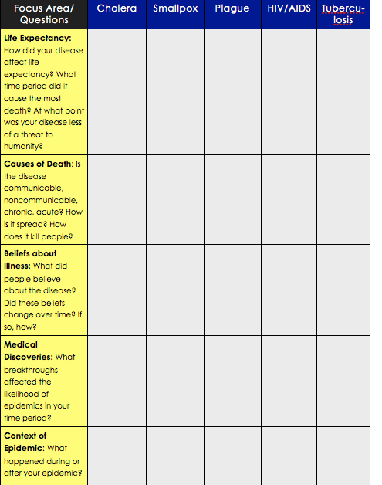
Infectious Diseases Throughout Time
Go to:
www.diseasedetectives.org/timeline
Notes:
Break the class into five groups (or ten with two groups focusing on each disease). Assign each to one of the five diseases (cholera, smallpox, plague, HIV, or TB) or allow them to choose as long as all are represented. Have students navigate to the Disease Detectives website. The website is: www.diseasedetectives.org/timeline

Slide 12
Patterns & Conclusions:
1) Life Expectancy: In what time period did life expectancy increase the most? Why?
2) Causes of Death: How did the types of diseases people commonly fell ill from change over time? Over what decade(s) did this change occur?
3) Medical Discoveries: What were the major types of medical discoveries that reduced epidemics of communicable disease and increased average life expectancy?
4) Beliefs about Illness: How did beliefs about the causes of illness and outbreaks change over time?
5) Epidemics: In what ways have the the patterns and trajectories of epidemics changed over time?
Notes:
Life Expectancy: Increased by more than 30 years in 20th century (47 to 78)
Causes of Death: communicable (infectious) to noncommunicable (chronic) shift began in 1920’s
Medical Discoveries: Antibiotics, vaccines, diagnostic & treatment tools
Beliefs about Illness: Divine intervention—people were being punished for their sins then… Miasmas theory: diseases spread by miasmas or “bad air”then… Germ theory: diseases cause by microorganisms
Epidemics: History of uncertain explanations of origin and patterns; Changed with transportation patterns; Scientists began collecting & analyzing data

Slide 13
Homework: Research an Epidemic!
Choose any epidemic that you have not yet studied in class. Research the epidemic so that you understand its history in terms of:
life expectancy
causes of death
beliefs about illness
medical discoveries
context of epidemic
Then pretend you are a survivor of the epidemic (in any country, at any period of time!) and write a letter to a friend living on another continent, explaining the epidemic and it’s impact on yourself, you family and friends, your community and your nation.
Notes:
The purpose of this homework assignment is to challenge students to learn more about epidemics in an intimate way, by imagining themselves in that time period and situation.

