Slide 1
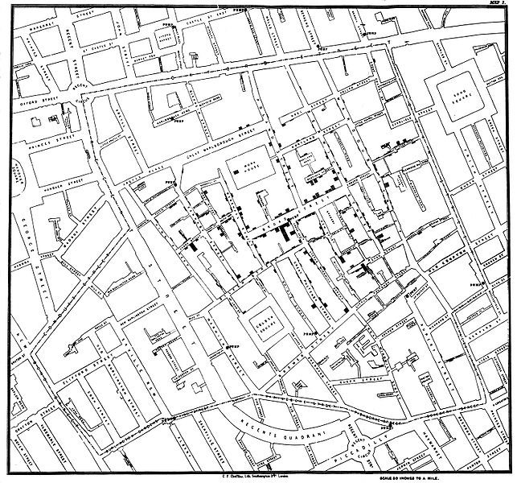
Lesson 9.1: John Snow & Cholera
Obj. 9.1: Identify the scientific thinking John Snow used to identify the source of the famous cholera epidemic.
Module 9: Epidemiology
Notes:
Overview: This lesson will expose students to the birth of epidemiology through a study of John Snow & the cholera outbreak. Students will begin by studying the map of the outbreak created by Snow and determine individually and then as a team how they would solve the mystery of the disease. Then students will read John Snow’s story and answer questions. Finally, they will learn three enduring understandings about epidemiology that stem from Snow’s work.
Image source: http://en.wikipedia.org/wiki/File:Snow-cholera-map-1.jpg

Slide 2
Do Now
Your name is John Snow and you are a “disease detective” in the year 1854. Cholera, a disease that causes watery diarrhea and vomiting and can lead to dehydration and death, has suddenly descended upon London and is causing widespread panic. Most people believe in the miasma theory, that diseases are spread from “bad air.” But you suspect it is caused by something else. Your first idea is to create the map below, showing the cases of cholera in the London neighborhood of Soho highlighted in black.
Notes:
If students struggle, ask more focused guiding questions such as:
1) What are some things you would want to know about the people who got sick and died in the neighborhood?
2) What would you want to know about people who lived in the neighborhood who did not die?
3) What would you want to know about people who died and lived away from the neighborhood?

Slide 3
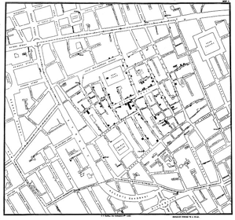
Do Now
Now that you have your map complete, what will you do next?

Slide 4
Scientists Collaborate!
Scientists usually work in teams but they do not always agree, and this is a good thing! Form a small group and share your ideas. As disease detectives, debate the best strategy for identifying the cause of this cholera outbreak. You must come to some sort of agreement on how to proceed, even if it means combining ideas to test multiple theories or using a variety of different methods. When you finalize a plan, write out the steps you will take.
Notes:
Ask students, “Why do you think scientists usually work in teams? Why do they often not agree? Why is this a good thing? What if they usually did agree—what might the consequences be? How do they resolve their disagreements?”

Slide 5
John Snow, The Father of Epidemiology
Cholera is a terrible disease. People who have been infected with cholera have diarrhea so badly that they get dehydrated. Within a short time—two or three days—nearly half the patients will die.
On the night of the 31st of August, 1854, cholera broke out in the Soho section of London. It was, according to a local doctor, “the most terrible outbreak of cholera which ever occurred in the kingdom.” In a single night, doctors reported 56 new cases of cholera—all within a few blocks of each other. Before the outbreak was over, nearly 500 people had lost their lives.
In those days, people did not have running water in their homes. They carried in water from pumps located around the neighborhood.
Source: CDC, BAM Body & Mind!, “John Snow, the First Epidemiologist. <http://www.cdc.gov/bam/teachers/epi-snow.html>
Notes:
This reading is from a lesson devised for the BAM website by the CDC. It can be found at CDC, BAM Body & Mind!, “John Snow, the First Epidemiologist. <http://www.cdc.gov/bam/teachers/epi-snow.html> This website provides great resources and notes that could be used to supplement this shorter lesson.

Slide 6
John Snow, The Father of Epidemiology
At the time, most people—even the best scientists—thought that cholera was spread through the air. But one local doctor did not agree. His name was John Snow. He believed that cholera was caused by a microbe and was spread by contaminated water. But at the time, no one knew how this terrible disease was spread.
Snow carefully mapped the location of each death. Nearly all lived close to the pump at the corner of Cambridge and Broad Streets. Two women who had died lived many miles away. But Snow learned they had drunk water from the pump. Some people who lived in the area had not gotten sick. Snow learned that most of them drank water from other wells.
Snow presented the map to local authorities. This time, they paid attention. He asked them to take the handle off the pump, and eventually, they did. The number of new cases of cholera went down (although it had been declining already since so many people had left the area).
Source: CDC, BAM Body & Mind!, “John Snow, the First Epidemiologist. <http://www.cdc.gov/bam/teachers/epi-snow.html>

Slide 7
John Snow, The Father of Epidemiology
Later, people learned that the well below the pump was about 28 feet deep. But close by ran a sewer that was only 22 feet below ground level. A few days before people got sick, some people remembered a bad smell near the pump. The raw sewage had seeped through the ground and into the well. As more people got sick, the sewage contained more of the microbes that caused cholera. That made the water even more contaminated.
Today, John Snow is recognized as one of the first “disease detectives.” His methods of gathering information are still used by epidemiologists. One of the first things epidemiologists do when they get to the site of an outbreak of a new disease is to map it. They figure out in detail where all the sick people live, work, and play. They also keep track of anyone with whom a sick person has had contact.
Source: CDC, BAM Body & Mind!, “John Snow, the First Epidemiologist. <http://www.cdc.gov/bam/teachers/epi-snow.html>

Slide 8
The Science of Disease Investigation:
Once John Snow plotted the cases of cholera on a map, what do you think he did next?
How do you think Snow arrived at the hypothesis that cholera might be spread through water?
What evidence did Snow need to convince others that his hypothesis was correct?
Suppose the disease was not spread through water. What other explanation might you make for the pattern of distribution of the disease on Snow’s map?
Another scientist argues that the cholera outbreak is caused by “bad air.” What evidence would you need to disprove this hypothesis?
What skills do you think Snow needed to accomplish the goal of solving the mysterious cholera outbreak in Soho and convincing others?
Notes:
Have students pair up to work on these questions alone or in pairs. Push them to answer thoughtfully and defend their answers with logic, examples, and/or evidence.

Slide 9
Fundamental Epidemiologic Understandings:
John Snow is considered the father of modern epidemiology. Since his investigation of the Soho cholera outbreak in 1854, the field of epidemiology has come a long way. Read on for some basic understandings about epidemiology:
1) The causes of health and disease are discoverable by systematically and rigorously identifying their patterns in populations, formulating causal hypotheses, and testing those hypotheses by comparing groups. These methods lie at the core of the science of epidemiology. Epidemiology is the basic science of public health, a discipline responsible for improving health and preventing disease in populations.
2) Health and disease are not distributed haphazardly in a population. There are patterns to their occurrences. These patterns can be identified through the surveillance of a population.
3) Analysis of these patterns can help formulate hypotheses about the possible causes of health and disease.
Source: Kaelin MA, Huebner WW, Cordell RL, & Szklarczuk B, Professional Development for Prospective Epidemiology Teachers in Grades 6-12. Public Health Reports. 2008 (123).
Notes:
These understandings come from a set of 12 concepts and principles sequenced in the article listed below. They will be referenced and used throughout the lessons in this module.
Kaelin MA, Huebner WW, Cordell RL, & Szklarczuk B, Professional Development for Prospective Epidemiology Teachers in Grades 6-12. Public Health Reports. 2008 (123).

Slide 10
Check Your Understanding:
Answer the following questions in approximately 2-4 sentences.
What method did John Snow use to determine the source of the cholera outbreak in 1854?
Why is John Snow considered the “Father of Epidemiology?”
Notes:
Possible answers:
John snow used a spatial analysis of the locations of cases of the disease. He then mapped possible environmental sources of contamination (namely, the Broad street pump) in relation to the cases. He also gathered information from the cases and controls, probably by going door to door with a questionnaire for all residents. Next, he tried to determine explanations for cases not in proximity to the source of the water contamination and for those who were within proximity but did not get the disease.
Snow published the first documented study that successfully showed how epidemiological methods can be used to identify and prevent causes of contagious disease. At the time, the Germ Theory had not yet emerged and most people thought there were spiritual or other causes for disease (i.e. miasma theory—”bad air”, so this was a huge discovery.

Slide 11
Homework:
Explore the John Snow Web site created by the UCLA Department of Epidemiology at http://www.ph.ucla.edu/epi/snow.html. This site is includes both articles about John Snow as well as some of his primary source documents, including some of the maps he made of the cholera epidemic in London. As you explore, write a 5 question quiz about John Snow and his cholera outbreak. (Be sure to write answers on a separate page!)
Notes:
The purpose of this homework is to give students additional background information about Snow, the Soho Cholera outbreak of 1854, and the foundations of epidemiology. If time permits in the following class, students can exchange quizzes with a partner in class and try to answer each others questions. Making this a competition ( to see who can get the most right) might promote more engagement in this exercise.

