Slide 1
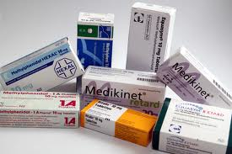
Lesson 8.7: Medication Adherence
Obj. 8.7: Identify factors that influence patient medication adherence.
Module 8: Pharmacy
Notes:
Overview: In this lesson, students will tackle two related, but complex topics--health literacy and medication adherence. First students will examine prescription drug use trends and notice a rates of medication usage over time. Then students will watch an eye-opening video featuring patients who discuss how their literacy impacted their health. Next, students will review statistics on medication non-adherence. Finally, students will review factors that make up various dimensions of non-adherence and examine a resource listing recommended questions to ask a physician about medication.
Image source:

Slide 2
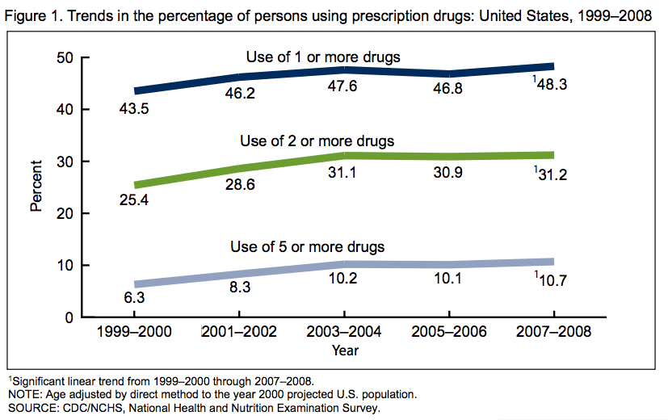
Do Now: Trends in Prescription Drug Use
Source: CDC (http://www.cdc.gov/nchs/data/databriefs/db42.htm)

Slide 3
Do Now: Trends in Prescription Drug Use
1. Explain the trend in prescription drug use from 1999-2008.
2. What percentage of the population used five or more drugs in 2007-08?
3. What percentage of the population uses no prescription drugs in 2007-08?
4 .Which population shown in this graph increased the most between 1999 and 2008?
Notes:
Answers:
1.Steadily increasing
2. 10.7 percent
3. 51.7 percent (100-48.2)
4. Use of 2 or more drugs

Slide 4
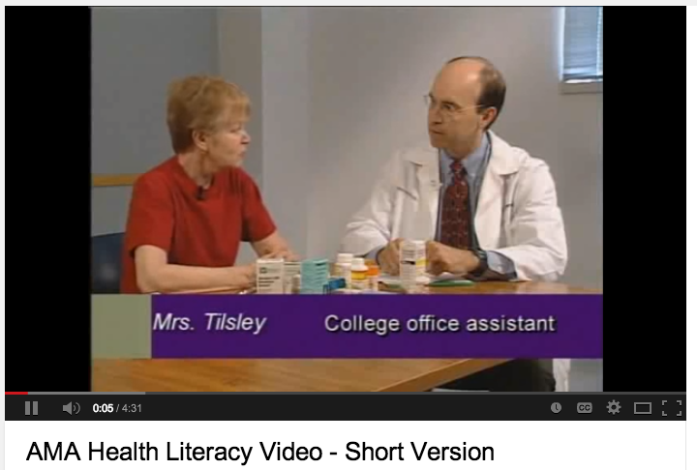
Health Literacy Video
1. How did their literacy level impact their health & lives? (Give a few specific examples)
2. What could the health professionals could have done to help these patients?
Video: https://www.youtube.com/watch?v=BgTuD7l7LG8
Notes:
Video source: AMA Health Literacy Short Version, Run time: 4:31 (https://www.youtube.com/watch?v=BgTuD7l7LG8)
A longer version of the video (run time: 23:18) is an excellent learning tool for this lesson, if time permits. It cab be found at: https://www.youtube.com/watch?v=cGtTZ_vxjyA

Slide 5
A Snapshot of Med Adherence
With a partner, review the following statistics. Then discuss the implications of the problems presented together.
Notes:
Ask students, “What are some reasons people would get a prescription but then not fill it? How about reasons why they would get it, fill it, but then not take/continue it as prescribed?” Also ask, “Why does non-adherence cost more?”

Slide 6
Dimensions of Non-Adherence
Source: CDC (http://www.cdc.gov/primarycare/materials/medication/docs/medication-adherence-01ccd.pdf
Notes:
This set of slides is from a larger presentation on medication adherence designed for primary care educators. It is a free resources from the CDC for use in any classroom setting. Ask students how this relates to the social-ecological model.

Slide 7
Dimensions of Non-Adherence
1. What are some possible reasons that patient education materials are not written in plain language?
2. Considering we live in a digital age, how would you update the Health-care system list to reflect digital rather than just written information?
Source: CDC (http://www.cdc.gov/primarycare/materials/medication/docs/medication-adherence-01ccd.pdf
Notes:
Possible answers:
1. Lack of time/resources in writing materials or updating them; lack of education on health literacy among the materials writers; etc.
2. Existence of websites, social media, blogs, & apps; type of information present; literacy level or adaptability of content to various literacy levels

Slide 8
Dimensions of Non-Adherence
3. What factors might contribute to the lack of positive reinforcement for health care providers to take time to improve medication adherence with patients?
Source: CDC (http://www.cdc.gov/primarycare/materials/medication/docs/medication-adherence-01ccd.pdf
Notes:
Possible answers
3. Insurance company reimbursement, patient load, lack of recognition and encouragement from colleagues supervisors, assumption that nurses or other health professionals are doing this work, etc.

Slide 9
Dimensions of Non-Adherence
4. Which of the condition- and therapy-related factors do you think an older patient with dementia would be most affected by?
Source: CDC (http://www.cdc.gov/primarycare/materials/medication/docs/medication-adherence-01ccd.pdf
Notes:
4.Answers will vary (complexity and frequent changes should be mentioned; dementia patients may not remember complex, frequently changing pill or treatment regimens!)

Slide 10
Dimensions of Non-Adherence
5. What specific patient or environmental factors would make a patient prone to the factor of “inability to access or difficulty accessing pharmacy”?
Source: CDC (http://www.cdc.gov/primarycare/materials/medication/docs/medication-adherence-01ccd.pdf
Notes:
5. Lack of mobility/handicap; lack of transportation; safety of neighborhood, etc.

Slide 11
12 Questions to Ask About Your Medication
1. Assume a patient DID NOT ask any of these questions and stopped taking their medication after one week. List at least THREE reasons they may have stopped:
2. Which of these questions do you think physicians are LEAST LIKELY to voluntarily explain (without the patient asking) during a visit? Which are pharmacists LEAST LIKELY to routinely explain?
3. Assuming a patient did not print this guide and bring it to their visit, they may think of some questions when they get home or after they begin taking the medication. What can be done to ensure patients have an opportunity to ask questions, access information, and get answers AFTER the initial physician and pharmacy visits?
Source: Script Your Future (http://www.scriptyourfuture.org/file/4dc82f61134a7.pdf)
Notes:
The website www.scriptyourfuture.org has a number of excellent resources on prescription medications, medication adherence, health literacy, and more! Direct students to this site during the upcoming case studies!

Slide 12
Assess: Patient Scenario
Mr. Smith is an elderly man with mild dementia. He is taking seven medications and stores them in his bathroom medicine cabinet, which is cluttered with bottles, some of which are several decades old and expired. Mr. Smith doesn’t have any family nearby, but his neighbor stops in to check on him every few days. He visits his physician once every few months to get his diabetes and high blood pressure checked. When these visits occur, there are often minor tweaks to his medication regimen.
List at least THREE factors that influence Mr. Smiths medication adherence:
Notes:
Health-care team: Patient’s forgetfulness
Provider factors: # of comorbid condition; # meds needed per day
Patient/Condition factors: complexity & changes in treatments
Social: lack of family support

Slide 13
Homework: Brainstorm Solutions
What can health providers do about the health literacy and medication non-adherence problem? Come up with a list of recommendations. Then choose one of your ideas and write a detailed explanation (at least one paragraph long).
Notes:
The purpose of this homework assignment is to have students expand upon their understanding of the problems of health literacy & medication adherence by working toward solutions.

