Slide 1
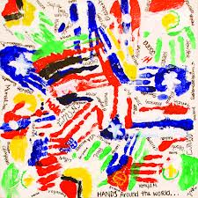
Lesson 8.6: Cultural Competency
Obj. 8.6: Apply effective communication and cultural competency skills to community pharmacy situations.
Module 8: Pharmacy
Notes:
Overview: Students will learn how important communication and cultural competency are in healthcare in this lesson. First, students will reflect upon a situation where they experienced a poor communication with a healthcare professional. Then, they will anticipate what cultural competency is before reviewing some concepts in communication and cultural competency. Next they will view a video and analyze written scenarios depicting communication between a pharmacist and patient, and determine what skills are present or lacking in the pharmacist’s actions.
Image source: Flickr,

Slide 2
Do Now: Breakdown in Communication
Explain a time when you and a health care provider had poor communication? What were the causes? What were the effects?
Notes:
Ask students how they knew the communication was poor. What there something you didn’t have a chance to or feel comfortable with communicating? Did you misunderstand the healthcare professional or walk away feeling confused? Did the interaction feel impersonal or even uncomfortable? Etc..

Slide 3
Discuss: Cultural Competency
What does the word “culture” mean to you?
What does the word “competent” mean to you?
On a scale of 1-10 (1 being very unimportant and 10 being very important) how important do you think listening & communication skills are in general? Specifically to pharmacists? Why?
Notes:
Ask students, “For what other healthcare professionals is communication extremely important? Why?”

Slide 4
What is Cultural Competency?
CULTURAL COMPETENCY:
—Refers to an ability to interact effectively with people of different cultures and socio-economic backgrounds
—Cultural competence comprises four components:
1. Awareness of one's own cultural worldview
2. Attitude towards cultural differences
3. Knowledge of different cultural practices and worldview
4. Cross-cultural skills. Developing cultural competence results in an ability to understand, communicate with, and effectively interact with people across cultures.
Notes:
Ask students, what OTHER differences in culture (besides socio-economic background) does this definition include, although not listed explicitly? (Students will often consider culture as ethnic, racial, or geographical difference only. In fact, they should consider other differences, such as sexual orientation (LGBTQ), faith, education level, etc.)

Slide 5
What is Supportive Communication?
SUPPORTIVE COMMUNICATION:
—An effective way of communicating with individuals, especially used in times of crisis (ex. Patient who has just found out they have cancer, etc.)
—Includes using: Empathy, Respect, Positive regard, Non-judgmental stance, Empowering, Practical, Confidentiality, Ethical conduct.
—Includes verbal and non-verbal communication
Notes:
Ask students, “what is empathy? Non-judgmental stance? Empowering?” to ensure they have a clear understanding of all this entails.

Slide 6
What does it look like?
Listening + Supportive Communication: What does it look like?
—Will - Making the choice to listen actively
—Attention – Focusing on the patient
—Bracketing – Not being judgmental (where we think about cultural competency); rephrasing the patient’s concern
—Empathic Responding – Experiencing how someone else feels & letting them know you understand
Notes:
Ask students, which of these is most natural (or easiest) for you in everyday life? Which is most challenging? Ask students why they think the terms “will” and “bracketing” are used to describe those respective skills.

Slide 7
Cultural Competency Scenarios:
1. Ms. B is an African American mother of a child with special health care needs. Frequently, when she walks up to the front desk, she is automatically asked for her Medicaid card. Her family is not eligible for any Medicaid waivers and has private insurance through her husband’s employer. She does not appreciate that the front desk automatically assumes that because she is African American, she is poor.
What are the effects of this situation for:
a) Ms. B? b) Her child? c) The pharmacist?
Notes:
What are the effects of this situation for:
a) Ms. B? Likely won’t adhere to the medicinal therapy; Will likely resist the treatment and advice
b) Child? Less likely to be cured
c) Pharmacist? Become frustrated that patient is angry

Slide 8
Cultural Competency Scenarios:
Mr. Q speaks very little English. He finds it very difficult to make appointments and get prescriptions renewed at his child’s doctor’s office and pharmacy. He chose his child’s pharmacy because one of the pharmacists speaks Spanish. There is another person in the office who speaks Spanish, but she is often busy interpreting for someone else. Thus, Mr. Q feels very hesitant about calling or going to the pharmacy.
What are the effects of this situation for:
a) Mr. Q? b) His child? c) The pharmacist?
Notes:
What are the effects of this situation for:
a) Mr. Q? Likely won’t adhere to the medicinal therapy; Will likely resist the treatment and advice
b) Child? Less likely to be cured
c) Pharmacist? Become frustrated that patient is angry; Fewer patients

Slide 9
Watching Communication in Action
http://www.youtube.com/watch?v=D3UBuRc9sZ4
As you watch, try to identify which of the 4 parts of communication are being used and which of the 4 are being left out. (Will, Attention, Bracketing, Empathic Responding)

Slide 10
will, attention, bracketing, or empathic response?
1. Angelica goes to the pharmacist and explains that she has “terrible back pain that will not go away.” She is frustrated because she has gone to several different pharmacies, and no one will give her medication. After listening, the pharmacist calmly looks at Angelica and says, “I can understand how you’re frustrated. I encountered a similar situation when I had terrible stomach pain.” Which communication or cultural competency skill best describes the step in the process of supportive communication?
Notes:
1) The pharmacist is demonstrating Empathic reasoning

Slide 11
will, attention, bracketing, or empathic response?
2. Oliver just received a prescription eye drop from his doctor. When he got home, he checked his online and discovered that the drops the doctor gave him were intended for an ear ache. If he put them in his eye, he could potentially go blind! He rushed to the pharmacy to complain, and what frustrated him further was that the pharmacist answered the phone in the middle of talking to him! Which skill was the pharmacist not practicing?
Notes:
2) The pharmacist is NOT demonstrating Attention.

Slide 12
will, attention, bracketing, or empathic response?
3. Vincent calls his local pharmacist and tells him that his doctor prescribed him some medicine that is now making him feel very dizzy and nauseous. The pharmacist has dealt with Vincent before, and knows that Vincent complains of dizziness with every medication and acts sort of “wimpy”. The pharmacist decides to be professional and push that thought out of his mind, so he can really listen to Vincent. Maybe this time it’s serious! Which skill best describes the step in the process of listening?
Notes:
3) The pharmacist is demonstrating bracketing and will!

Slide 13
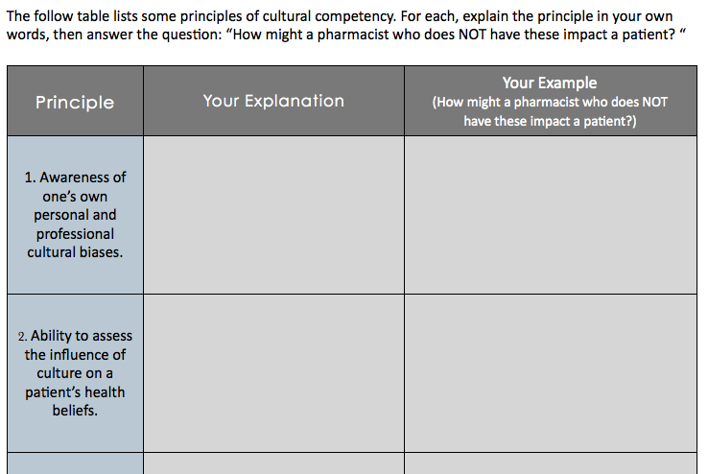
Homework:
Notes:
The purpose of this assignment is to expand on the concept of cultural competency beyond the focus of this lesson, communication.

