Slide 1
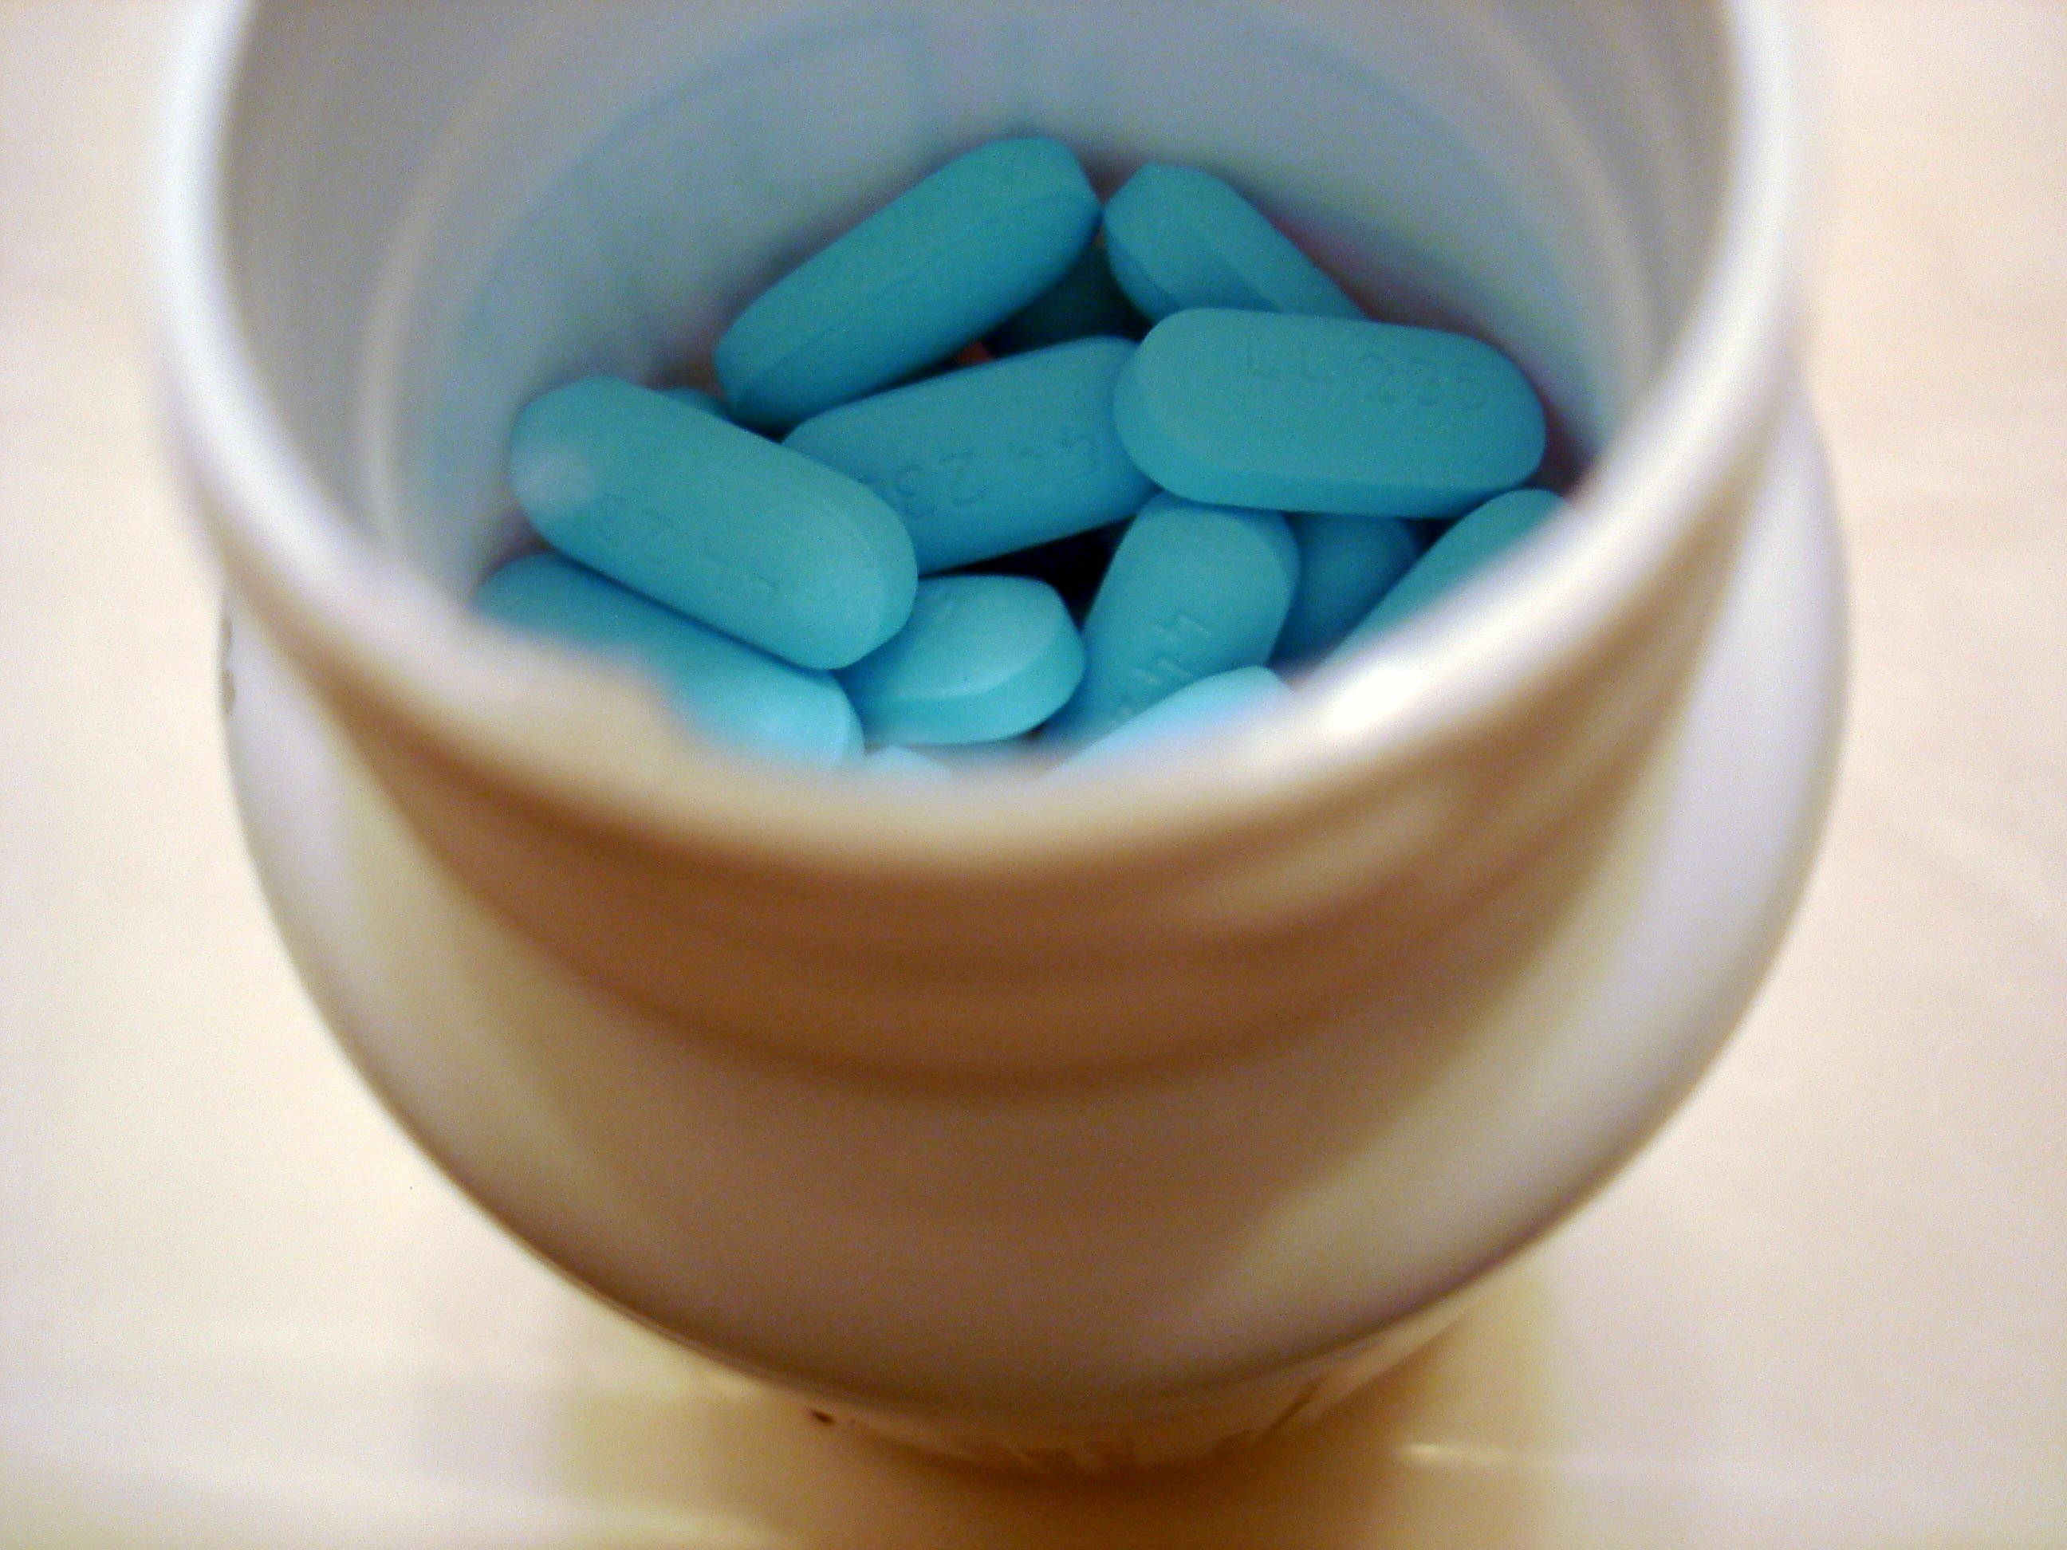
Lesson 8.4: Prescription PaiNkiller Abuse
Obj. 8.4: Identify causes and effects of the painkiller abuse problem.
Module 8: Pharmacy
Notes:
Overview: This lesson will challenge students to explore a crisis in our country--prescription painkiller abuse. It is a relevant topic to high schoolers as they prepare to head to college or post-secondary life. Students will begin by reading the first part of a recent news article. Then they’ll dig into some background research. This will set them up to begin a webquest using the Drug Free World website where they’ll digest a great deal of information on the topic written in an engaging way.
Image source: Stephen Cummings via Flickr (http://www.flickr.com/photos/spcummings/3156907205/)

Slide 2
Do Now: Free pills from friends driving painkiller abuse
March 4, 2014 (CBS NEWS)
CHICAGO -- Most people who abuse addictive prescription painkillers get them for free from friends or relatives, while drug dealers are a relatively uncommon source for those at highest risk for deadly overdoses, a government study found.
People who abuse the most frequently often doctor-shop; more than 1 in 4 who used these drugs almost daily said they had been prescribed by one or more physicians. Almost as many said they got them for free from friends or relatives; only 15 percent of the most frequent abusers said they bought the drugs from dealers or other strangers.
Source: http://www.cbsnews.com/news/free-pills-from-friends-driving-painkiller-abuse-study/
What do you think are some possible consequences of painkiller abuse?
What do you think the term “doctor-shop” refers to?
What factors might increase a teenager’s likelihood to obtain prescription painkillers from a friend or relative?
Notes:
Ask students if they have heard about the painkiller abuse epidemic? Some students may have personal experiences or know a family member or friend who is addicted, so set the tone for sensitivity and respect.

Slide 3
Prescription Painkiller Background
What is the role of prescription painkillers?
How do prescription painkiller deaths occur?
Who is most at risk?
Source: (http://www.cdc.gov/homeandrecreationalsafety/rxbrief/)
Notes:
Before reading, probe students to find out what they already know and what questions they have.

Slide 4
The Truth About Painkillers (DrugFreeWorld)
Navigate to: http://www.drugfreeworld.org/drugfacts/painkillers.html
PRESCRIPTION PAINKILLER ABUSE
1. Why do so many young people choose to get high from prescription painkillers?
WHAT ARE PAINKILLERS
2. What are opioids and why are they so addictive?
UNDERSTANDING WHY PAINKILLERS BECOME SO ADDICTIVE
3. What is one of the most serious risks of opioids?
OXYCONTIN THE “HILLBILLY HEROIN”
4. Why is OxyContin considered the drug of greatest concern to law enforcement agencies in some areas?
Notes:
The website www.drugfreeworld.org has great resources for all types of prescription drug abuse topics. Consider assigning other mini-research projects for homework, if time permits. Students may be very naturally interested in this information, so this would also be a great optional or extra credit challenge.

Slide 5
The Truth About Painkillers (DrugFreeWorld)
Navigate to: http://www.drugfreeworld.org/drugfacts/painkillers.html
MENTAL AND PSYCHOLOGICAL EFFECTS OF PAINKILLERS
5. List them mental and psychological effects of painkiller in order from least to most severe (in your opinion).
PAINKILLERS: A SHORT HISTORY
6. In what years did Vicodin, OxyContin, and Percocet come onto the market with FDA approval?
WARNING SIGNS OF PRESCRIPTION PAINKILLER DEPENDENCY
7. List 3 signs of dependency on prescription painkillers.

Slide 6
Summarize:
Describe the prescription painkiller abuse epidemic to someone who has never heard of this problem. In your description, include some causes or risk factors and effects or consequences.

Slide 7
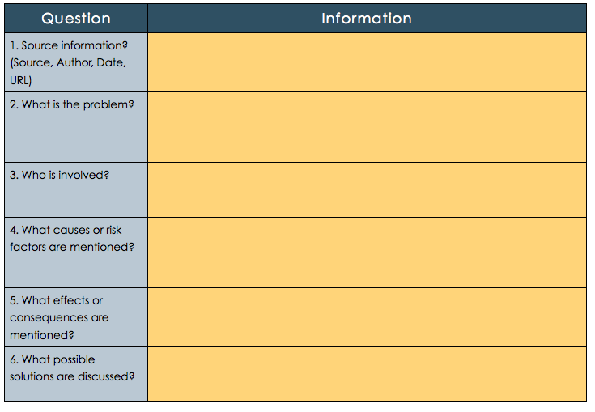
Homework: Painkiller Abuse in the News
Find a news article from the last five years describing a case or issue related to prescription painkiller abuse. Summarize the article in the table below:
Notes:
The purpose of the homework assignment is to make students aware of the extent of the problem of painkiller abuse, while helping them practice recognizing the risk factors, effects/consequences of the problem in the article they find. Encourage students to star their search for a news article on Google, if they add the word “News” or click the Google News tab, they will be directed to recent articles that are from news outlets.

