Slide 1
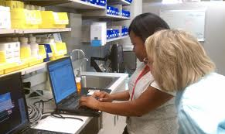
Lesson 8.2: Pharmacy settings
Obj. 8.2: Differentiate between the four main pharmacy services.
Module 8: Pharmacy
Notes:
Overview: This lesson exposes students to the variety of possible work settings the field of pharmacy encompasses and helps them understand how pharmacists are able to be critical members of the patient care team. In this lesson, students will reflect upon their own most recent experiences with pharmacies and split up research roles to “jigsaw” information on the four different types of pharmacy.
Image source: Wikimedia Commons, http://commons.wikimedia.org/wiki/File:Winn_Army_Community_Hospital_Pharmacy_Stays_Online_During_Power_Outage.jpg

Slide 2
Do Now: Pharm Experiences
Describe the last experience you had with a pharmacy or pharmacist.
Where was it? Describe the physical characteristics.
What was the purpose of the interaction? (You do not need to disclose specific medical details!)
Who did you interact with? Was the interaction effective and positive? Explain.
What details made the pharmacy or pharmacist unique?
Notes:
Most students will have last visited a chain pharmacy. A few may have recently been in a hospital (for themselves or a loved one), or in a nursing home visiting a relative, but they are unlikely to have encountered those pharmacy settings directly.

Slide 3
COMPARE & CONTRAST
Share your pharmacy experiences with a partner.
What was similar about your experiences?
What was different about your experiences?

Slide 4
4 Types of Pharmacy Jigsaw
Step 1: In a group of four, assign each member to ONE of the following types of pharmacies:
1: Community Independent Pharmacy
2: Community Chain Pharmacy
3: Institutional Pharmacy
4: Long-term care pharmacy
Step 2: Research your type of pharmacy on the Internet. Take notes in the graphic organizer. (10m)
Step 3: Share with your team. (15m)
Notes:
Students will split up topics, then return to the “home group” to share what they have learned. When students split have each cohort of students working on similar types of pharmacies sit together and work as a temporary team to share websites & information.

Slide 5
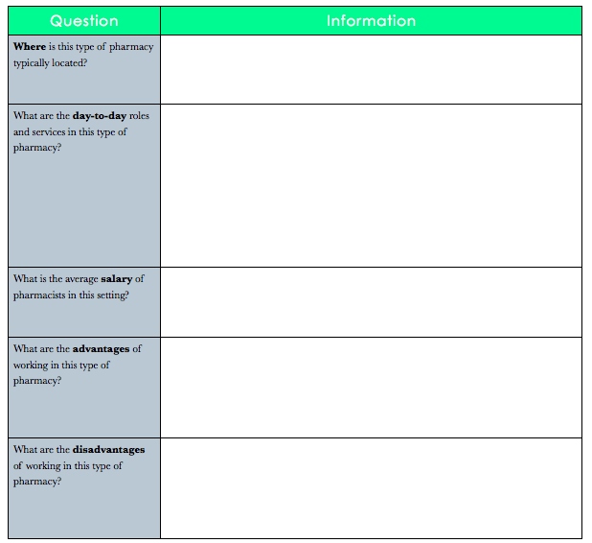
4 Types of Pharmacy Jigsaw
Notes:
Remind students to look for credible sources and let them know they may not find sources that list all four in a nice, neat package. For example, navigating to the wikipedia page for “pharmacy” leads to 11 different types of pharmacy practice areas. Within that list or other organizational frameworks on different resource sites, students should be able to find their assigned type of pharmacy.

Slide 6
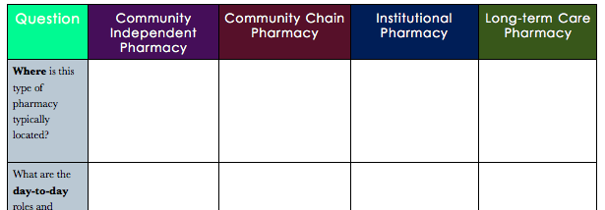
4 Types of Pharmacy Chart
Notes:
Refer to the PDF of notes in the resources file for an “answer key.” Have students present information to their groups simultaneously.

Slide 7
Assess: What type of pharm…?
Identify which of the four main types of pharmacy services fit for each question. Label your answers as pharmacy as independent, chain, institutional, or long term care.
1. Based in a hospital?
2. Often a locally managed branch of a corporation?
3. Independently managed and owned?
4. Based in a nursing home?
Notes:
Answers: 1- Institutional; 2-Chain; 3-Independent; 4-Long term care (this should be a quick and easy review for students!)

Slide 8
Homework:
1. Locate 4 pharmacies nearest to your house.
2. Write down the name & location in the table below.
3. Label the pharmacy as independent, chain, institutional, or long term care. Try to find at least two that are NOT chain pharmacies (i.e., CVS, Walgreens)
Notes:
The purpose of this homework assignment is to help students realize the variety of pharmacy settings that may be surrounding them and practice identifying the types of pharmacies in a real setting.

