Slide 1
Lesson 8.10: Technology & Health
Obj. 8.10: Explain how technology can influence and support people to make positive health choices.
Module 8: Pharmacy
Notes:
Overview: This lesson will engage students in contemplation about the role of the Internet in health and its potential as a future health tool. Students will begin by deciding which technologies they believe health professionals should engage in. Then they will read a summary of the Pew study on Internet and Health, responding to reflection questions as they go. Finally, they will combine the information they learned with their own ideas about the role of healthcare providers online and the use of the Internet in patient’s quest to improve health.
Image source: Wikipedia/Wikicommon (http://en.wikipedia.org/wiki/File:Internet1.jpg)

Slide 2
Do Now: Health Professionals & Tech
1. Electronic tools health professionals should use: (place a check by any that apply): Texting, Blogging, E-mail, Social media (Facebook, Twitter, etc.), Instant messaging, Video messaging, Youtube (posting content or commenting), & Other?
2. Which of the tools should doctors use to communicate with patients directly, if any? Why?
3. Which of the tools should doctors use only to communicate with a larger audience as a whole (which may or may not include their specific patients)? Why?
4. What are the possible BENEFITS of health professionals using these electronic tools?
5. What are the possible RISKS of health professionals using these electronic tools?
Notes:
Use think-pair-share for reviewing these answers. If time permits, make a list of risks and benefits (#4 & 5) on the wall.

Slide 3
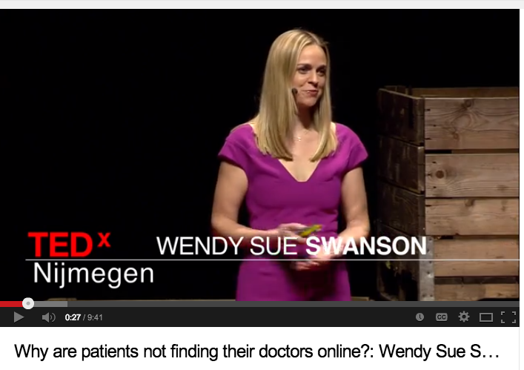
Why are patients NOT finding their doctors online?
Video: https://www.youtube.com/watch?v=64sfC8Di1pw
Notes:
Wendy Sue Swanson is a pediatrician and author of the popular medical blog, “Seattle Mama Doc.” She is an advocate for physician presence online. For the homework assignment, remind students of her example.
Video: https://www.youtube.com/watch?v=64sfC8Di1pw

Slide 4
Why are patients NOT finding their doctors online?
1) What perspectives does Wendy Sue Swanson speak from?
2) According to Dr. Swanson, what opportunities does social media give us?
3) ”Roughly 80% of the people in the USA first go to Google when they are concerned about something in their body.” What is Dr. Swanson’s overall response to this fact. Do you agree with her approach? Why or why not?

Slide 5
“Health Online 2013”: Online Diagnosers
One in three American adults have gone online to figure out a medical condition.
Notes:
If time is an issue, assign groups to work on each sub-section and report out.

Slide 6
“Health Online 2013”: Online vs. Offline Care
Clinicians are a central resource for information or support during serious health episodes — and the care and conversation take place mostly offline.

Slide 7
“Health Online 2013”: Health Inquiries & Search Engines
Eight in 10 online health inquiries start at a search engine

Slide 8
“Health Online 2013”: Barrier to Access
Half of health information searches are on behalf of someone else
One in four people seeking health information online have hit a pay wall

Slide 9
“Health Online 2013”: The Social Life of Health Info
The social life of health information is a low-key but steady presence in American life

Slide 10
Where are the Health Care Professionals?
This research demonstrates that patients are going online for their health in large numbers. So why aren’t most pharmacists, doctors, and other health professionals also online? With a partner, discuss and list as many reasons as you can for why many health care professionals are not taking their work online.
Notes:
Some possible reasons: Worried about privacy concerns, don’t have time, fearful of being judged, not skilled or comfortable with technologies online, not allowed to based on rules In their practice, don’t believe it will be effective use of time, unsure where to begin, don’t have peers/colleagues also doing so (don’t want to “stick out”), etc.

Slide 11
Assess: Harnessing the Power of the Internet for Health
Studies have shown prevalent health information-seeking on the Internet is today. In order to capitalize on this trend, explain some possible actions health professionals should take.

Slide 12
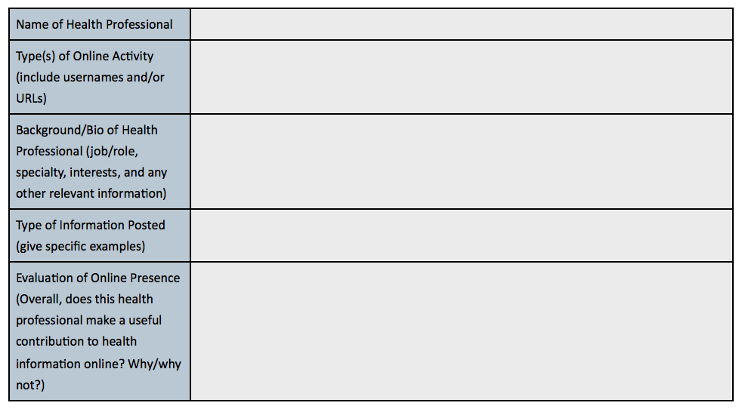
Homework: Who IS online?
Find one example of a health professional engaging in health dialogue online. They could be blogging, creating video content on Youtube or Vimeo, using social media (Twitter, Facebook, etc.), updating a web page for their medical practice, or some combination of these things.
Notes:
The purpose of this homework assignment is to help students explore what information is out there from health professionals. They may find a variety of resources from authored articles to blogs to social media accounts. They can find health professionals who are connecting with the online world through Google searches, browsing Ted Med talks, or searching on social media sites. If students have a particular interest in healthcare (i.e want to be a pediatrician or a pharmacist) challenge them to find a health professional who fits that description.

