Slide 1
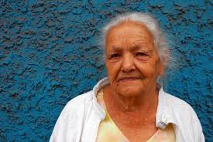
Lesson 7.6: Elder Abuse
Obj. 7.6: Identify the types of elder abuse and the risk and protective factors for elder abuse.
Module 7: Violence
Notes:
Overview: Students will grapple with the troubling problem of elder abuse in this lesson. They will begin by examining a news headline and reviewing some statistics on the problem in order to reflect. Then they will learn about the types of elder abuse and the risk and protective factors for perpetration of elder abuse. Finally, they will work in teams to devise interventions to reduce elder abuse in their community.
Image source: Flickr, http://www.flickr.com/photos/kioko/3180017779/

Slide 2
Do Now: Prevalence of Elder Abuse
A recent ABC News headline proclaimed, “Elderly Abused at 1 in 3 Nursing Homes.”
Have you heard of elder abuse? If so, when or where? What do you already know about it?
Do you have any elderly grandparents or family members in nursing homes or cared for and supported by nursing aides or other family members? If so, how might they be vulnerable to elder abuse? (If you do not, imagine elders in this setting in order to answer this question).
Notes:
Most students will be able to relate with this topic through their grandparents or other elders they know. However, some may have younger grandparents or no grandparents or elderly relatives. One possible way to introduce the topic is to show a short video. The video “An Age for Justice: Confronting Elder Abuse in America
” (Run time: 16:03) can be found at: https://www.youtube.com/watch?v=-eaJXBj87to

Slide 3
Incidence of Elder Abuse
The true incidence of elder abuse is difficult to determine.
Roughly 551,000 persons age 60 and older experienced elder abuse, neglect, or self-neglect in domestic settings
only 21% (about 115,000) were reported to and substantiated by Adult Protective Service (APS) agencies; the remaining 79% were either not reported to APS or not substantiated.
Between 1 and 2 million residents of the United States age 65 or older have been abused, neglected, or exploited by persons on whom they depended for care or protection
Why is elder abuse so common? What specific factors make elders vulnerable to abuse?
Why is elder abuse such an underreported problem? What specific factor prevent reporting?
Source: CDC, Consequences of Elder Abuse, http://www.cdc.gov/violenceprevention/elderabuse/consequences.html
Notes:
More data and statistics on violence among the elderly (in general), as it compares with violence among other age groups, can be found at the US Dept of Justice statistics site (http://www.bjs.gov/content/pub/pdf/cpa6502.pdf.) Some interesting trends to have students look for: 1) violence decreases as age increases; 2) compared with other violence and other age groups, robbery/theft/purse-snatching appears highest in the elderly (over 65).

Slide 4
Forms of Elder Abuse:
Physical Abuse
Sexual Abuse or Abusive Sexual Contact
Psychological or Emotional Abuse
Neglect
Abandonment
Financial Abuse or Exploitation
Notes:
Source: http://www.cdc.gov/violenceprevention/elderabuse/definitions.html
For more background information on the Consequences of elder abuse, navigate to the tab labeled “Consequences”

Slide 5
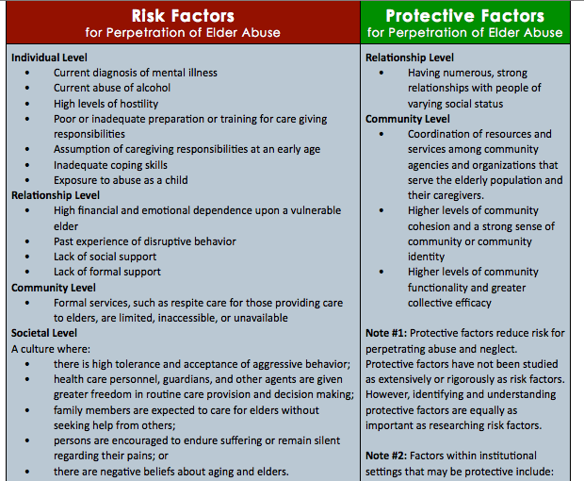
Source: CDC, Risk and Protective Factors for Elder Abuse (http://www.cdc.gov/violenceprevention/elderabuse/riskprotectivefactors.html)
Notes:
Ensure students understand what the word “perpetration” means.
Source: http://www.cdc.gov/violenceprevention/elderabuse/riskprotectivefactors.html

Slide 6
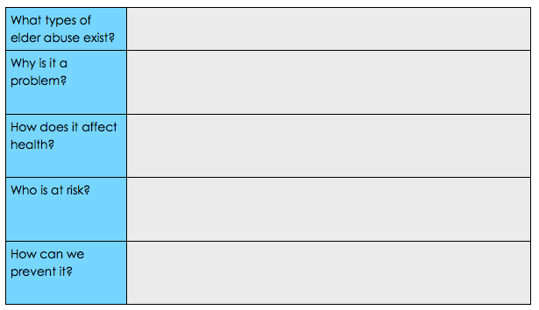
Understanding Elder Abuse
Read the ‘Understanding Elder Abuse Fact Sheet” and answer the questions that follow as you read
Notes:
Fact sheet can be found at: http://www.cdc.gov/violenceprevention/pdf/em-factsheet-a.pdf or using the PDF file located in the Resources folder. Ensure a class set of copies are made for the lesson.

Slide 7
Interventions to Reduce Elder Abuse
As a team, create a strategy to reduce elder abuse in your community by proposing an intervention. Recall the risk and protective factors for elder abuse, as well as the prevention strategies you just read about in the CDC Factsheet. Use the questions below to plan your solution:
What risk factor or protective factor will you target?
Describe your intervention? (Be sure to answer Who, What, When, Where, Why, and How)
What evidence will you collect to determine the success of your intervention?
Notes:
If time permits have students informally present their intervention ideas to the class. Have one student be a recorder and type of the interventions in a list. Then assign another student or team to look up addresses of senior centers or agencies that work with seniors and mail the list with a cover letter explaining the class assignment. This could be offered for extra credit if school & class policies permit. This is a great way to engage students in the real world impact of their daily work in the classroom.

Slide 8
Assess:
1. Name 3 forms of elder abuse:
2. Name 2 risk factors for the perpetration of elder abuse.
3. Name 2 protective factors against the perpetration of elder abuse.
Notes:
For answers, refer to the “New Info” section of the notes on elder abuse.

Slide 9
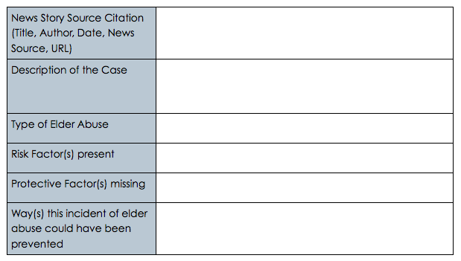
Homework: Elder Abuse in the News
Unfortunately, elder abuse is all too common and often makes it into the news. Using your local paper or online news articles from any source in your state, nation, or world, find a story about a case of elder abuse and answer the questions in the table below.
Notes:
The purpose of this homework assignment is to encourage students to make connections to the real lives that elder abuse impacts. By finding a news story featuring a case of elder abuse, students can apply the information they learned from the CDC’s research on RFs and PFs to a real case.

