Slide 1
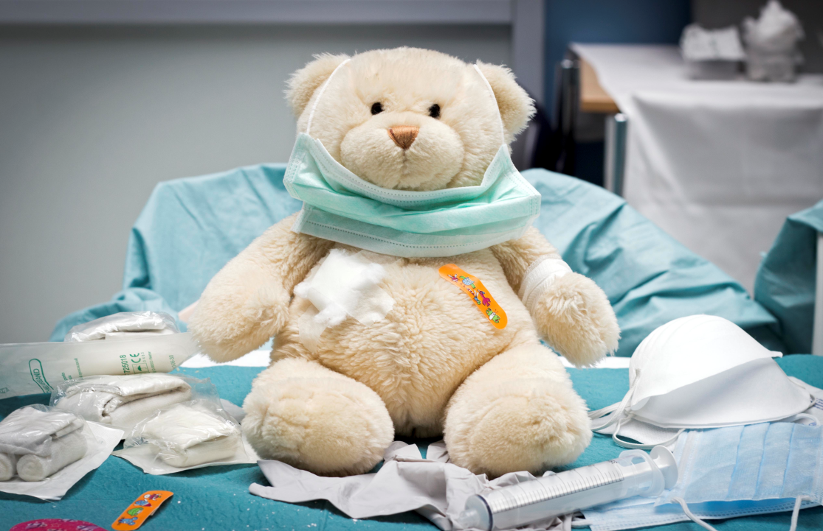
Lesson 7.5: Child Maltreatment
Obj. 7.5: Explain the role of safe, stable, and nurturing parent-child relationships to children’s health.
Module 7: Violence
Notes:
Overview: This lesson will help students explore the concepts of child maltreatment prevention through a close examination of risk factors and qualities of healthy relationships. First, students will brainstorm qualities that make relationships successful, then learn the CDC’s recommendation of 3 critical qualities. Next, students will read about child maltreatment and its risk and protective factors. Finally, students will review scenarios depicting child maltreatment and identify which of the 3 qualities are missing.
Image source: Flickr, http://www.flickr.com/photos/christiaantriebert/9024165415/

Slide 2
Do Now: Parent-Child Relationship
List qualities of parent-child relationships that might be important to ensure a healthy environment for children as they grow and develop. List as many as you can!
Notes:
Set norms in the classroom for a respectful and sensitive environment for learning, since the issue of child maltreatment may have a personal connection for some students and may be an emotionally challenging topic to focus on in school.

Slide 3
3 Critical Qualities
The CDC has identified SAFETY, STABILITY, and NURTURING as three critical qualities of relationships that make a difference for children as they grow and develop. They can be defined as follows:
■ Safety: The extent to which a child is free from fear and secure from physical or psychological harm within their social and physical environment.
■ Stability: The degree of predictability and consistency in a child’s social, emotional, and physical environment.
■ Nurturing: The extent to which a parent or caregiver is available and able to sensitively and consistently respond to and meet the needs of their child.
Source: CDC, Essentials for Childhood (http://www.cdc.gov/violenceprevention/pdf/efc-01-03-2013-a.pdf)
Notes:
Ask students for examples of each of these 3 qualities. What does it look like to maintain safety in a relationship? Stability? Nurturing? What does it look like when these are missing?

Slide 4
Discuss
Did you include these qualities (or similar qualities) when you brainstormed in the box above?
Why do you think these three are promoted as some of the most important? Do you agree?
What additional quality do you think the CDC should promote as a critical part of relationships?
Notes:
Ask students to share with the class the additional qualities they decided the CDC should promote. Students may offer suggestions such as love, honesty, etc. Ask students why these values are important? Are they essential to preventing child maltreatment? Why do you think the CDC did NOT elect to include them in it’s list of CRITICAL qualities?

Slide 5
What is Child Maltreatment?
What is Child Maltreatment?
Child maltreatment includes all types of abuse and neglect of a child under the age of 18 by a parent, caregiver, or another person in a custodial role (e.g., clergy, coach, teacher). There are four common types of abuse:
Physical Abuse
Sexual Abuse
Emotional Abuse
Neglect
Source: CDC, Risk & Protective Factors for Child Maltreatment
(http://www.cdc.gov/violenceprevention/childmaltreatment/riskprotectivefactors.html)
Notes:
Ask students for examples of each type of abuse. Emphasize that the abuse does not have to be extreme to be considered maltreatment. For example, inappropriate touching is considered sexual abuse just as rape is.

Slide 6
Risk Factors for Victimization
Risk Factors for Victimization
Individual Risk Factors
Children younger than 4 years of age
Special needs that may increase caregiver burden (e.g., disabilities, mental retardation, mental health issues, etc)
Source: CDC, Risk & Protective Factors for Child Maltreatment
(http://www.cdc.gov/violenceprevention/childmaltreatment/riskprotectivefactors.html)

Slide 7
Risk Factors for Perpetration
Individual Risk Factors
Parents' lack of understanding of children's needs, child development and parenting skills
Parents' history of child maltreatment in family of origin
Substance abuse and/or mental health issues including depression in the family
Parental characteristics such as young age, low education, single parenthood, low income
Nonbiological, transient caregivers in the home (e.g., mother’s male partner)
Parental thoughts and emotions that tend to support or justify maltreatment behaviors
Family Risk Factors
Social isolation
Family disorganization, dissolution, and violence, including intimate partner violence
Parenting stress, poor parent-child relationships, and negative interactions
Community Risk Factors
Community violence
Concentrated neighborhood disadvantage (e.g., high poverty and residential instability, high unemployment rates, and high density of alcohol outlets), and poor social connections
Source: CDC, Risk & Protective Factors for Child Maltreatment
(http://www.cdc.gov/violenceprevention/childmaltreatment/riskprotectivefactors.html)

Slide 8
Protective Factors:
Family Protective Factors
Supportive family environment and social networks
Nurturing parenting skills
Stable family relationships
Household rules and child monitoring
Parental employment
Adequate housing
Access to health care and social services
Caring adults outside the family who can serve as role models or mentors
Community Protective Factors
Communities that support parents and take responsibility for preventing abuse
Source: CDC, Risk & Protective Factors for Child Maltreatment
(http://www.cdc.gov/violenceprevention/childmaltreatment/riskprotectivefactors.html)
Notes:
There is research to support the first RF (supportive family environment and social networks) but research is still ongoing to demonstrate the efficacy of the other protective factors on the list in eliminating child maltreatment.

Slide 9
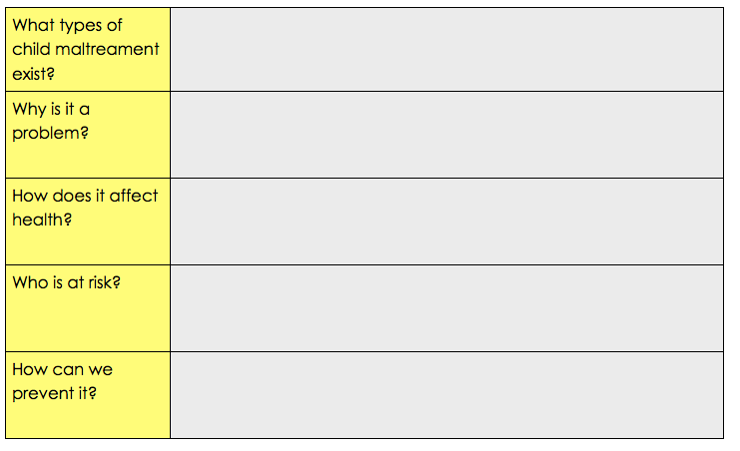
Child Maltreatment Facts
Read the handout entitled “Understanding Child Maltreatment” and use the information to complete the chart below on child maltreatment.
Notes:
Ensure a class set of copies of the 2-page PDF are made in advance. Source file can be found in the resources folder, or at: http://www.cdc.gov/violenceprevention/pdf/cm-factsheet--2013.pdf

Slide 10
Child Maltreatment Scenarios
For each of the following scenarios, identify which quality the parent’s actions are lacking: safe, stable, or nurturing.
1. Juanita leaves her 3-year-old at home while she goes over to hang out at the neighbors house. Usually she leaves her in the crib napping, but occasionally leaves her watching television. Which quality of healthy relationships is missing?
2. Brayden, the father, works late shifts at a local restaurant but likes to see his 1-year-old when he gets up. Marcine, the mother likes to go out with friends so she often leaves the older siblings in charge of putting the 1-year-old to bed. The child is typically allowed to stay up until Daddy gets home, which usually ranges anywhere between 10pm and 1am. Lately Brayden and Marcine have been having problems in their relationship, so Brayden will be away from home for weeks at a time. Which quality of healthy relationships is missing?
Notes:
Answers:
Safe
Stable

Slide 11
Assess:
For each of the following scenarios, identify which quality the parent’s actions are lacking: safe, stable, or nurturing.
1. Louis thinks that showing his 5-year-old son any physical or verbal affection will make him too “soft.” He avoids hugs, tough, and loving words. He also thinks that the child should be raised to be tough, solving all of his own problems and fending for himself. Which quality of healthy relationships is missing?
2. Diana is a single mom with a 9-year-old son and 7-year-old daughter. She has been unemployed for several years. She relies on governmental aid to feed her children, but they often do not have a place to stay. Every few weeks, they move around to a new place--homeless shelters, homes of family members or friends, or occasionally a cheap place to rent for a month or two at a time. Which quality of healthy relationships is missing?
Notes:
Answers:
Nurturing
Stable

Slide 12
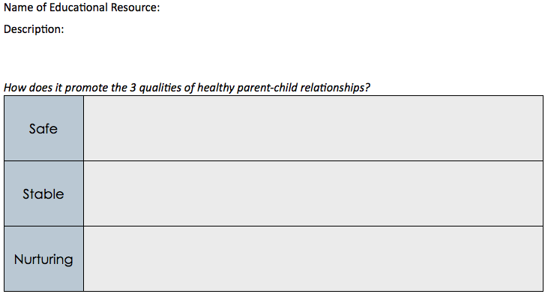
Homework: Parenting Skills Resources
Research to find an educational resource that teaches parenting skills. The educational content may be found in a book, course at a local organization or hospital, on a website, through a program in your community, or more. Once you have analyze the program, identify how the educational intervention does (or does not) promote the following qualities:
Notes:
The purpose of this homework assignment is to challenge students to examine the resources on parenting available in their community, local library, or online. There is a wealth of parenting advice and educational programs available. Some may focus on safe, stable, and nurturing relationships while others do not. Ask students to fill in the table based on what they observe, but if those elements are NOT present to indicate how that resource could be improved to include them.

