Slide 1
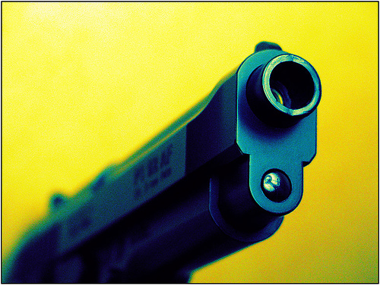
Lesson 7.3: Gun Violence
Obj. 7.3: Demonstrate how to influence and support others to reduce gun violence.
Module 7: Violence
Notes:
Overview: Students will grapple with the complex issue of gun control and gun violence in this lesson. First, students will examine data representing the use of guns and other weapons in violent incidents. Then students will discuss their views on gun control. Next, they will read some background information on gun violence from the National Institute of Justice. Finally, students will work in teams to develop interventions to reduce gun violence among a selected target population.
Image source: Flickr, http://www.flickr.com/photos/photographi_esc_/1937184496/

Slide 2
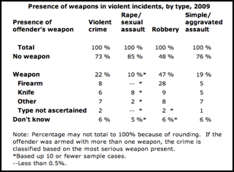
Do Now
Source: Bureau of Justice Statistics (http://www.bjs.gov/index.cfm?ty=tp&tid=43)
Notes:
Ask students, “What other data would you want to see to determine the impact of guns/firearms on public health?”

Slide 3
Do Now
1. Did any of the data in this table surprise you? Explain.
2. Which type of weapon was most commonly used in violent crimes?
3. Of the four types of violent incidents, which type is the use of a firearm most common?
4. Which type of weapon should efforts be directed toward removing from potential offenders in order to target robbery in a community?
Source: Bureau of Justice Statistics (http://www.bjs.gov/index.cfm?ty=tp&tid=43)
Notes:
Possible answers:
1. Answers will vary
2. Firearms (8%)
3. Robbery (28%)
4. Answers will vary; targeting robbery and firearms would be most supported by data

Slide 4
What is Gun Control?
Gun control: any law, policy, practice, or proposal designed to define, restrict, or limit the possession, production or modification, importation, shipment, sale, and/or use of firearms. (wikipedia.org)
Notes:
Ask students, “What is the difference between gun control and gun rights?” “Why does debate on this topic often get so ‘heated’?”

Slide 5
Discuss
Gun control is a timely and controversial topic. With school shootings making headlines and debate among citizens and politicians about how to reduce the violence, the conversation on gun control is ongoing. With a partner, discuss your views on gun control in a respectful, thoughtful, and open-minded manner. What do you think influences your views? What issues are you convinced about and unsure about? Why might others disagree with your views?
Notes:
Encourage students to explain the rationale, evidence, or logic behind their views and to examine possible influences on them (i.e., parents, relatives, television, etc.).

Slide 6
Who has guns & how are they acquired?
Many juveniles and young adults can easily obtain guns illegally; most claim to carry them for self-defense.
A study of persons arrested for a wide range of crimes showed that a higher percentage of arrestees than regular citizens own firearms. Arrestees are also more likely to be injured or killed by gun violence. Within a community, this amounts to an identifiable group of “career” offenders.
Surveys of offenders have found that they prefer newer, high-quality guns and may steal or borrow them; most, however, acquire guns “off the street” through the illicit gun market.
Source: National Institute of Justice, Gun Violence (http://www.nij.gov/topics/crime/gun-violence)

Slide 7
Who is most affected by gun violence?
People between the ages of 15 and 24 are most likely to be targeted by gun violence as opposed to other forms of violence. From 1976 to 2005, 77 percent of homicide victims ages 15-17 died from gun-related injuries. This age group was most at risk for gun violence during this time period.
Teens and young adults are more likely than persons of other ages to be murdered with a gun. Most violent gun crime, especially homicide, occurs in cities and urban communities.
Source: National Institute of Justice, Gun Violence (http://www.nij.gov/topics/crime/gun-violence)

Slide 8
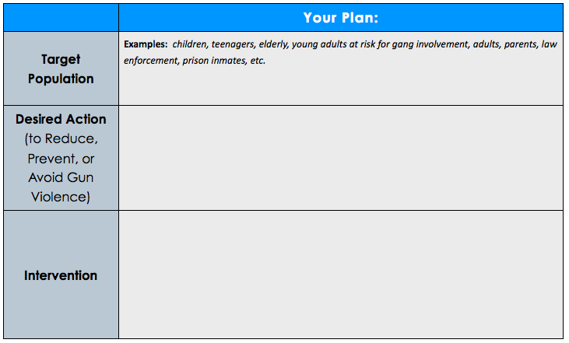
Gun Violence Interventions
Notes:
Have student teams present their interventions to the class briefly (Suggestion: 2 minutes or less). Then call on 2-3 students in the class to critique the intervention. Give one piece of positive feedback, one constructive criticism, and ask one question.

Slide 9
Assess: Review
Short Answer:
1. What population most often has easy access to illegal guns? How do they access guns?
2. Who is most affected by gun violence?
Notes:
Answers:
“Many juveniles and young adults can easily obtain guns illegally” /” Surveys of offenders have found that they prefer newer, high-quality guns and may steal or borrow them; most, however, acquire guns “off the street” through the illicit gun market.”
“People between the ages of 15 and 24 are most likely to be targeted by gun violence as opposed to other forms of violence. From 1976 to 2005, 77 percent of homicide victims ages 15-17 died from gun-related injuries. This age group was most at risk for gun violence during this time period.
Teens and young adults are more likely than persons of other ages to be murdered with a gun. Most violent gun crime, especially homicide, occurs in cities and urban communities.”

Slide 10
Homework:
Reflect upon the issue of gun violence in your community by completing a free-write (approx. 2-4 paragraphs). As you write, answer the following questions:
Does your community have problems with gun violence? How do you know?
If so, what is the impact of gun violence on your community?
If not, what can be done to reduce the likelihood of gun violence?
Notes:
The purpose of this homework assignment is to get students to engage in a reflection on how gun violence impacts their community. Most students will identify direct ways gun violence impacts them, their families, schools, and community. However, if students do not feel particularly affected by it, ask them to brainstorm subtle ways that it may affect their community…. (i.e. fear among citizens, policies must be implemented for crisis preparedness, money spent on law enforcement to keep streets/schools safe, etc.)

