Slide 1
Lesson 7.2: Social Work
Obj. 7.2: Identify the roles of a social worker.
Module 7: Violence
Notes:
Overview: Students will identify their background knowledge on social work and discuss the 2014 theme, “All People Matter” as a central theme of social work. They will then read about the social work profession and examine different ways that social workers help to work to reduce and prevent violence and its negative effects on society.
Image source: Flickr, http://www.flickr.com/photos/juditk/5655247429/

Slide 2
Do Now: What do you know about SW?
When you think of social work, what do you think of?
Have you had any encounters with a social worker? If so, what were they like?
Compare social workers with other health professionals. How do you think their roles are different?
How do you think social workers address social, mental, and physical health needs?
Notes:
Allow students to share their answer with a partner or the entire class, if time permits.

Slide 3
Discuss: “All People Matter”
The National Association of Social Workers selected the theme “All People Matter” for the 2014 annual Social Work Month, which occurs in March. Why do you think they selected this theme? How do you think it represents the social work profession?
Notes:
More information on this can be found at: http://www.socialworkers.org/pressroom/swmonth/
From the website: “We selected this year’s theme and logo to help raise awareness about the American social work profession’s 116-year commitment to improving social conditions and quality of life opportunities for everyone. Social workers across the globe believe that all people have dignity and deserve respect.
NASW’s goal for Social Work Month 2014 is to educate the public about how these values are essential to improving relationships within families, making social support systems more effective, and building stronger communities.
Did you know?
The American social work profession was established in the late 19th century to ensure that immigrants and other vulnerable people gained tools and skills to escape economic and social poverty.
The profession of social work (a) helps people in their personal and interpersonal lives in order to achieve social improvement, and (b) pursues social change to benefit a wide variety of individuals, families and communities.
Social workers believe that everyone has the right and potential to lead a productive and fulfilling life. Social workers believe in the importance of human relationships in civil society, and that each person has dignity and worth.
The NASW Code of Ethics prioritizes human well-being.
The policies and programs created by social workers throughout U.S. history seek to give more people—regardless of life circumstances—the opportunity to cope with and overcome obstacles.”

Slide 4
What is Social Work?
Social workers help people solve and cope with problems in their everyday lives. One group of social workers, clinical social workers, also diagnose and treat mental, behavioral, and emotional issues. Sometimes social workers are called “professional helpers” because they help others obtain resources, resolve problems, make it through crises, and fulfill needs.
Source: National Association of Social Workers, Help Starts Here
(http://www.helpstartshere.org/careers)
Notes:
Ask students, “What other professions are considered “helping” professions?”

Slide 5
Why do Social Work?
Social work is…
meaning, action, diversity, satisfaction, and options
caring about people, wanting to make things better, relieving suffering
a profession devoted to helping people function the best they can in their environment.
Example:
A man suffering stress stemming from single parenting may be referred by a social worker to a child care agency. The social worker also might help him explore flextime with his employer and might work with a coalition of local employers to make flextime and child care more available. In addition, the social worker might provide therapy to help him handle the immediate stress.
Source: National Association of Social Workers, Help Starts Here (http://www.helpstartshere.org/careers)
Notes:
Ask students to share examples of where they have encountered social workers? (Ex: school, hospitals, organizations in neighborhood, someone they know, etc.)
Ask students if they would be interested in going into social work? Why or why not? Ask them what they benefits and challenges of a career in social work might be.

Slide 6
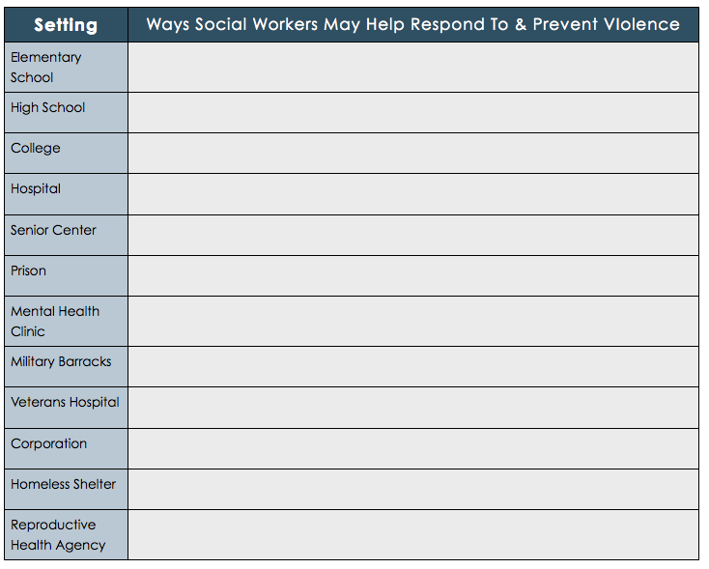
Social Work & Violence
Notes:
A random selection of example answers:
Elementary school: Reporting cases of potential child abuse
College: Intimate partner violence education; crisis counseling
Senior center: Patient/client advocacy to prevent abandonment & neglect, education on elder abuse reporting
Military barracks: Crisis counseling, PTSD counseling, suicide prevention awareness & education

Slide 7
Assess:
In the scenarios below, describe one way a social worker may help the client:
1. A 35-year-old man has recently been laid off of his steelworker job. He lives with his mother and just went through a messy breakup with his long-term girlfriend. He is eager to try to win her back.
2. A 10-year old girl is struggling with reading and math. Her teacher reports that she looks tired and often seems hungry in the mornings. She has also started making inappropriate comments to other students in the class.
3. A 88-year old woman with Alzheimer’s disease has recently lost her only daughter in a car crash. She doesn’t have any other family to take care of her. With her daughter no longer able to pay for her care in an upscale elderly care facility, she will have to move elsewhere.
Notes:
Possible answers:
1. Connecting with career opportunity resources/services in community; relationship counseling or psychological help to deal with mental health after breakup, connection with affordable housing options to begin living independently
2. Referral to child services agency (possible abuse/neglect); working with student to counsel and listen to determine possible problems; connecting with tutoring, mental health support, and family services
3. Connecting with governmental and agency aid, identifying an appropriate care setting, ensuring a continuum of care between health care providers and home setting, connecting with social supports to prevent loneliness and disconnection from a community

Slide 8
Homework: Social Work in Your Community
Identify a problem among some people in your community and describe how social work is working to resolve it. Answer the questions below based on your problem.
1. What is the problem?
2. How could this problem be addressed by social workers? (List as many ways as you can).
3. Do social workers in your community seem to be addressing this problem? Why or why not? (List any evidence you have of this answer.)
Notes:
This assignment will challenge students to make connections with the real world to determine where social workers are located in their community and what needs are being filled and possibly going unfilled.

