Slide 1
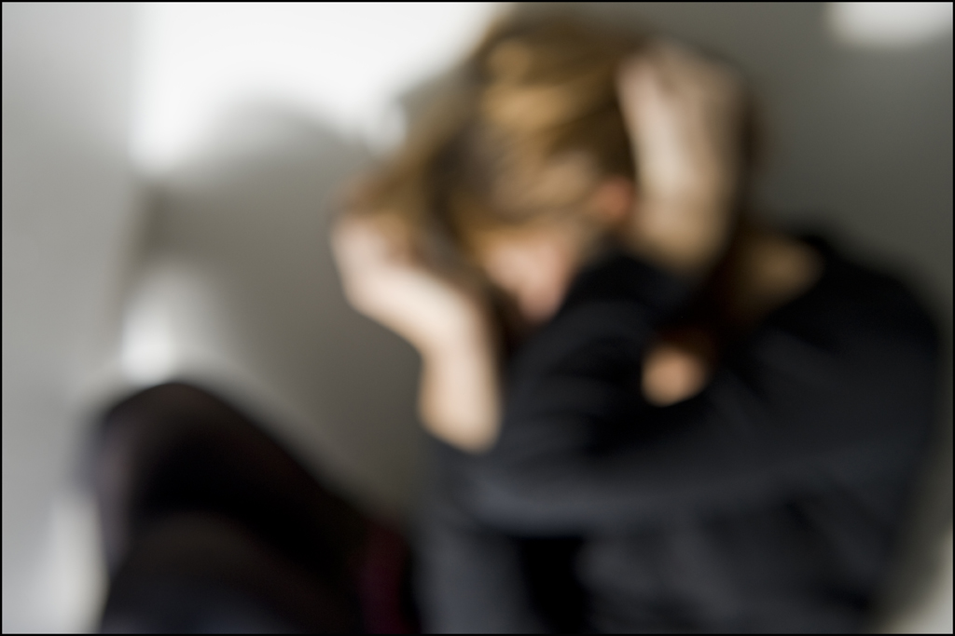
Lesson 7.1: Intro to Violence
Obj. 7.1: Demonstrate strategies to prevent, manage, or resolve conflicts.
Module 7: Violence
Notes:
Overview: Students will examine the issue of violence from a public health perspective. They will begin by identifying the impacts of violence, including deaths from homicide and suicide as a leading cause of death for teens. They will consider the problem of violence as an epidemic and learn about the different types of violence. They will examine a public health approach to reducing violence and work in teams to portray a violence scenario in a skit.
Image source: Flickr, http://www.flickr.com/photos/european_parliament/4135410241/

Slide 2
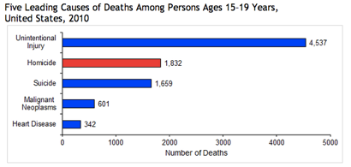
Do Now
Source: CDC (http://www.cdc.gov/violenceprevention/youthviolence/stats_at-a_glance/lcd_15-19.html)
Notes:
Ask students, “Do you think the leading causes of death are significantly different for younger teens? Children? Adults? Elderly?”

Slide 3
Do Now
1. What role does violence play in deaths among teens?
2. Approximately how many times more people age 15-19 died from homicide than malignant neoplasms (cancer)?
3. Considering the leading causes of injury, what should public health professionals focus on in their prevention efforts? Why?
Notes:
Possible answers:
Violence is responsible for the second and third leading causes of death for teens 15-19. Homicides and suicides together make up the leading causes of violence.
3 times more people 15-19 years old died from homicide than cancer
Answers will vary. Students may argue that a focus should be placed on reducing violence (i.e., gun control, violence prevention education)

Slide 4
Discuss
The graph depicted the leading causes of death among teenagers 15-19. However, the graph does not show other effects that result from violence. With a partner, discuss the impact, effects, and cost of violence on individuals, families, communities, and society.
Effects of Violence:
Notes:
Possible answers
Individuals: mental health, sense of safety, time spent outdoors/interacting with others, loss of school, work, etc. days, increased medical bills
Families: broken homes/families, court intervention & lawyer fees, emotional toll on family members, especially children
Communities: increased spending on public safety, less tourism/business, lower property values, less new businesses starting
Society: healthcare expenses, healthcare worker shortages, burden on social welfare system, etc.

Slide 5
The Violence Epidemic
From infants to the elderly, it affects people in all stages of life.
In 2010, over 16,250 people were victims of homicide and over 38,360 took their own life.
Many more survive violence and are left with permanent physical and emotional scars.
Violence also erodes communities by reducing productivity, decreasing property values, and disrupting social services.
Source: CDC Violence Prevention (http://www.cdc.gov/ViolencePrevention/index.html

Slide 6
What is Violence?
"the intentional use of physical force or power, threatened or actual, against oneself, another person, or against a group or community, that either results in or has a high likelihood of resulting in injury, death, psychological harm, maldevelopment, or deprivation."
Source: WHO Violence Prevention (http://www.who.int/violenceprevention/approach/definition/en/)

Slide 7
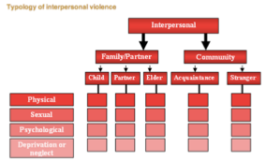
Types of Violence
Self-directed violence
Interpersonal violence
Collective violence
Source: WHO Violence Prevention (http://www.who.int/violenceprevention/approach/definition/en/)
Notes:
Ask students which type(s) of violence they THINK are overlooked, ignored, or given less attention in society (among healthcare professionals, news/media, social welfare agencies, etc.). Why are these forgotten or falling between the cracks? Are they more difficult to identify, less commonly reported, or some other reason?

Slide 8
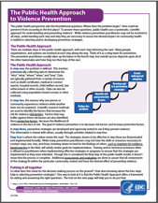
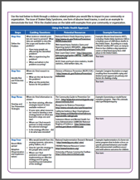
The Public Health Approach to Violence
Read the handout, “The Public Health Approach to Violence Prevention.” Before you begin reading page 2, select one type of violence from the diagram on the previous page and use it to fill in the boxes labeled ‘Your Turn.’
Notes:
Ensure that a class set of this handout is copied. Handout can be found in resources folder for this module.

Slide 9
Violence Prevention Skits
Notes:
Consider setting a time limit on skits in terms of preparation and presentation. 30 minutes should be a sufficient amount of time to prepare an informal skit. 2-3 minutes in length should be enough to convey necessary information. If more time is needed, plan to use the following class period.

Slide 10
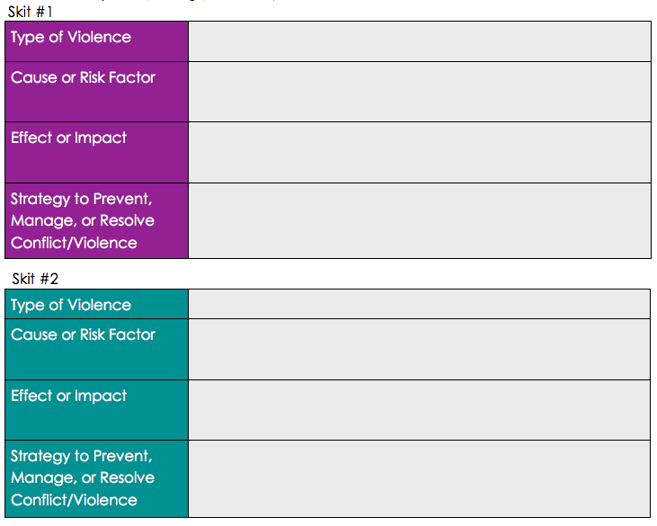
Assess:
Select two of the skits you observe to record in the table below. Identify the type of violence depicted, one cause or risk factor, one impact or effect, and one strategy to prevent, manage, or resolve.
Notes:
The assessment hinges on students ability to portray (and as an audience member: identify) strategies to prevent, manage, and resolve violence.

Slide 11
Homework:
Determine what resources for violence prevention are available in your school, neighborhood, community, or city/town.
Using any available sources, find one resource (i.e., neighborhood watch, advocacy organization, education program, etc.).
Write a 1-3 paragraph summary of the resource including:
the type of violence the organization focuses on
target population served
causes or risk factor targeted
impact or effect of the organization
strategies used to prevent, manage, or resolve conflicts or violence
Notes:
Students will gain a sense of the assets and needs in their community through this exercise while they practice identifying strategies to prevent, manage or resolve violence in the real world.

