Slide 1
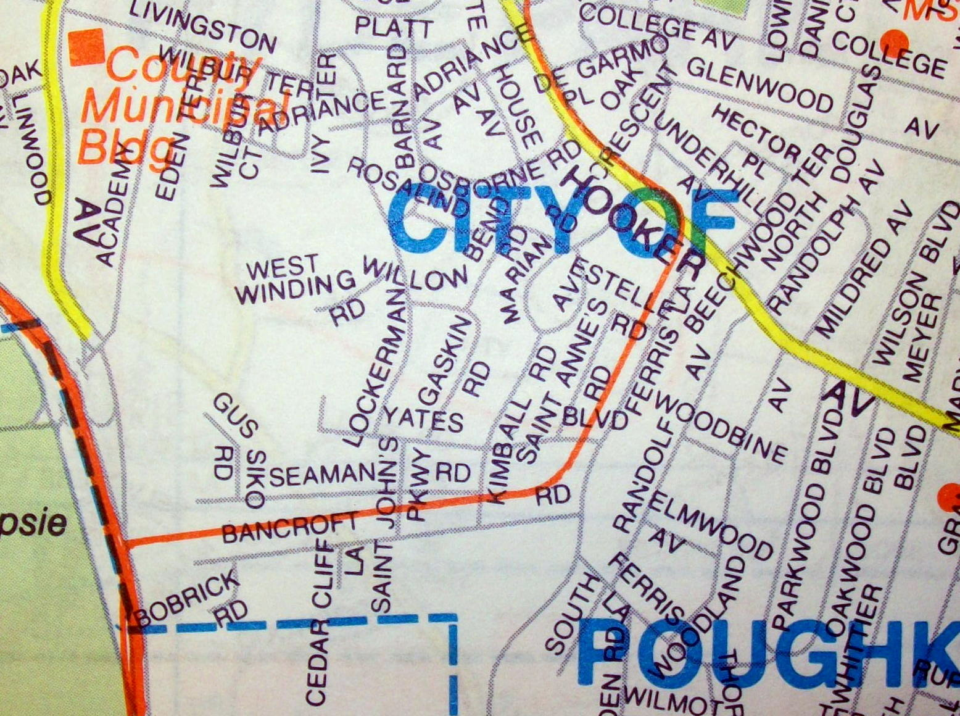
Lesson 7.11: Asset Mapping
Obj. 7.11: Create a map to determine the accessibility of products and services that enhance health.
Module 7: Violence
Notes:
Overview: Students will be introduced to the asset map in this lesson as they practice making two different types of asset maps. The lesson will begin with students observing a picture of an asset map created with post-it notes and inferring possible purposes for the tool. Then students will engage in discussion about the assets in their communities. Next, students will learn the basic definition of an asset map and the steps needed to create it. After that, students will create an asset map for their school focused on fire safety. Finally students will summarize their understanding of asset maps and be assigned to create an asset map of their neighborhood for homework.
Image source: Flickr, http://www.flickr.com/photos/23465812@N00/8426531904/

Slide 2
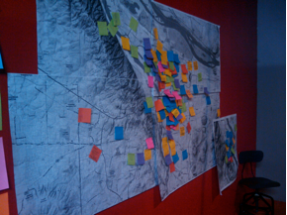
Do Now: What’s This?
Source: Aaron Ray via Flickr (http://www.flickr.com/photos/aaronray/3435406085
Examine the image above. What do you think this map might be showing? Who might have created it? What is its purpose?
Notes:
This map is just one of many ways an asset map can be created. Asset maps are flexible tools that can be modified to meet the purpose at hand. The sticky notes here featured input from a variety of community members and stakeholders.

Slide 3
Discuss
1. Think about your neighborhood. List all of the things you can think of that help to promote healthy lives. Consider mental health, social health, and physical health.
2. Partner up and share your lists. Were there any similarities? Major differences?
Notes:
For more information and examples, see: http://outreach.msu.edu/bpbriefs/issues/brief4.pdf

Slide 4
What is Asset Mapping?
Finding the strengths in a community!
a process of inventorying the resources or assets of individuals or organizations available to a specified neighborhood or community.
Includes: skills of community members, interests of the community as a whole or interests of sub-groups within the community, experiences the community have learned from, relationships, public capital, cultural resources, and more.
May be geographic or visually demonstrate relationships between individuals, organizations, agencies, and other entities.
Notes:
A good site summarizing various types of asset mapping and a basic primer can be found here: http://backspace.com/notes/2004/06/what-is-asset-mapping.php

Slide 5
Simple Steps to Asset Mapping
Step 1: Determine your purpose.
Step 2: Based on the purpose, determine what type of map to create. Geographical or conceptual?
Step 3: Survey, gather data, observe, or interview people to determine the assets.
Step 4: Create a visual tool to map the assets or show their relationship.
Notes:
These are VERY basic steps. There is no exact science or single way to create an asset map. The organization and format used should meet the purpose.

Slide 6
Fire Safety Asset Map
Work as a team to create an asset map for your school with the theme of fire safety.
There is no universal or single way that your asset map must look, so get creative and think about a way to best organize and present the assets you come up with.
You can focus on a variety of assets or a single type of asset.
Consider things like: posted evacuation plans, fire alarms, sprinkler, fire extinguishers, proximity of fire department to school, response time of fire department, number/quality of drills, staff and students experience/training in fire emergency protocol, etc.
Notes:
Ideas for managing and executing:
--Have students to tour the school to do a visual inventory
--Have some staff members pre-assigned as “experts” to answer questions – i.e. one admin member, one teacher, one security or custodial staff
--Have students research fire safety in schools to determine what the recommendations are
--Get a firefighter to come in to provide students with information or conduct the asset mapping exercise with students

Slide 7
Assess:
1. What is an asset map (in your own words)?
2. How would you go about creating an asset map of your neighborhood if you wanted to focus on access to health care?

Slide 8
Homework:
Create a simple asset map of your neighborhood.
Choose a theme or focus area to keep it this assignment manageable
Examples:
social health
health education & literacy
youth/teen health
exercise and healthy eating
Notes:
The purpose of this assignment is to give students another opportunity to think about asset mapping in a different (and relevant!) context. Encourage them to make the asset map of their neighborhood community in a different way or format than the fire safety map. Allow students to work in partners or groups if they share the same neighborhoods (optional).

