Slide 1
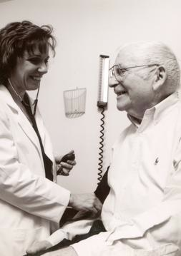
Lesson 6.9: OPQRST Symptom Assessment
Obj. 6.9: Obtain subjective information from a patient using the OPQRST mnemonic
Module 6: Rural Health
Notes:
Overview: Students will engage in more focused learning to continue to their study of the SOAP note method, by examining the OPQRST mnemonic for acute symptom assessment. They will also learn about heart attacks, and how the OPQRST questioning elicits information to determine when a heart attack should be suspected. Through role plays, students will practice the art of questioning and learn to apply different scenarios to the process of gathering subjective information.
Image source: http://en.wikipedia.org/wiki/Portal:Medicine

Slide 2
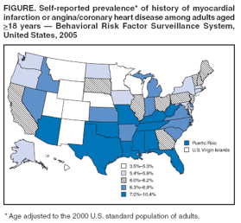
Do Now
1. What was the self-reported prevalence of history of heart attack or heart disease in your state?
2. What geographical trends do you notice in the prevalence of heart attack/heart disease?
3. What factors do you think may account for these trends?
Notes:
ANSWERS:
In Illinos: 6 – 6.2%
Higher rates of heart attack & heart disease in the Southern states; pockets of very low rates in middle states and Northern states
Answers will vary… Diet, physical activity, cultural habits for diet/activity may play a role

Slide 3
Discuss
Why do you think many heart attacks are difficult to predict and diagnose early?
Notes:
Students can venture any logical guess; there are many possible reasons, including but not limited to: 1. heart attack symptoms can vary, sometimes be subtle, and often progress slowly over hours, days, and even weeks. 2. many people may be reluctant to call 9-1-1 or go get tested. 3. some people may be in denial about such a serious health event occurring in their body or fearful of knowing. 4. lack of access to emergency services or nearby hospitals/clinics, etc.

Slide 4
Review:
SOAP: Subjective, Objective, Assessment, Plan
method of documentation used by providers to write out notes in a patient chart.
Subjective: all the questions asked to gather information.
SAMPLE history
Signs/symptoms
Allergies
Medications
Past history
Last oral intake
Events leading to illness/injury)
Notes:
Previous lessons on the SOAP next (from prior modules) include: Lesson 1.8 – Intro to SOAP Note; Lesson 2.9 – Vital Signs; Lesson 4.8 – SAMPLE history

Slide 5
OPQRST:
acute illness: a disease with a rapid onset and/or a short course
OPQRST
Mnemonic for a set of questions used to assess a symptom (often pain).
Heart attack
Headache
Stomach pain
Any symptom of acute illness!
Questions can be asked in any order
Notes:
Some sources also have AAA (as in OPQRST-AAA). The additional A’s stand for Associated symptoms, Alleviating and Aggravating factors, and Attributions/Adaptation. If students are at an advanced level and can handle more to remember, or would want to guess why these additional question categories might be useful, these could be presented to students as extra notes.
Reference: http://en.wikipedia.org/wiki/Opqrst

Slide 6
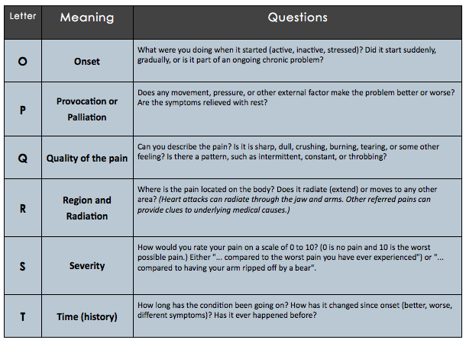
OPQRST:
Notes:
Select one or more volunteer students ahead of time and ask them to answer the questions based on the last headache or stomachache they had. (They can make it up!) Going through this information the first time in a more authentic question/response format will help it “stick” better for students.

Slide 7
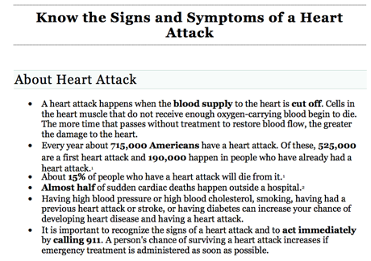
What is a heart attack?
Notes:
Ask student another name for a heart attack (Myocardial infarction—or MI—from the Do Now). Ask them why this is the medical name (Myo = muscle; Cardi = heart; Infarction = tissue death caused by a local lack of oxygen).
Ask students if they know what happens when an infarction affects another part of the body, besides the heart? (ex: lungs = pulmonary embolism; brain = stroke; limbs = blood clot)

Slide 8
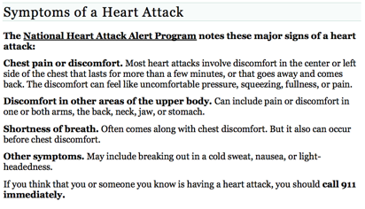
Symptoms of Heart Attack:
Notes:
An excellent visual slide show of information about heart attack/heart disease can be found here: http://www.webmd.com/heart-disease/ss/slideshow-visual-guide-to-heart-disease

Slide 9
Discuss:
One study showed that women are two times as likely than men to call 911 if they are showing signs of a heart attack. What might explain this finding?
Notes:
Another excellent news article can be found at: http://online.wsj.com/news/articles/SB10001424052702304432704577347723157872672
A wonderful graph in this article summarizes the benefit of exercise (70% reduction if one gets 30 min a day; 63% with 20m a day; 47% with just 10m a day)

Slide 10
Role Play: OPQRST Interview
Goal: Practice the OPQRST interview from both angles, the patient and the health care provider
Directions:
1. Choose your starting roles. One person will be an emergency room triage nurse. The other will be a patient who has driven to the hospital, worried about chest pain.
2. Patient uses the first column in the table to record brief details about the chest pain, so they are prepared to act convincingly and answer all questions.
3. Healthcare provider begins the patient interview by asking questions and use the first column in the table below to record the OPQRST information.
4. Switch roles and repeat, using the second column.
Notes:
Allow students to choose a different scenario (besides chest pain) for the 2nd round when they switch roles, to keep things fresh and interesting.

Slide 11
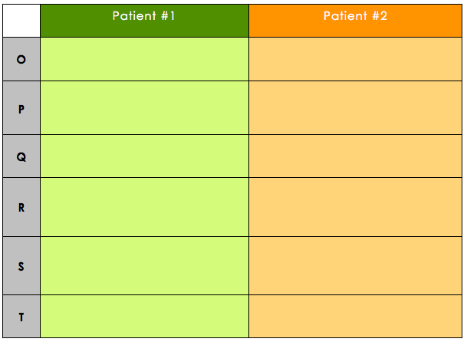
Role Play: OPQRST Interview
Notes:
Encourage students to write brief shorthand notes, but to balance this with the need to document enough to provide a clear picture to someone else who is reading the patient’s chart.

Slide 12
Discuss:
What was most challenging about the OPQRST interview? (Consider both the healthcare provider and the patient perspectives)

Slide 13
Assess:
1. The pain in my head is a 9.5. It’s the worst pain I’ve ever felt.
2. My head throbs all over, as if someone is squeezing my brain.
3. When I turn off all the my head feels better.
4. It started last night around 11:30pm.
5. My headache has started to move into my neck.
6. It stopped hurting about an hour ago.
Notes:
Answers: 1. Severity; 2. Quality; 3. Palliation 4. Onset; 5. Radiation/Region; 6. Time

Slide 14
Homework:
Goal: Practice the OPQRST interview for an acute illness
Directions:
1. Choose any acute illness.
2. Research the illness so you understand how a patient may respond when interviewed.
3. Write out the dialogue between the healthcare provider and patient for an OPQRST interview.
4. Find a partner who will agree to help you act out your script in case you are called on to present your interview next class.
Notes:
The purpose of this assignment is for students to practice one more time so that this starts to become more comfortable and they are ready for the case study, where they will interview a mock patient in real time and would not want to miss one of the important parts of OPQRST.

