Slide 1
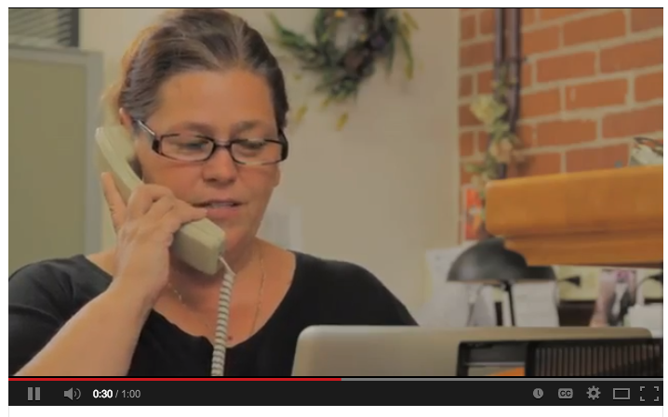
Improving Access, Improving Lives
Video: http://www.youtube.com/watch?v=d9WziivfYZ0
Notes:
Video: 1 minute

Slide 2
Discuss
What are some potential drawbacks, challenges, or difficulties with telemedicine?
Notes:
Some possibilities: Difficult communication; less ability to read body language or perform physical exams; less intimate; patient may be agitated, nervous, or anxious; unexpected problems with technology, initial funding/start up costs needed to implement tech, initial training and continual training needed to get providers prepared; training may be inadequate…

Slide 3
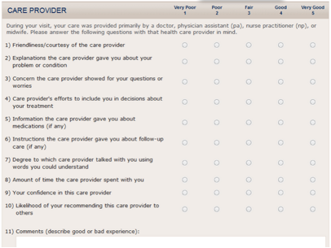
Telemedicine & Patient Satisfaction
Examine the patient care survey example.
Survey created by an independent patient satisfaction company called Press-Ganey.
Notes:
Source of survey: https://healthcare.utah.edu/fad/pressganey.php\

Slide 4
Telemedicine & Patient Satisfaction
Which areas of the patient experience do you think would be most POSITIVELY? Why?
Most NEGATIVELY affected? Why?
Predict: What specific advantages and disadvantages would you expect to find during a telemedicine doctor-patient visit?
Notes:
Example answers:
1.Might be POSITIVELY affected: Amount of time with provider (less travel and wait time); Information and instructions given (tech can simultaneously be used to show visuals, display information, etc.)
2. Might be NEGATIVELY affected: friendliness & concern provider shows (lack of intimacy and in-person contact may leave the interaction feeling a bit distant)
3. Advantages: more can be accomplished with the time & technology; better quality care because the best experts/doctors are accessible, no matter the distance
Disadvantages: Some things may be lost in translation if direct dr-patient interaction is missing

Slide 5
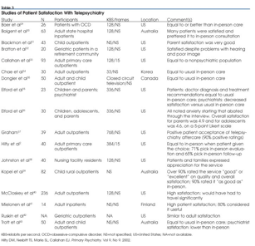
Telepsychiatry & the Dr-Pt Relationship
DISCUSS: What do results from this study suggest about the impact of the telemedicine visit on patient satisfaction?
Notes:
Results show that overall, patients seem satisfied with the telepsychiatry care. There is a lot of depth here that students can dig into.
Ask: Based on the participants in these studies that were reviewed, are researchers neglecting any specific populations which we might predict would have a different opinion or outcomes using telepsychiatry?

Slide 6
Assess:
A. Name 3 ways that telemental health may improve rural mental health care?
B. Name 1 challenge or drawback from using telemental health for rural mental health care?

Slide 7
Homework:
Conduct research on a telemedicine technology of your choice & review it!
Any technology. Examples:
an app for patients or healthcare providers, a software package for clinics, a platform or system for telemedicine networks, or an online website-based tool.
REVIEW:
Describe your telemedicine technology. (Include your sources)
What are the pros and cons of this specific technology?3
Who is the target audience or users, of this technology?
Would you recommend this this technological product for telemedicine? Why or why not?
Notes:
The purpose of this assignment is for students to become immersed in the expansive telemedicine marketplace to build there awareness of all the possible technologies that can be used and implemented. By providing a critique or review of one product, they will also build critical thinking skills.
One starting point for students is the site: http://www.telementalhealthcomparisons.com/ which allows comparisons of technology based on the target user and the type of technology needed.
Image source: http://en.wikipedia.org/wiki/List_of_video_telecommunication_services_and_product_brands

