Slide 1
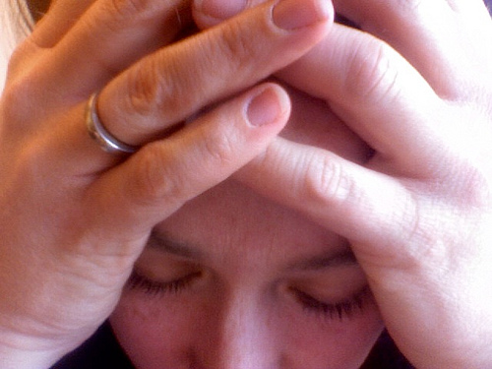
Lesson 6.7: Mental health
Obj. 6.7: Determine when professional mental health services are required.
Module 6: Rural Health
Notes:
Overview: Students will explore mental health from a rural health perspective by considering the possible members of a mental health care team, identifying the prevalence, impact, and barrier to access for mental health in rural settings, and reading about strategies for seeking mental health care. Students will demonstrate their understanding of mental health concepts by creating a mock hotline call portraying a teenager who is struggling with a potential mental health issue.
Image source: Flickr, user Jennaream, accessed at: http://www.flickr.com/photos/33478010@N02/4175034274/

Slide 2
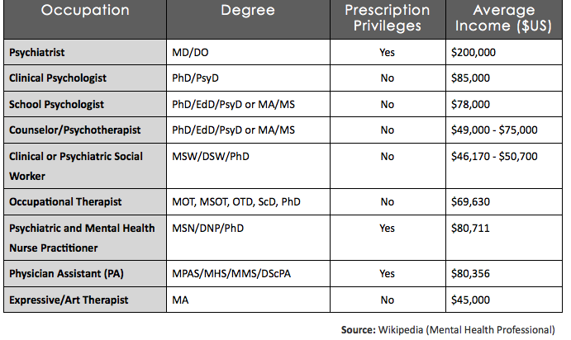
Do Now: Mental Health Professionals
Notes:
The purpose of the Do Now is to expose students to possible career paths in the mental health arena. There is a shortage of mental health professionals, especially in rural communities, so getting students engaged in considering these careers is important. Some high schoolers have a natural inclination toward majoring in psychology (even if they don’t completely understand what this entails); this list may open their eyes to other similar possibilities.

Slide 3
Do Now: Mental Health Professionals
1. A psychiatrist is a medical doctor who evaluates, diagnoses and treats mental illness. If you were to become a psychiatrist, what might you like and dislike about the career?
An occupational therapist may work with those who have mental health problems by choosing activities to help them learn to engage and cope with daily life. What types of activities might these include?
Which mental health professionals may have the ability to prescribe medicines?
Of these mental health careers, which interests you most? Why?
Notes:
Answers will vary. Provide students who are interested in these health care career tracks to share with the class what makes them interested or passionate about them.

Slide 4
Discuss
What are the benefits and challenges of having such a wide variety of professionals who may support a person with mental health needs?
Notes:
Some possible benefits: various providers play different roles so the spectrum of needs are met for individuals mental health issues; different perspectives can offer balance and insight into aspects of mental health; ‘it takes a village” concept—the more support, the better!
Some possible challenges: coordinating care may be difficult across a team with members each in different settings; ability to ensure patients who require medications have access may be difficult if the roles that can prescribe medicines are limited in number, lack of communication may cause confusion and lack of consistency in approach with patient

Slide 5
What is Mental Health?
Disrupts a person's thinking, feeling, mood, ability to relate to others and daily functioning.
Diminished capacity for coping with the ordinary demands of life.
Examples:
depression, schizophrenia, bipolar disorder, obsessive compulsive disorder (OCD), panic disorder, post-traumatic stress disorder (PTSD) and borderline personality disorder.
Affect persons of any age, race, religion or income.
NOT the result of personal weakness, lack of character or poor upbringing.
Treatable!
Source: http://www.nami.org/Template.cfm?Section=By_Illness
Notes:
Ask students what other mental health issues they know about.

Slide 6
Mental Health in Rural Settings
problems with access to behavioral health services
inadequate number of providers in rural areas
stigma regarding obtaining behavioral health treatment
Source: “The Future of Rural Health.” National Rural Health Association Policy Brief. Feb. 2013.
Notes:
Ask students what mental health professional resources they know of that exist in their community. Encourage them to think broadly—school, church, health care settings, social work agencies, etc.

Slide 7
Discuss
What is stigma? Which mental illnesses do you think carry the most stigma?
In addition to stigma, for what other reasons might people avoid mental health care?
Why might rural communities have higher rates of mental illness?
Notes:
Question #2: Possible reasons may include denial, disbelief, being stubborn or too “proud” to receive care, fear, lack of knowledge of resources, lack of resources available, lack of time, no money to pay feeds, insurance does not cover services or person does not believe insurance will cover it, etc.

Slide 8
Read: Seeking Mental Health Care
Figure out why you are reluctant
Use anonymous help lines
Stop using pejorative language
Ask around
Talk it out
Ask for company
Keep a journal
Consider support groups
Consider what to expect
Set limits
Source: “Seeking Mental Health Care: Taking the First, Scary Step,” by Roxanne Porter for Psych Central. : http://psychcentral.com/lib/seeking-mental-health-care-taking-the-first-scary-step/00013701
Notes:
Source: “Seeking Mental Health Care: Taking the First, Scary Step,” by Roxanne Porter for Psych Central. : http://psychcentral.com/lib/seeking-mental-health-care-taking-the-first-scary-step/00013701
More information can be found at: http://www.webmd.com/anxiety-panic/guide/mental-health-tests-you-take

Slide 9
Mental Illness Facts and Numbers
“One-half of all chronic mental illness begins by the age of 14; three-quarters by age 24.15 Despite effective treatment, there are long delays−sometimes decades−between the first appearance of symptoms and when people get help.”
What can be done to get people help sooner? Brainstorm some ideas with a partner.
Source: Mental Illness Facts & Numbers:
http://www.nami.org/factsheets/mentalillness_factsheet.pdf
Notes:
Encourage students to think creatively. Consider offering butcher paper or an opportunity to record a comprehensive list of their ideas on the board.

Slide 10
Mock Hotline Call
Challenge:
mental health hotline specifically for a target population of rural teenagers
create a realistic fictional call into the hotline from a teen who might be struggling with a mental health illness.
includes at least two of the strategies for seeking mental health care in the information given to the teen
Purpose is not to diagnose the teenager’s mental health illness over the phone, but rather to listen, to ensure they are safe, and to provide support, encouragement, and resources for seeking professional mental health care.
Notes:
Consider sharing copies of the “Sample Suicide Intervention Script” (PDF available in lesson resources) as an example for students. Alternatively, giving students a chance to do some mini-role playing with brief exchanges may help. For example, call on a student to explain how they would respond if someone called a hotline and said, “I am thinking about hurting myself.” or “I just can’t stop feeling sad. I can’t even get out of bed.”

Slide 11
Possible Mental Health Illnesses for Mock Hotline Call:
Anxiety Disorders
Attention-Deficit/Hyperactivity Disorder (ADD/ADHD)
Bipolar Disorder
Borderline Personality Disorder
Depression
Dissociative Disorders
Eating Disorders or Substance Abuse
Obsessive-Compulsive Disorder (OCD)
Panic Disorder
Posttraumatic Stress Disorder (PTSD)
Schizoaffective Disorder or Schizophrenia
Seasonal Affective Disorder
Source: http://www.nami.org/Template.cfm?Section=By_Illness
Notes:
Excellent information on these illnesses can be found at the National Alliance on Mental Illness (NAMI) website, at: http://www.nami.org/Template.cfm?Section=By_Illness. Students should research the mental illness they choose for their scenario.

Slide 12
Mock Hotline Call PLANNING:
Consider:
Who is the caller? What is their gender, age, and other characteristics?
What mental illness or specific symptoms/problems is the person calling about?
What prompted the call? Was there an event or incident?
How does the caller feel about mental health services? Is he/she resistant? Does she lack access or knowledge?
What strategies for seeking mental health care will the counselor use? What will be the outcome of the call?
Notes:
What to do in emergency? Get IMMEDIATE HELP! (Info here: http://www.mentalhealth.gov/get-help/immediate-help/index.html)
What is this job? Crisis line counselors provide counseling and emotional support to people who are abused, depressed, grieving, suicidal, homeless, or mentally ill. Some volunteers have mental health backgrounds, but many don’t. (http://www.crisissupport.org/crisis_line)

Slide 13
Assess:
1. Explain why the teenager in your hotline scenario should seek mental health care?
2. What were the barriers for seeking mental health care that the teen faced?
3. What specific strategies or resources did the mental health counselor on the hotline offer to help?

Slide 14
Homework: Prepare Hotline Skits
Prepare to present your hotline scenario to the class.
Live skit or recorded audio/video
One partner should act as the mental health counselor and the other should be the teenager who is calling in.
Make an action plan!
Notes:
This homework assignment will prepare students to share their skits with the class. If more time is needed for preparation, an extension to a future class can be given.

