Slide 1
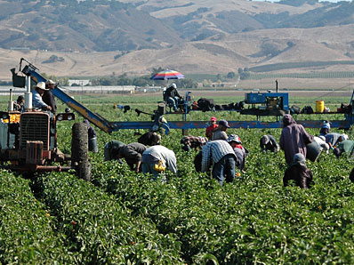
Lesson 6.6: Migrant Worker Health
Obj. 6.6: Analyze the relationship between access to care and health status for migrant workers.
Module 6: Rural Health
Notes:
Overview: This reading-heavy lesson will expose students to a unique new perspective in rural health, that of the migrant worker. Through reflections using image and text, students will examine what it means to face significant barrier to accessing the healthcare system. By the end of the lesson, students will create skits in groups depicting these scenarios and how they impact migrant workers’ health status.
Image source: http://annualreport.ucdavis.edu/2009/features/health/improved_migrant_health_care.html

Slide 2
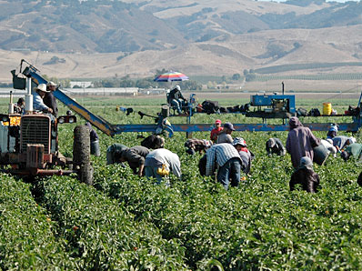
Do Now
What kind of unique health concerns might the migrant workers in this image face?
Notes:
Possible answers: Exposure to pesticides & chemical hazards; sun exposure (skin cancer), strain-related injuries/back pain/injury, dehydration, stress, depression, fatigue, poverty & job instability (low income work) & a resulting lack of money for food, medicine, shelter, clothing, healthcare, etc.

Slide 3
Discuss: Access to Healthcare
A recent headline for a news story proclaimed, “Fear keeps migrant workers from getting health care.”
How might fear be a barrier to healthcare?
What other barriers might migrant workers face?
If migrant workers do not access health care when they need it, how might this affect their health?
Notes:
Full article can be found at: “Fear keeps migrant workers from getting health care” (6/6/2012)
http://usatoday30.usatoday.com/news/nation/story/2012-06-06/migrant-workers-health-care/55432010/1

Slide 4
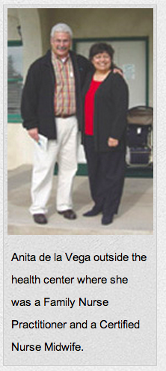
Read: Farmworker & Clinician
“ My mother had no prenatal care and none was available to her… I lived in tents, I picked fruit so I could get through school along with my other family members.”
“I am the eldest of five children and became my parents’ advocate because they could not speak English…”
“…a system that was not very sensitive to people who had a different culture and a different language…”
“…with my two languages, I can empower them to use a system that is sometimes very negative and very hard and very cruel.”
Source: http://www.migrantclinician.org/issues/migrant-info/voice.html
Notes:
Ask students, what do you think compelled Anita de la Vega to return to her own “community” of migrant workers? Do you think it was a difficult decision for her?

Slide 5
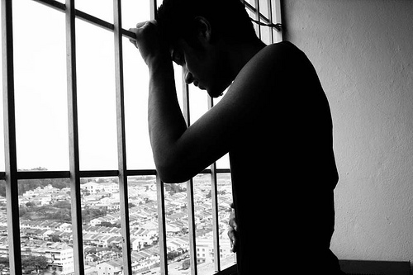
Discuss: Reflect
In what ways is the healthcare system failing migrant workers?
Notes:
Image source: http://www.flickr.com/photos/b3ni/2990601183/

Slide 6
Read: Intro to Migrant Issues
High risk jobs; occupationally-related injury
Environmental exposures in their “home environments”
mobile lifestyle
economic insecurity
language barriers
prejudice
isolation of these workers and their
A migrant is defined as an individual who is required to be absent from a permanent place of residence for the purpose of seeking employment.
Source: http://www.migrantclinician.org/issues/migrant-info/migration-patterns.html
Notes:
Encourage students to annotate or “mark up” the text to practice active reading.

Slide 7
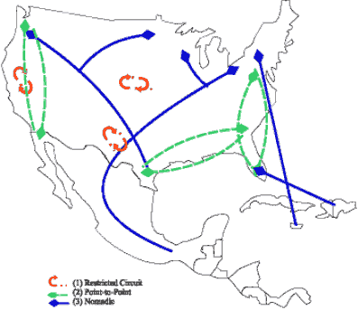
Read: Migration Patterns
Migration is changing the demographics of the United States in dramatic way.
This community of immigrants is extremely isolated from social networks as well from social service and healthcare providers.
These young, inexperienced immigrants are working in some of the most hazardous occupations. (Dunn, 2003).
Source: http://www.migrantclinician.org/issues/migrant-info/migration-patterns.html
Notes:
This slide is additional information, not found in the student workbook reading. See link for more information

Slide 8
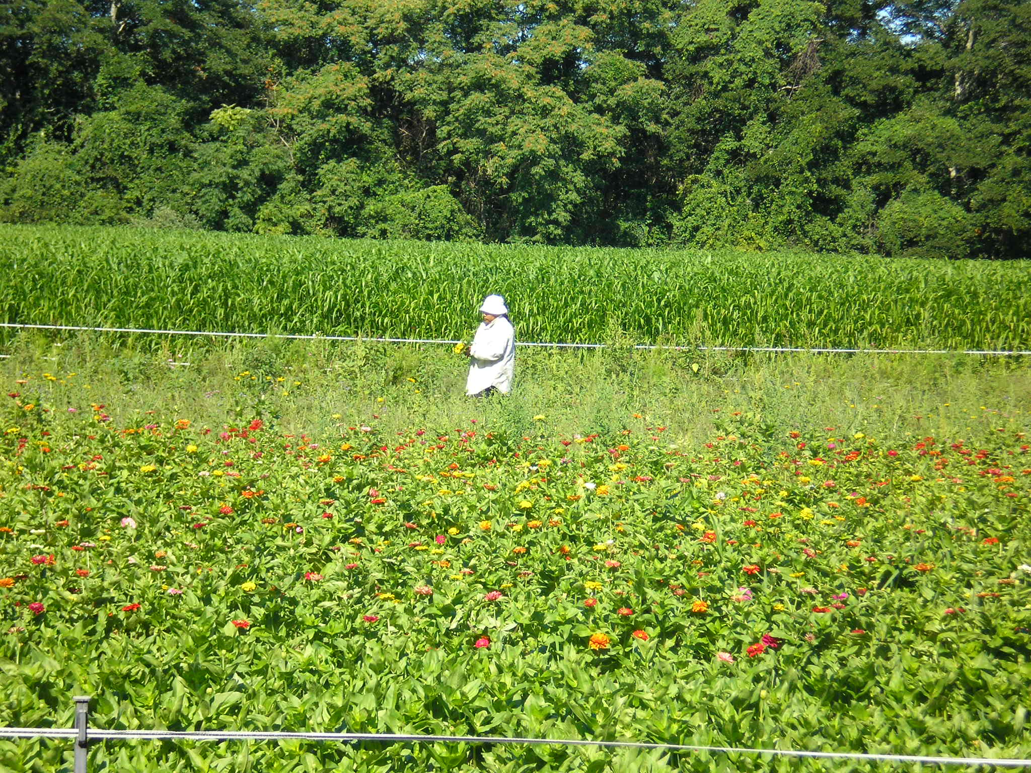
Discuss:
What health hazards do migrant workers and their families face?
Notes:
This question is similar to the Do Now question, but at this point in the lesson students should be able to return to this question and expand their answers, based on new knowledge.
Image source: http://simple.wikipedia.org/wiki/Migrant_worker

Slide 9
Read: Migrant Health Issues
Migrants and their dependents experience more frequent and more severe health problems than the general United States population.
Health issues are made worse by:
poor nutrition
lack of resources to seek care early in the disease process
infectious diseases from overcrowding and poor sanitation
migratory lifestyle and the inherent dangers and health risks involved in their occupations
Only a limited number of scientific studies have been made on the health status of migrants and other mobile underserved populations.
Source: http://www.migrantclinician.org/issues/migrant-info/health-problems.html
Notes:
Key Point: Migrant workers are in UNIQUE rural health situations. They experience similar health challenges as many in rural settings, but their problems are greatly compounded by a multitude of additional barriers.

Slide 10
Read: High Risk General Problems
Trends:
more of everything
common conditions have been allowed to progress to very serious stages
delays in seeking professional medical attention
Health issues occurring more frequently among migrants:
diabetes, cardiovascular disease, and asthma.
Source: http://www.migrantclinician.org/issues/migrant-info/health-problems.html
Notes:
Key Point: Primary care and preventative medicine can go a LONG way in greatly improving the health of migrant workers and their families; the problem is that there is little access to this basic standard of care among this population due to the barriers. Students should be starting to become frustrated and outraged that such poor health status is the result of a problem that should be SO SIMPLE to fix. Stoke the coals a bit if students are lukewarm or not getting engaged in the gravity of this problem.

Slide 11
Read: High Risk General Problems
Active TB consistently found
Dental issues: Bottle mouth caries, gingivitis
Absence of prenatal care
High incidence of premature births, preeclampsia, and other pregnancy complications.
Over-immunization and under-immunization of children
Depression which may be related to isolation, economic hardship or weather conditions which can hamper work.
Substance abuse that can be related to poverty, stress, lack of mobility or recreational opportunities.
Source: http://www.migrantclinician.org/issues/migrant-info/health-problems.html

Slide 12
Migrant Health Skits
As a team, create a skit depicting an scenario involving migrant workers and a health issue.
Be creative!
Your skit should portray how barriers may limit access to care and how this in turn impacts health status.
Outline your ideas and write a script!
Notes:
Allow students to perform skits at the next class period. Set expectations for students: 1. All team members must have role; 2. Be respectful of cultural differences; 3. Keep the dialogue simple so you don’t have to read from a script directly; 4. Practice, practice! (Optional: Give students a chance to record their skits outside of class on video and share a link or file with instructor prior to the next class).

Slide 13
Assess:
List and explain three health disparities related to migrant worker health.
1.
2.
3.

Slide 14
Homework: Let’s Eliminate These Disparities!
Choose one of the disparities you explained above in the previous section. Brainstorm possible solutions and choose one idea to explain in detail. Write a short explanation.
Notes:
The purpose of this homework assignment is to get students to think in a solutions-oriented. Way. If more time is needed to develop and prepare skits, this homework assignment can be replaced with an assignment to finish skits.

