Slide 1
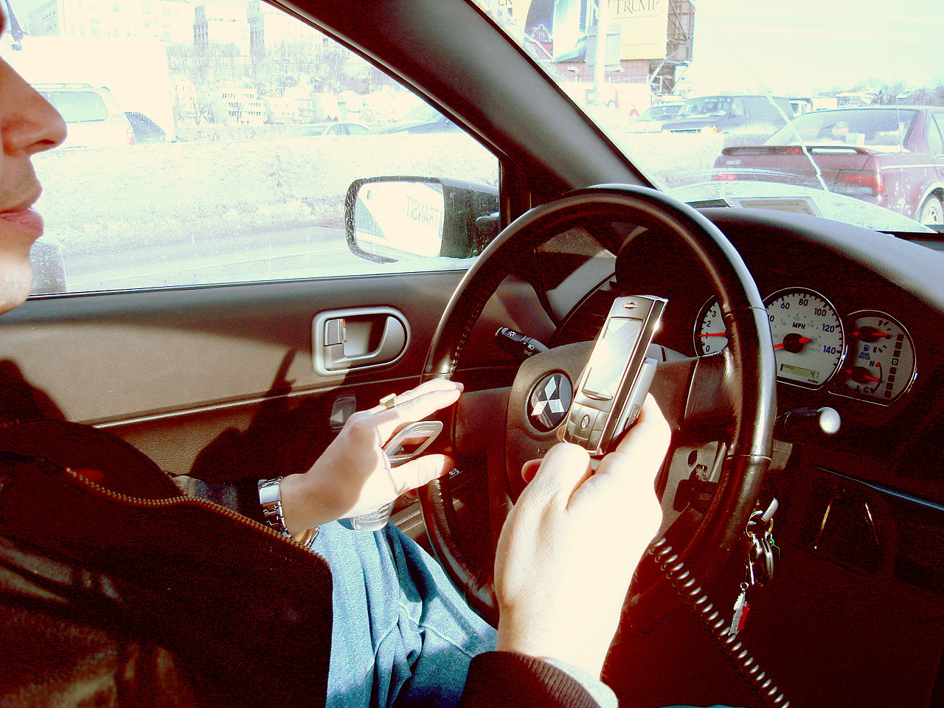
Lesson 6.5: Unintentional Injuries
Obj. 6.5: Analyze risk factors for unintentional injuries in order to provide safety recommendations.
Module 6: Rural Health
Notes:
Overview: Students will work in teams to create an intervention to reduce injuries in their communities, using an approach that focuses on one of the 3E’s of injury prevention: education, engineering, or enforcement/enactment. To prepare them for this challenge, they will be immersed in data on the leading causes of death and listen to a CDC podcast interview with a leading scientist who researches injuries.
Image source: http://en.wikipedia.org/wiki/Work-related_road_safety_in_the_United_States

Slide 2
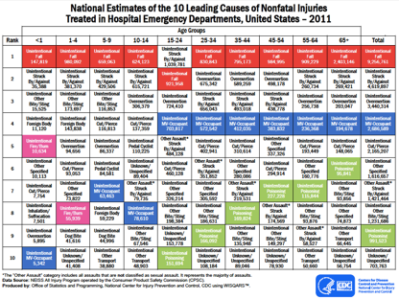
Do Now: Causes of Nonfatal Injuries
Notes:
Make copies of the PDF handout (included in lesson resources, “CDC Leading Causes of Death PDF”), so that students can examine the table easily and read the smaller print.
Ask students to explain how the table is organized. Ask them to notice why some types of injuries are color-coded. Ask them to identify examples of each of the types of injuries, especial those that may be confusing (ex: Struck by/Against, MV Occupant, etc.)

Slide 3
Do Now: Causes of Nonfatal Injuries
What is the overall leading cause of nonfatal injuries?
What is the leading cause of nonfatal injuries among 15-24 year olds?
For 15-65+ year olds, in what rank place does “Unintentional MV-Occupant” place?
Are bicycle injuries or motor vehicle injuries more common among 5-9 year olds?
What trend do you notice in unintentional poisoning injuries? What do you think is contributing to this trend?
The local fire department is starting a campaign to educate people on testing their smoke alarms. For which age groups would this intervention most likely reduce nonfatal injuries?
Notes:
ANSWERS:
1.Unintentional Fall
2. Unintentional Struck by/Against
3. 4th place
4. Bicycle!!! (pedal-cyclist is #6 vs. MV Occupant--motor vehicle occupant is #)
5. As people get older, unintentional poisonings become a higher and higher ranked cause of injury. Students may not be able to come up with the answer, but may try some guesses. Tell them that they will learn part of the answer later when they listen to a podcast (prescription drug overdose/misuse is on the rise, according to the CDC scientist)
6.Infants (<1) most because it is the 5th leading cause of injury; 1-4 year olds as well because it is the 8th leading cause of injury for that age group

Slide 4
Brainstorm
List as many specific examples of types of injuries as you can in the bubble.
Ex: “Unintentional Struck By/Against” might include sports, playground equipment, and bicycle injuries.
Notes:
Consider making it a contest, as many students may be motivated by competition. Challenge them to see how many examples they can think of in 3 minutes.
After students finish brainstorming, ask them to circle the top THREE that they think are MOST COMMON in their community? In all rural communities?

Slide 5
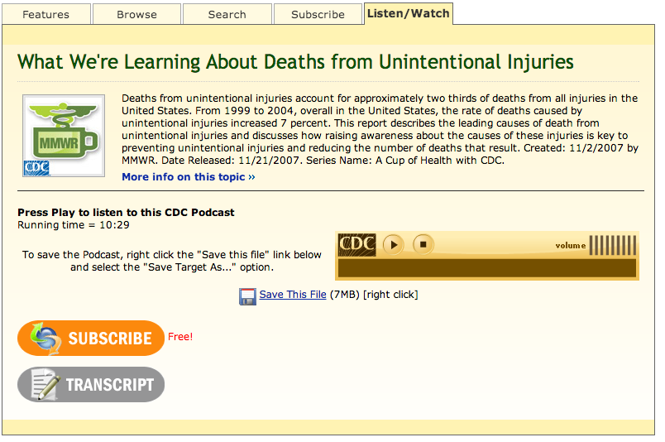
A Cup of Health with CDC Podcast
Podcast: http://www2c.cdc.gov/podcasts/player.asp?f=7299
Notes:
Consider playing the Podcast all the way through once while students just listen. Then have them read through the questions and play it again as they work on answering and follow along on the transcript. This will allow students to listen well the first time for pleasure, without the added pressure of writing.

Slide 6
A Cup of Health with CDC Podcast
Why do researchers use the term “unintentional injury” instead of “accident?”
Give three examples of things that qualify as “unintentional injuries” and one example of something that does not.
What is the #1 leading cause of death from unintentional injury?
What is one cause of unintentional injury that is on the rise among adults?
On the individual level, what are two things parents can do to prevent injuries for their children?
By how much have unintentional injury rates increased recently?
Notes:
ANSWERS:
1. The term is important because by labeling these injuries correctly, people will understand that they are often preventable rather than things that happen that we have no control over.
2. Qualifies: housefire, drowning, motor vehicle crashes, bicycle crashes, falls, slips, trips, poisonings; Does not qualify: violent acts
3. #1 -- Motor vehicle crashes
4. Poisonings among adult population (prescription drug abuse/misuse) have risen recently
5. Buckle up their kids and use proper car seats correctly; Keep pools fenced in; Keep medicines and cleaning supplies safe and inaccessible to small children
6. 7% (especially due to elderly falls and poisonings from prescription drug abuse)

Slide 7
Injury Prevention:
Violence and injuries together kill more people ages 1–44 in the U.S. than any other cause (NCIPC: WISQARS)
Violence and injuries cost more than $406 billion in medical care and lost productivity each year (Finkelstein EA et al 2006)
Unintentional injury: any injury that was unplanned and does not result from intent (as in violence); the most common unintentional injuries result from motor vehicle crashes, falls, fires/burns, drowning, poisonings, and aspirations
Injury prevention: an effort to prevent or reduce the severity of bodily injuries caused by external mechanisms before they occur
Notes:
Other important RURAL HEALTH statistics related to unintentional injury to share:
1. Although only one-third of all motor vehicle accidents occur in rural areas, two-thirds of the deaths attributed to these accidents occur on rural roads.**
2. Rural residents are nearly twice as likely to die from unintentional injuries other than motor vehicle accidents than are urban residents. Rural residents are also at a significantly higher risk of death by gunshot than urban residents.
SOURCE: http://geiselmed.dartmouth.edu/cfm/education/ruralhs4.php

Slide 8
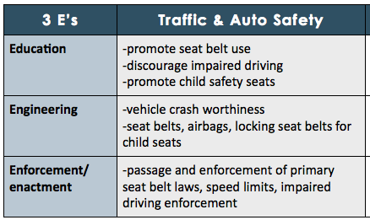
3 E’s of Injury Prevention:
Your Turn! …What 3E strategies can you come up with for Drowning?
Notes:
Examples for drowning: Education: swim classes, water safety classes, lifeguard classes; Engineering: fences around pools, lifejackets that are more appealing for kids/teens to wear or safer, warning/alert systems around pools, etc. Enforcement: fines for kids left unattended swimming under certain age, clearer signs around pools/waterfront

Slide 9
3E Interventions to Reduce Injuries
Challenge: Team up to improve health and safety by reducing unintentional injuries in your community!
1. Choose one type of injury to focus on.
2. Choose one of the 3 E’s.
3. Create an intervention that helps reduce injury.
4. Be ready to present your 3E intervention!
Notes:
Act as a moderator of student requests for specific types of injury (ideally, all students would choose a different type, or there would be enough variety to represent the spectrum of injury). Ensure the following class is feasible for student team presentations to take place, or offer a longer deadline and reserve a future class.

Slide 10
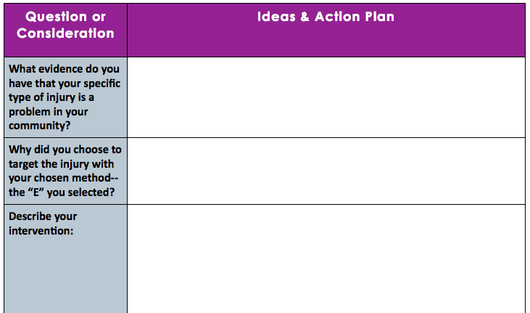
3E Intervention Planning:
Notes:
Encourage students to find evidence. If they cannot locate any evidence for their specific state, county or community, they can use national statistics.

Slide 11
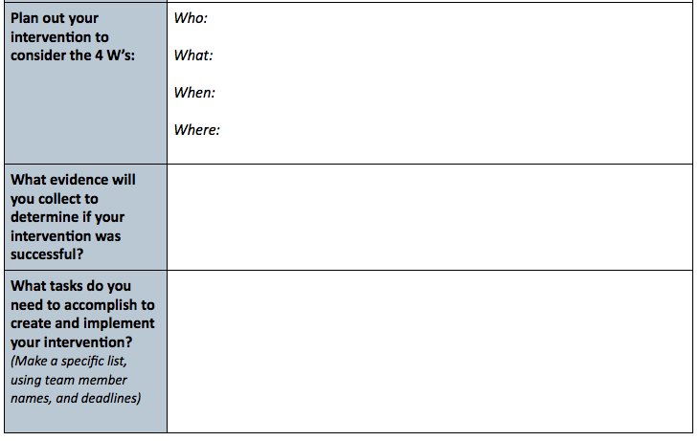
3E Intervention Planning:
Notes:
Require that students actually collect some type of data to determine how successful their intervention was. This can be simple and informal, but it is an important step. (Examples: Education—give a quick quiz, Engineering—talk to local experts/professionals to get their opinion of how it would work, Enforcement—give a poll about how a new law or policy would be received).

Slide 12
Assess:
List one RISK FACTOR & one PREVENTATIVE STRATEGY for each type of injury:
Childhood poisonings
Burns
Motor vehicle crashes
Notes:
Possible answers:
Childhood poisonings: RFs: lack of awareness of dangers; improper storage location; unsupervised children; Preventive: educate parents; provide free childproofing devices
Burns: RFs: missing smoke detectors; overcrowded conditions in homes; no fire escape plan; smoking in home; Preventive: free fire alarm outreach/testing, fire education in schools
Motor vehicle crashes: RFs: texting or using cell phone while driving, distracting driving, teen/inexperienced drivers, drinking and driving; Preventive: Enforce laws to make penalties harsher;

Slide 13
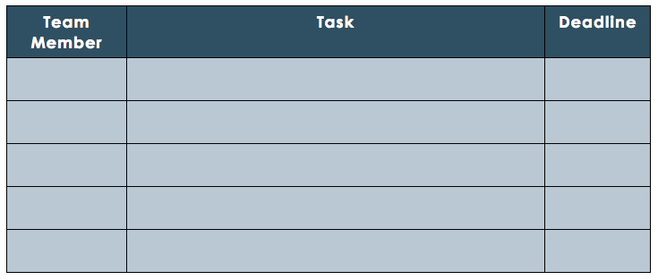
Homework: Create Your 3E Intervention
Plan your tasks to accomplish to create your injury prevention intervention:
Notes:
This homework assignment may require a bit more time, so an extended deadline for final completion and presentation of interventions may be helpful for students.

