Slide 1
Lesson 6.4: Chronic Disease
Obj. 6.4: Identify risk factors and preventive strategies for reducing chronic disease.
Module 6: Rural Health
Notes:
Overview: This lesson will give students an opportunity to work cooperatively in a team to create an informational health presentation for a target audience through a health fair booth. Students will learn about chronic disease disparities in rural populations and identify the risk factors and preventive behaviors to reduce their prevalence and impact.
Image source: http://en.wikipedia.org/wiki/Obesity

Slide 2
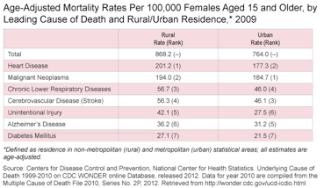
Do Now:
1. Which of the causes of death listed are preventable?
2. Which cause of death had the greatest disparity (difference) between rural and urban populations?
3. What are the leading causes of death for urban and rural females, respectively?
Notes:
Answers:
1. All are potentially preventable; yet some have preventable and non-preventable (or less preventable forms.) For example, cancer (malignant neoplasms) are preventable to some degree (ex: avoiding sunburns, not smoking, eating high-fiber diet, preventing sexually transmitted disease HPV, etc. are all behaviors to decrease your risk of cancer, but there is still a large component that is genetic).
2. Heart disease (Urban: 177.3, Rural: 201.2. The difference is 23.9 deaths per 100,000 females)
3. Urban: Cancer; Rural: Heart Disease

Slide 3
Discuss: Personal Connection
Do you know anyone who has dealt with any of the health issues shown in the data table above?
Notes:
This may be a sensitive topic for students who themselves are living with a chronic disease or those who have a close family member or friend who is living with one, was recently diagnosed, or deceased from a chronic disease. Create a safe space for students to share or not share (to their degree of comfort) and where all stories, ideas, and experiences will be respected.

Slide 4
Chronic Disease Terms:
A chronic condition develops and worsens over a long period of time. (Ex: heart disease, osteoporosis)
A illness that appears and worsens over a short period of time (Ex: heart attack, broken bone)
A medical condition or disease that is non-infectious & non-transmissible among people. (another common term for chronic disease)
A disease that is infectious & transmissible among people.
Notes:
Ask students for examples of more chronic and acute diseases, and communicable and noncommunicable diseases

Slide 5
Chronic Disease Rates:
7 out of 10 deaths among Americans each year are from chronic diseases.
In 2005, 133 million Americans – almost 1out of every 2 adults – had at least one chronic illness
Notes:
The enormity of this problem should not be lost on students. To really driving it home, remind them that 7 out of 10 of you (or possible more, given the direction obesity and other conditions are going in our country) will die of these causes.

Slide 6
Chronic Disease Causes:
Four modifiable health risk behaviors— are responsible for much of the illness, suffering, and early death related to chronic diseases. They are:
Lack of physical activity
Poor nutrition
Tobacco Use
Excessive Alcohol Consumption
Notes:
Ask students which of these causes are prevalent in rural communities? Ask students what influences these preventable cause behaviors?

Slide 7
Chronic Disease Assignments:
Your team will be assigned to one of the following chronic diseases or conditions:
(1) heart disease
(2) diabetes
(3) cancer
(4) hypertension
(5) obesity
(6) chronic obstructive pulmonary disease
(7) stroke
(8) arthritis.
Notes:
Students can work in small groups of any size (2-5 recommended). Determine the group sizes an how they will be assigned, if at all, prior to the class. Allow student groups to draft their choice of disease, if desired. Make sure each disease is not repeated. If more diseases are needed to account for all the groups, some additional options are: osteoporosis, asthma, and specific types of cancer—ex: lung, skin, cervical—that have some preventable component.

Slide 8
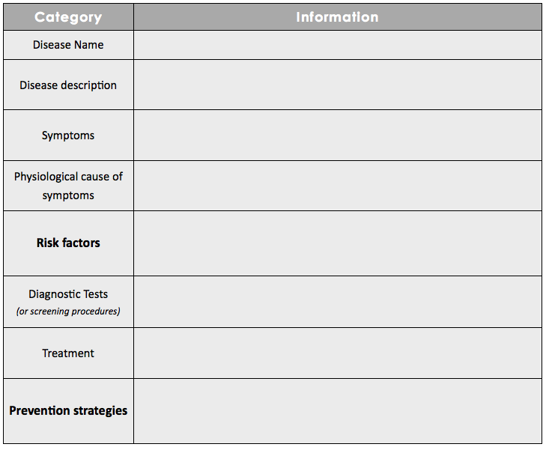
Chronic Disease Research:
Notes:
Mayo Clinic Disease Definition handouts are available in the lesson resources and can be printed and provided to students. Alternatively, students can look these up themselves or use any credible online resources, if technology permits.

Slide 9
Health Fair Booth Challenge:
Challenge: Present a health fair booth to the community, delivering information on your chronic disease or condition.
Goal: Reduce the prevalence of your chronic disease or condition through education.
How? Your booth should be engaging and build awareness with clear and accurate information.
Notes:
Ask students if they have ever attended a health fair. For any students who have, ask what they saw and learned. Ask students what would make a successful health fair or specific booth; what would make one ineffective?

Slide 10
Health Fair Booth Challenge!
Title
Target Population
Knowledge
Method of Presentation
Attraction of Audience
Interactive Element
Evidence of Success
Roles
Notes:
Plan for students to present their booths in the classroom during the next class period (or longer if needed). This can be done by actually setting up the booths around the room and having students take turns rotating around and “manning” their booth, or groups could present one by one to the entire class. An even more authentic and impactful way to carry this out would be conducting an actual school health fair, bringing in other younger students/classes, or members of the community.

Slide 11
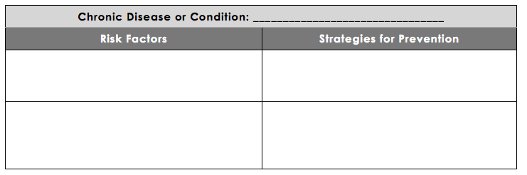
Assess:
List 2 risk factors and 2 strategies for prevention of your chronic disease or condition:
Notes:
Optional idea: Another assessment can be conducted during or after the health fair exchange. Students can be responsible for learning at least two risk factors and two preventive strategies for each chronic disease presented by other groups.

Slide 12
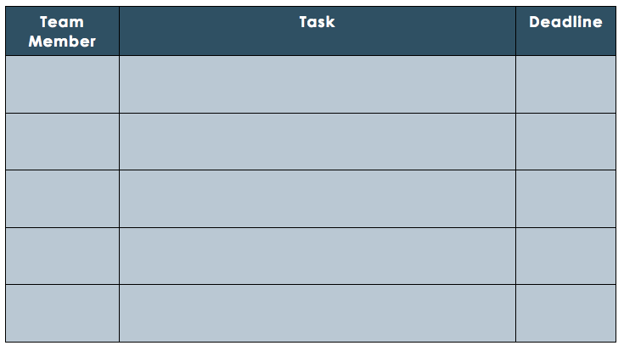
Homework: Create Your Booth!
Plan your tasks to complete to create your booth:
Notes:
This homework assignment will help students organize their division of labor and create a to-do list in order to be prepared. Be sure to set clear and realistic deadlines. Another class may be needed for planning, depending on class length and the amount that was accomplished in the first class setting.

